Slide 1
Water Use Efficiency for Drought Resiliency:
Challenges & Solutions
Presented by:
Juan Garcia
Senior Water Efficiency Specialist
Irvine Ranch Water District
Presented on behalf of the following water providers: City of San Clemente, El Toro Water District, Irvine Ranch Water District,
Laguna Beach County Water District, Moulton Niguel Water District, Santa Margarita Water District, South Coast Water District, and Trabuco Canyon Water District
Notes:
Thank you Mark!
Good morning everyone, thank you again so much for joining us today – my name is Justin Finch, I’m the Senior Water Efficiency Specialist at Moulton Niguel Water District and today I’ll be presenting on water use efficiency programs and services that are commonly available to HOAs and the professionals supporting our communities across south Orange County.

Slide 2
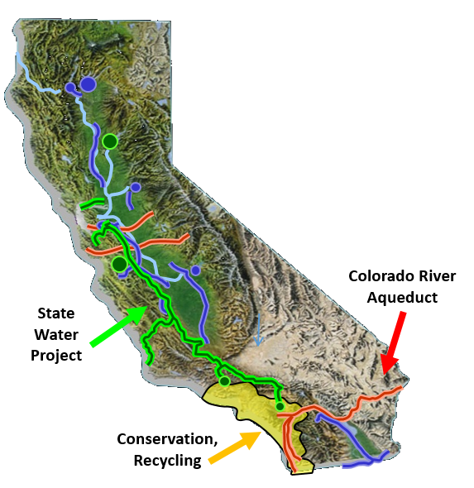
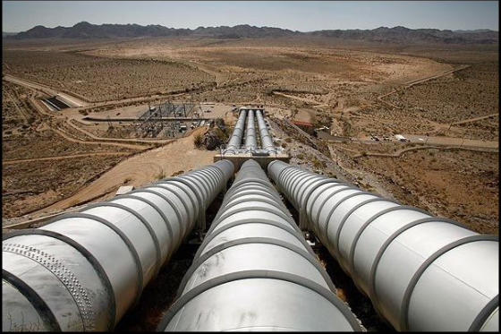
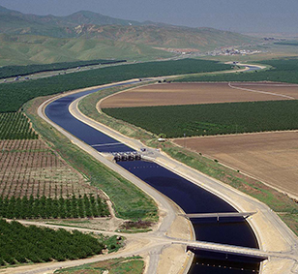
Water Supplies for South Orange County
Imported Water
Local Water
Recycled Water
Local Reliability Projects
Notes:
Water supply portfolios vary substantially across the state and even across a region like Orange County
The hydrogeology of south Orange County is very different from north Orange County, which benefits from a massive groundwater basin that provides most of the water for the community.
In South Orange County, we have limited access to these sources of supply.
South Orange County water suppliers import virtually 100% of our potable water supply from Metropolitan Water District. Those imported supplies are very reliable, but we pay a premium price to import the water, because it travels a looong way to get here. It takes a lot of energy to transport water from the Colorado River and from Northern California.
Due to the high cost of imported water, and of course to increase our supply reliability, we’re always looking to develop new supplies, local projects, and storage when it’s cost-effective
One source of new supply that south Orange County (and many others) have done a great job of providing is Recycled Water. Many agencies in this area have been producing recycled water as early as the 1960s and in fact several cities around here been master planned to distribute recycled water throughout their service area
Recycled water is great way to offset the need to purchase more imported water, and many in this room are probably plenty familiar with recycled water
Planed Desal from South Coast: reliability projects

Slide 3
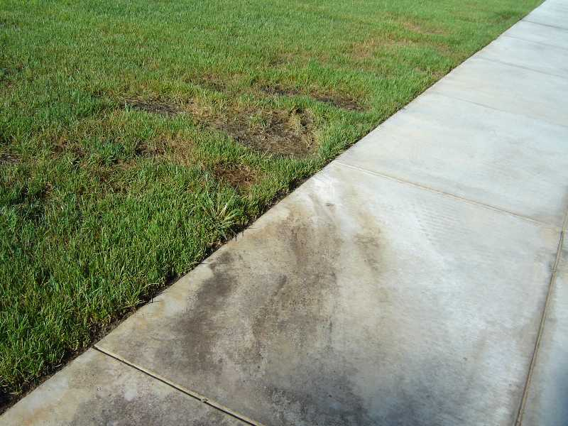
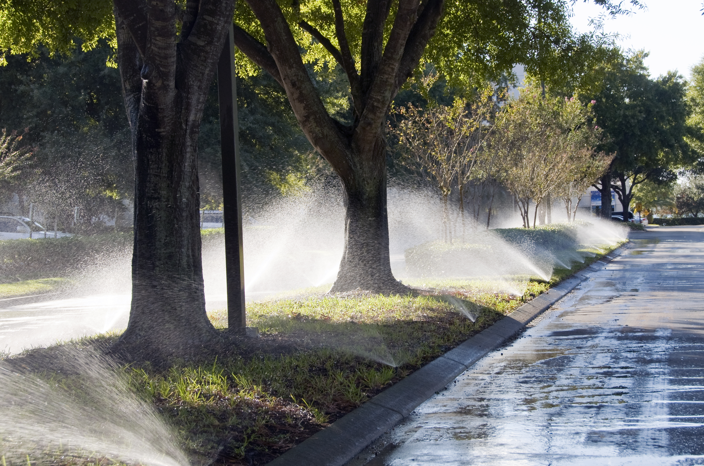
Benefits of Water Efficiency
Save water, energy, and money
Saves Us Money, Saves YOU Money
Keep water rates low
Reduce runoff & avoid property damage
Improve quality of local creeks and beaches
Delay investment in infrastructure and storage
Notes:
One of the greatest benefits of water efficiency is that it helps customers save money – Imported water is expensive! And, the cheapest unit of water is the one you don’t have to buy, which is why water efficiency is such an important tool to maintaining a cost-effective water supply
Keeping demands at an efficient level also helps water agencies delay, or often avoid, investment in infrastructure or storage projects, which can cost several million dollars and which may require rate increases to pay off.
Another benefit of using water more efficiently, and this particularly focuses on outdoor water use for irrigation, is a reduction in urban runoff and avoiding property damage. Sprinklers that point the wrong way or overspray can cause damage to stucco and food fences… and irrigation that runs onto the sidewalk and asphalt can deteriorate those surfaces and increase how often property owners will need to re-slurry the asphalt. A lot of property damage and repair work can be avoided by better irrigation management.
A secondary benefit of saving water is for the environment. When we can reduce and eliminate runoff, this improves water quality in local creeks and beaches. As you all heard from Devin’s presentation a few minutes ago, finding ways to curb urban runoff and mitigate the effects of pollution on our local creeks and beaches is a major priority of our cities.
Consider Pic for property damage

Slide 4
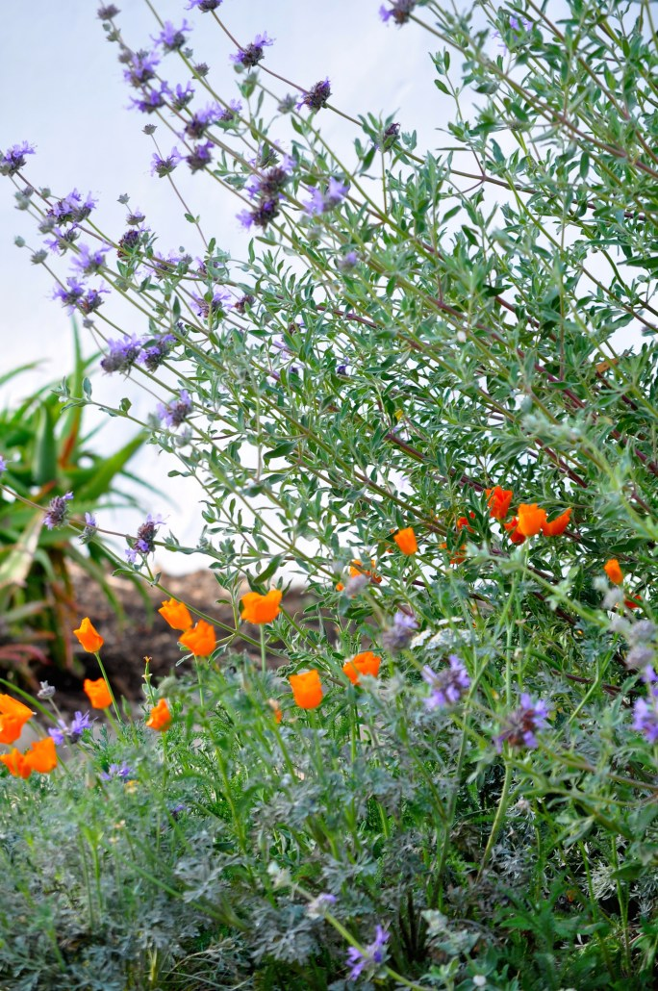
Water Use Efficiency Challenges and Solutions
Where Should We Start?
Managing Expectations through Education
Finances

Slide 5
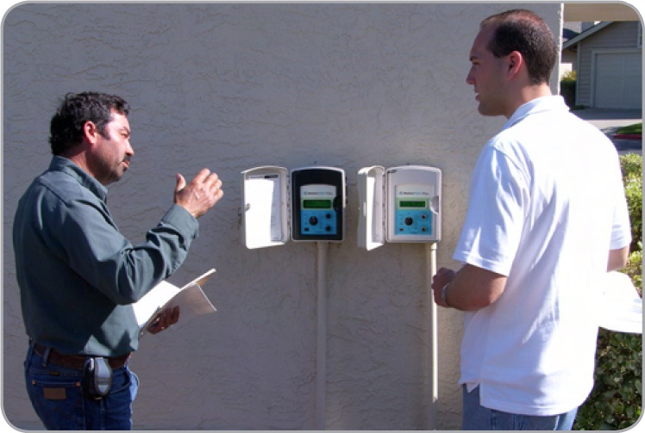
1. Where Should We Start?
Our landscapes are big! Projects can be overwhelming!
Who do I hire?
What plants should I replace my grass with?
Which smart sprinkler timer should I buy?
Surveys & Rebates We can meet with your HOA and landscaper!
Identify improvement opportunities
Create a priority action plan
Discuss your return on investments.
Notes:
We offer free landscape irrigation surveys for our customers, with the goal of educating and offering solutions to common problems.
Individual homeowners should contact their water provider for a survey at their own home.
For HOA common areas… We do offer free landscape irrigation surveys, some of us will do the survey in-house with our staff, others may utilize a regional program through our water wholesaler, Metropolitan Water District. Either way, contact your water provider and we’ll direct you on which service level we provide.
In general, a representative from the water provider or their consultant will come to your site, perform the evaluation, determine which water efficiency measures are best suited for you, and provide you with a report with return on investment information – and again, all of that is free.
Account managers must apply, in most cases, this is the property manager, so it's good to know the role of each person.
If your site is less than 1 acre, simply contact your water supplier, they may offer this service in-house.
Large Site Surveys. Keep general (not just MET’s prog), what it is, benefits, what to expect. ‘contact your water provider for more info’

Slide 6
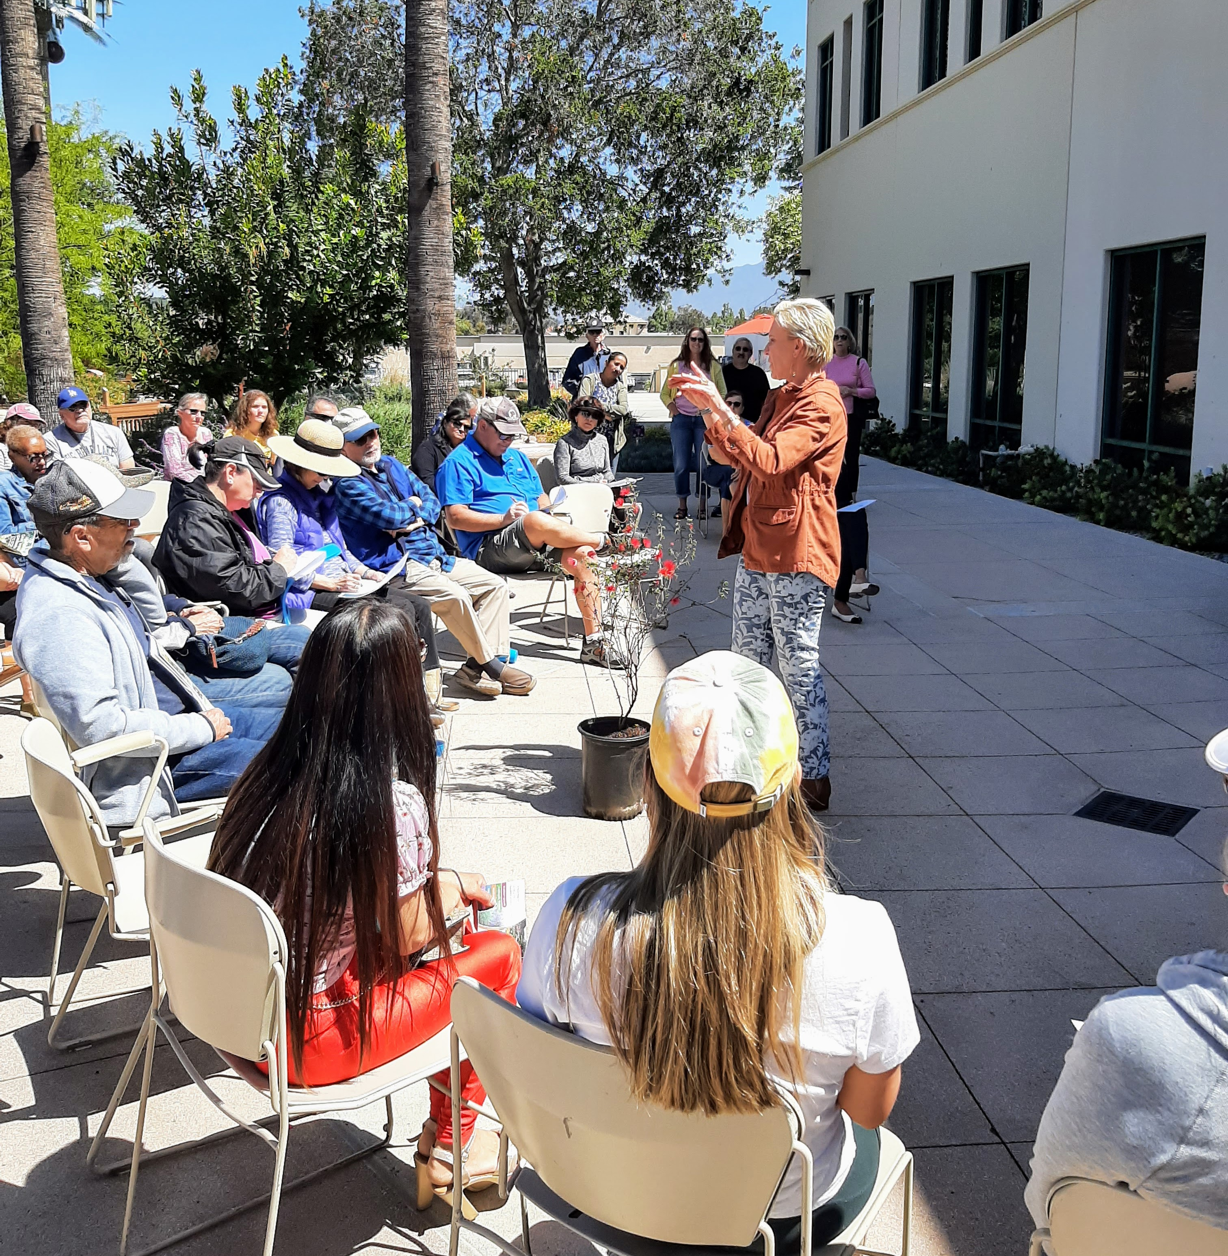
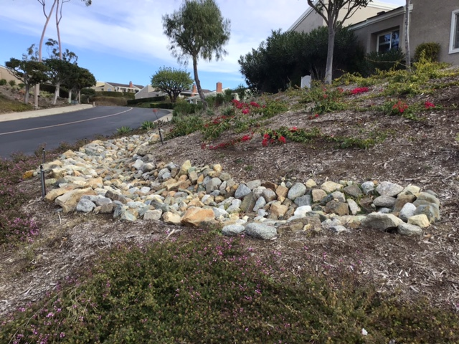
2. Managing Expectations Through Education
Residents want a green and well-kept and attractive landscapes
Changes Take Time
New landscapes take time to mature. Water savings and lower bills may come later.
Maximize Buy-In with Education
Work with residents about changes in appearance.
Speakers bureau -water supplier guest speaker at HOA meetings; invite residents to a landscape and irrigation workshop.
Notes:
**WATER SUPPLIER RESOURCES: landscape workshops, speakers bureau (Use for Slide)
Photos: Workshops
You can have both! Kind of.
If turf removal with a landscape upgrade is the project in mind, your residents need to know:
Landscapes take time to mature! Little baby plants will eventually fill in the brown mulched areas. Resist the urge to over-plant. Too many plants will only cost you more, and will eventually result in plant loss when the plants all compete for water and sun, and crowd each other out and look way too busy/messy. Also, it takes time for shrubs and trees to establish their extensive root systems and become established. Typically 1 year, but up to 2 years for some plants.
If landscape renovations aren’t needed, maybe it’s just a better irrigation controller. We’ve got some irrigation stores outside that can help you figure out which smart irrigation controllers, that automatically adjust the watering schedule based on local weather, would work best for your property… keeping your landscape green and your water bills in check.
Finally… change is scary! I’m a creature of habit myself, according to my very smart and observant wife. So, how do you maximize buy-in from your neighbors that are like me? Keep us informed! Newsletters, signage, email blasts, etc. Consider a pilot area, or simply do the projects in phases.

Slide 7
3. Finances
How should we fund our improvements? Operating, Reserves, Assessment?
When should we move forward?
Phasing over multiple Budget Years
Upgrades not Replacement Consider using reserves for most projects as these long-term investments are upgrades, not annual maintenance.
When? ASAP Water, labor, materials are the cheapest today it’s going to be. Lower maintenance costs moving forward. Repurpose savings for future projects like urban wildland interface rehabilitation.
Notes:
**PHASING
Simply put, most of any major renovations and upgrades should be charged to your reserves, and only part of the cost to your annual operating accounts. It’s very reasonable to use ‘some’ operating budget towards any major renovations since your operating costs should be lower the rest of the year since you will be doing less overall plant replacement and sprinkler repairs.
When? It’s been said “The best time to plant a tree was 20 years ago. The second best time is now.” Water, labor, and materials are the cheapest today that they’re ever going to be. Use our funding assistance programs so we can help you lower the upfront costs of projects, and you’ll be able to repurpose lower maintenance costs towards future projects, like wildland interface rehabilitation or renovating actively used turf areas.
1st phase as a demo/pilot, then conder more

Slide 8
4. Rules and Regulations
What can/can’t our HOA do?
What could/should our HOA do?
During a Drought Emergency
Cannot issue fines on homeowners for reducing or eliminating irrigation (Civil Code 4735(c)).
Regardless of Drought
Cannot enforce architectural guidelines that prohibit low water-using plants or artificial turf as a replacement of existing lawns (Civil Code 4735(a)).
Can enforce policies that require general maintenance and upkeep.
Be a Resource
Hire a Landscape Architect to develop landscaping guidelines and pre-approved plant palettes. Keep your look and feel, and sense of community!
Notes:
I’m not a lawyer ok, this is not legal advice…. But here’s my input as the water conservation guy, and items you may want to chat with your own legal counsel if you’re concerned.
During a drought emergency, the HOAs cannot issue fines for brown lawns. I know no one wants to see it. But, consider the short term inconvenience vs long term water savings – brown lawn is short term and cheap, but replacing the unused lawn areas is a long term investment into lower water bills and plants that can thrive in our climate and look great.
With that said, you can still enforce policies that require general maintenance and upkeep. There’s a difference between browning out lawn because of a drought, and neglecting the landscape entirely.
Regardless of drought, HOAs can’t have rules that prohibit low-water use plants.
So, what should we do? Focus on what you want, not what you don’t want.
You can create landscape guidelines can be created outside of CC&R… not same legal requirements or level of scrutiny. Those guidelines could set up the expectations for your architectural review committee and residents to help streamline the architectural review process.
Ex: NatureScape lessons learned ccr/rules/arch committee… lack proper guidance to residents (ex: boulder size, setback, flower color)… risk lawsuit but worst of all bad will among your neighbors. We all want beautiful, maintained LS, but have to be realistic. Be a resource, not a hurdle – for improving OUR NEIGHBORHOOD and home values

Slide 9
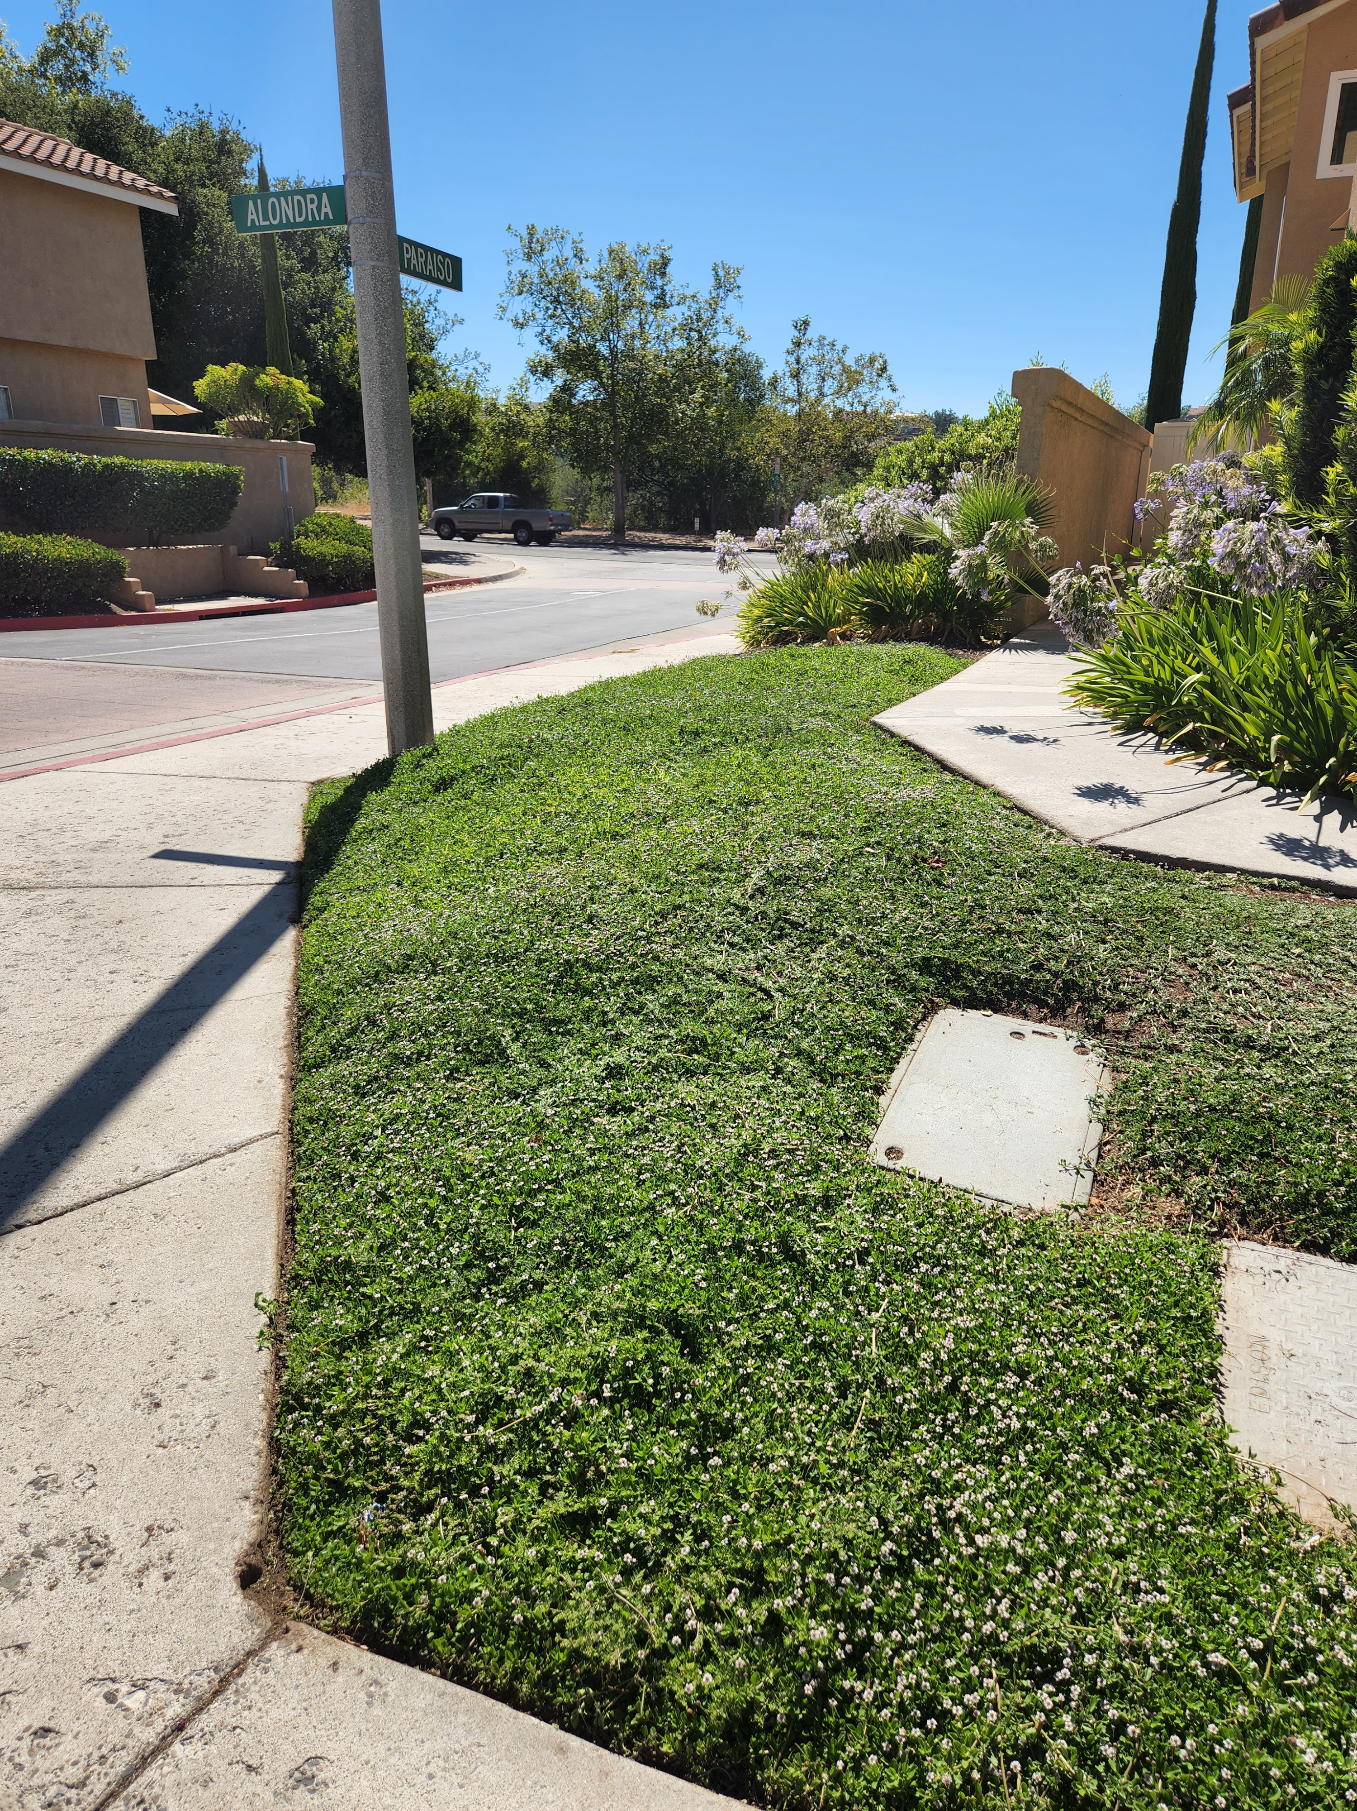
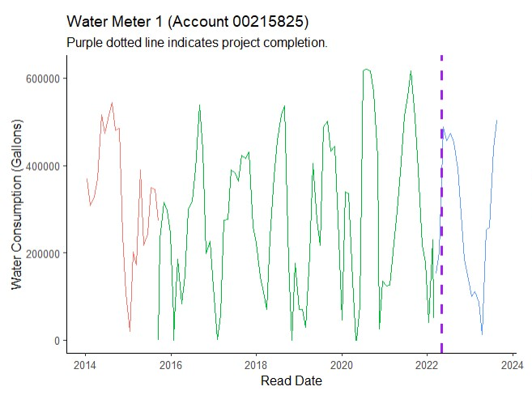
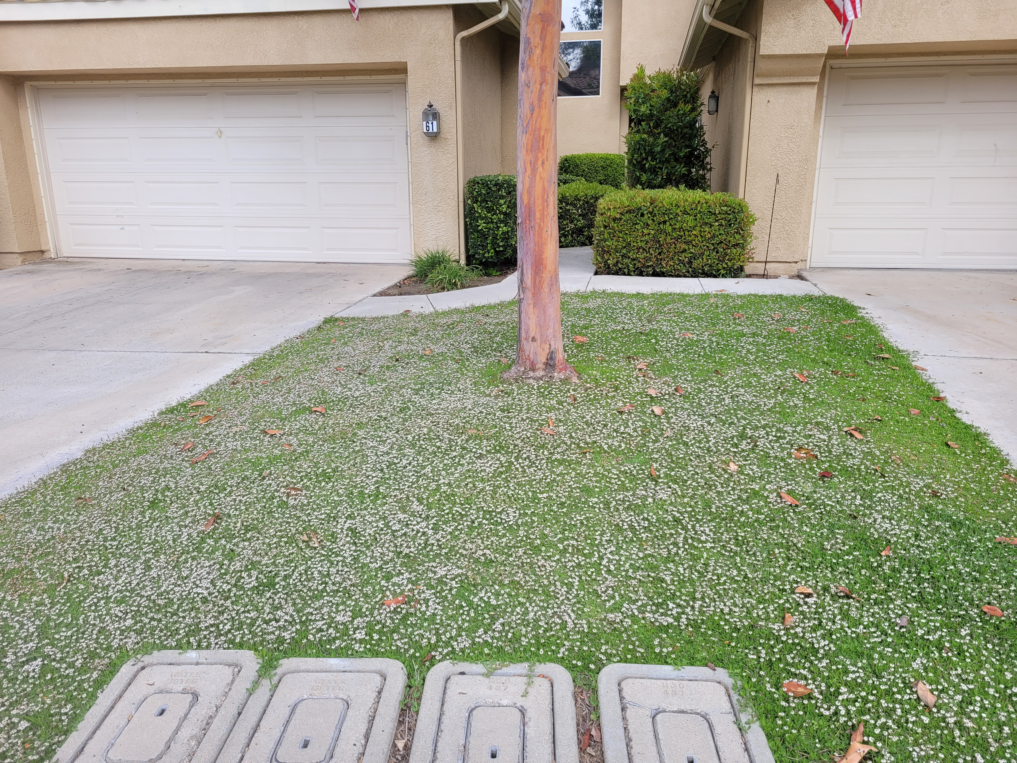
Turf Removal: Rancho Santa Margarita HOA
Neighborhood Common Areas and Driveway Strips
Transform 1-Acre of Turf Grass
Upgrade to HE Nozzles
Reduce Summer Peak Watering
Project Challenges
➠ High Visibility
➠ Cost vs. Rebate
Notes:
This is an example of the a conversion from turf grass to Kurapia in a HOA in Rancho Santa Margarita. Kurapia is a broadleaf ground cover that self heals and can be used in a variety of locations. It prefers full sun and can tolerate mowing and light foot traffic. Small white flowers resemble clover and can be mowed if desired. Max height is 4" tall. These turf swap projects require diligent weeding and monitoring during establishment for success. Subsurface drip is another way to irrigate to further increase water savings. Water savings shown above is total gallons used per month during the first 2-year establishment period. The expectation would be that it would continue to improve as the years continue.

Slide 10
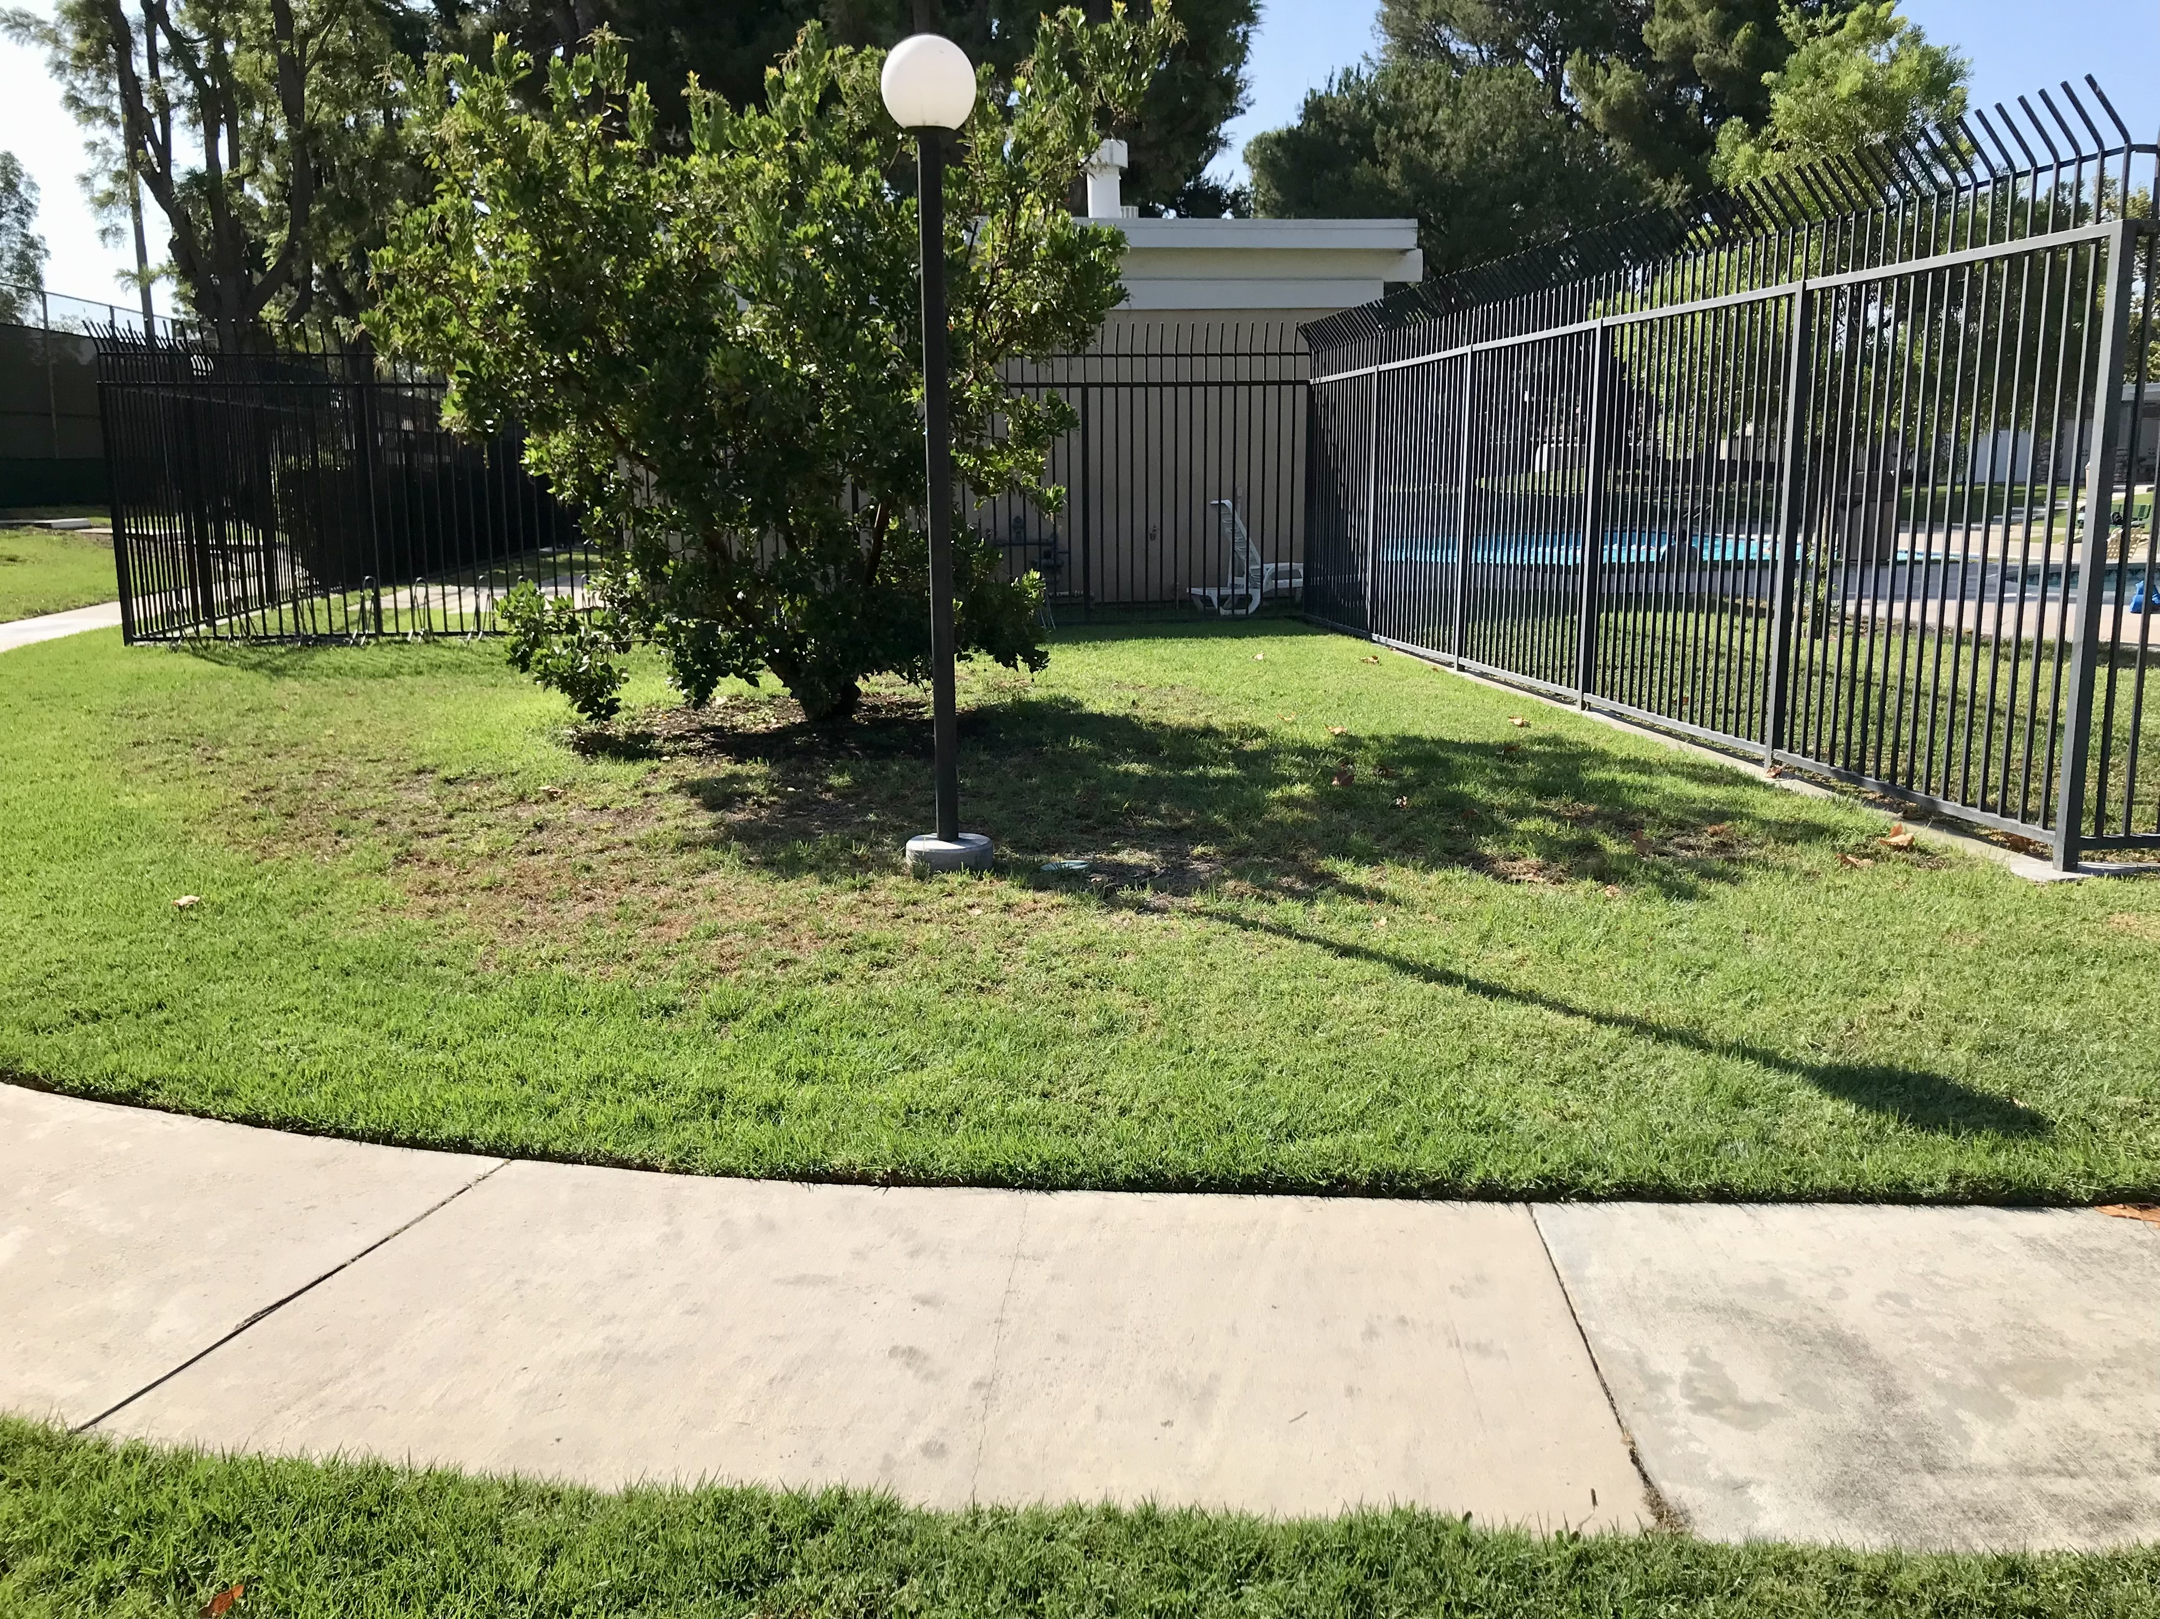
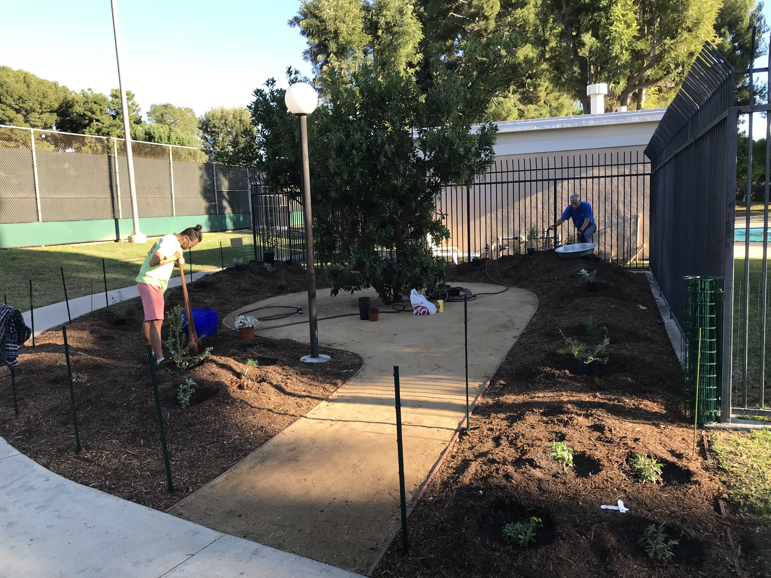
Turf Removal: Colony Club HOA in Irvine
Community buy-in
Pilot area - Transform to CA native garden
Berm used for sustainability feature
December 2022
Notes:
This is an example of the a conversion from turf grass to CA Native Garden.
Berm for Sustainability feature

Slide 11
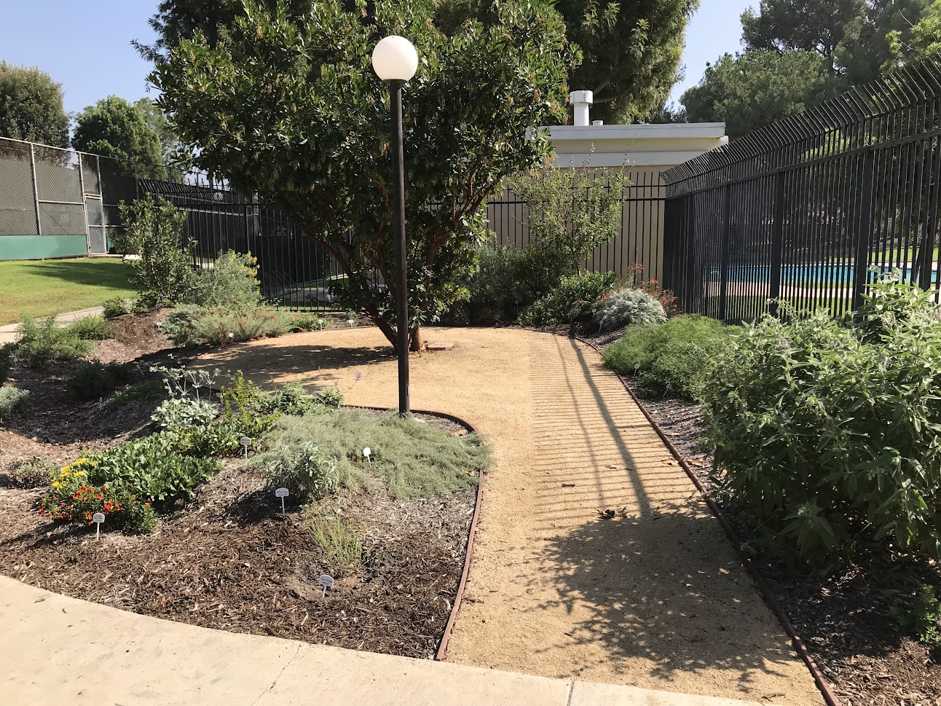
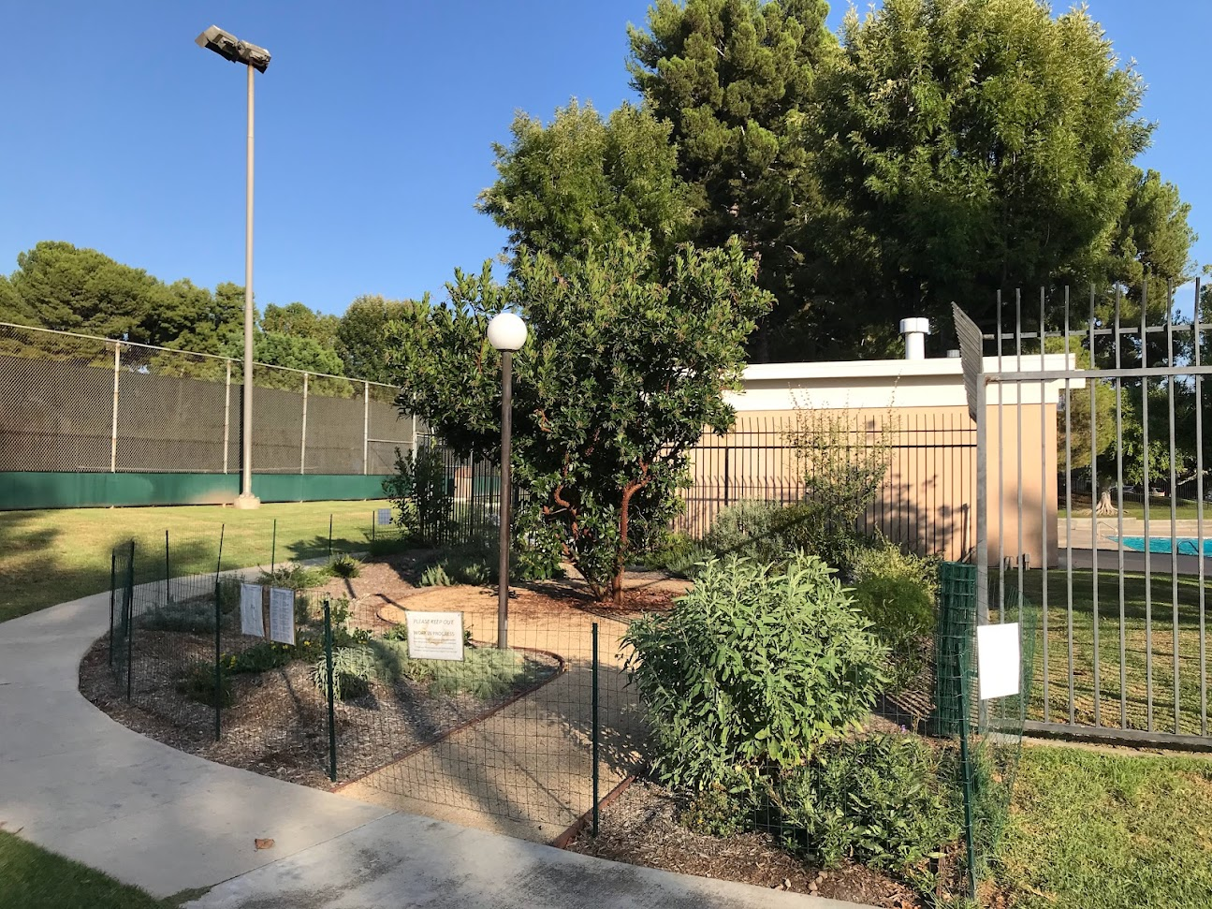
Turf Removal: Colony Club HOA in Irvine
Plant establishment
May take a year
Temporary fencing
Notes:
Juan – The Colony HOA, some native plants turf removal project;;; before & after
Fence taken down in September

Slide 12
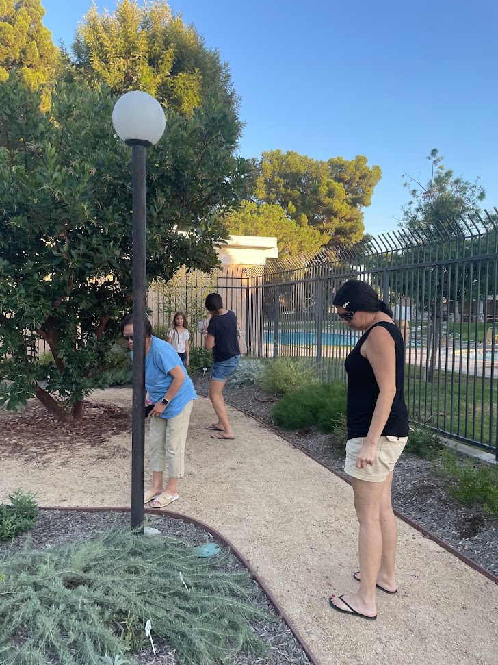
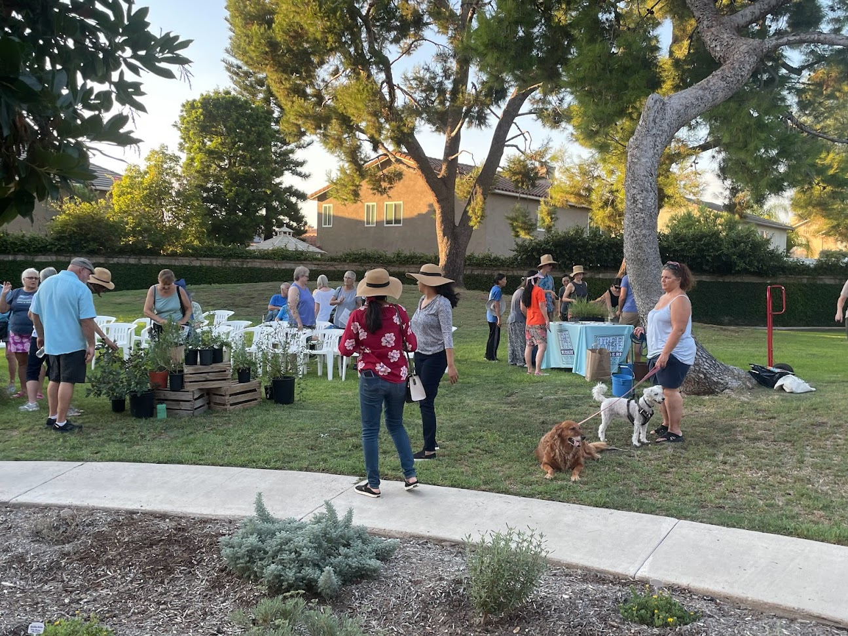
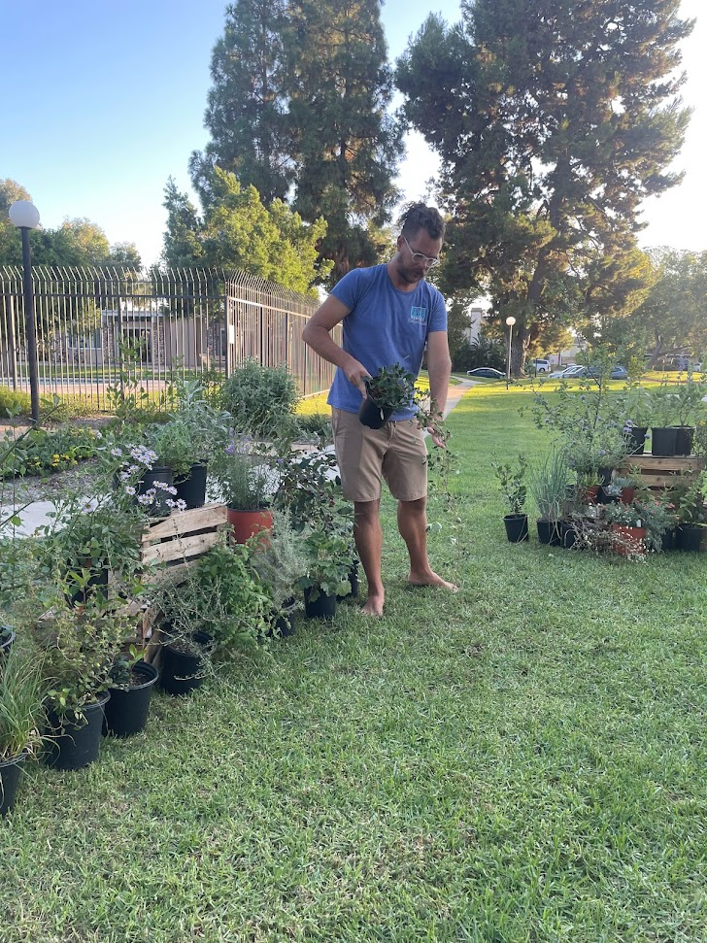
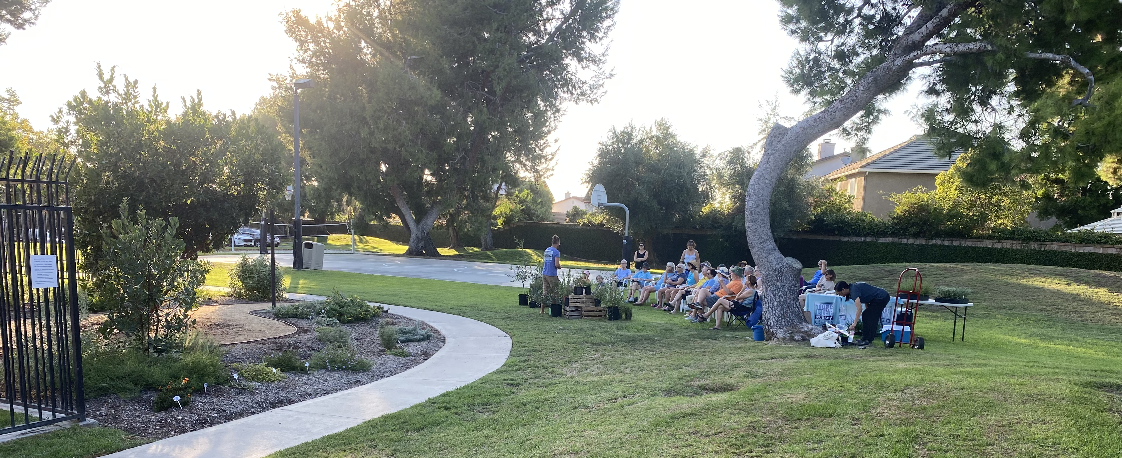
Turf Removal: Colony Club HOA in Irvine
Community engagement
More workshops to come!
Notes:
Juan – The Colony HOA, some native plants turf removal project;;; before & after
Plant labels have been added this month!

Slide 13
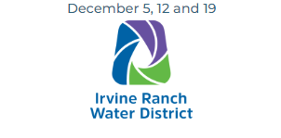
Professional Landscaper Training
Topics cover:
Landscape Water
Irrigation Maintenance & Trouble Shooting
Irrigation System Auditing
Irrigation Scheduling
Irrigation Controllers
Landscape Water Management
Landscape Water Budgeting
➠ Become a CLCA Certified Water Manager (CWM)
➠ Become a Qualified Water Efficient Landscaper (QWEL)
➠ Increase Your Individual and Company Marketability
➠ SIGN UP NOW TO ATTEND!
CLCA.org/WELDCP

Slide 14
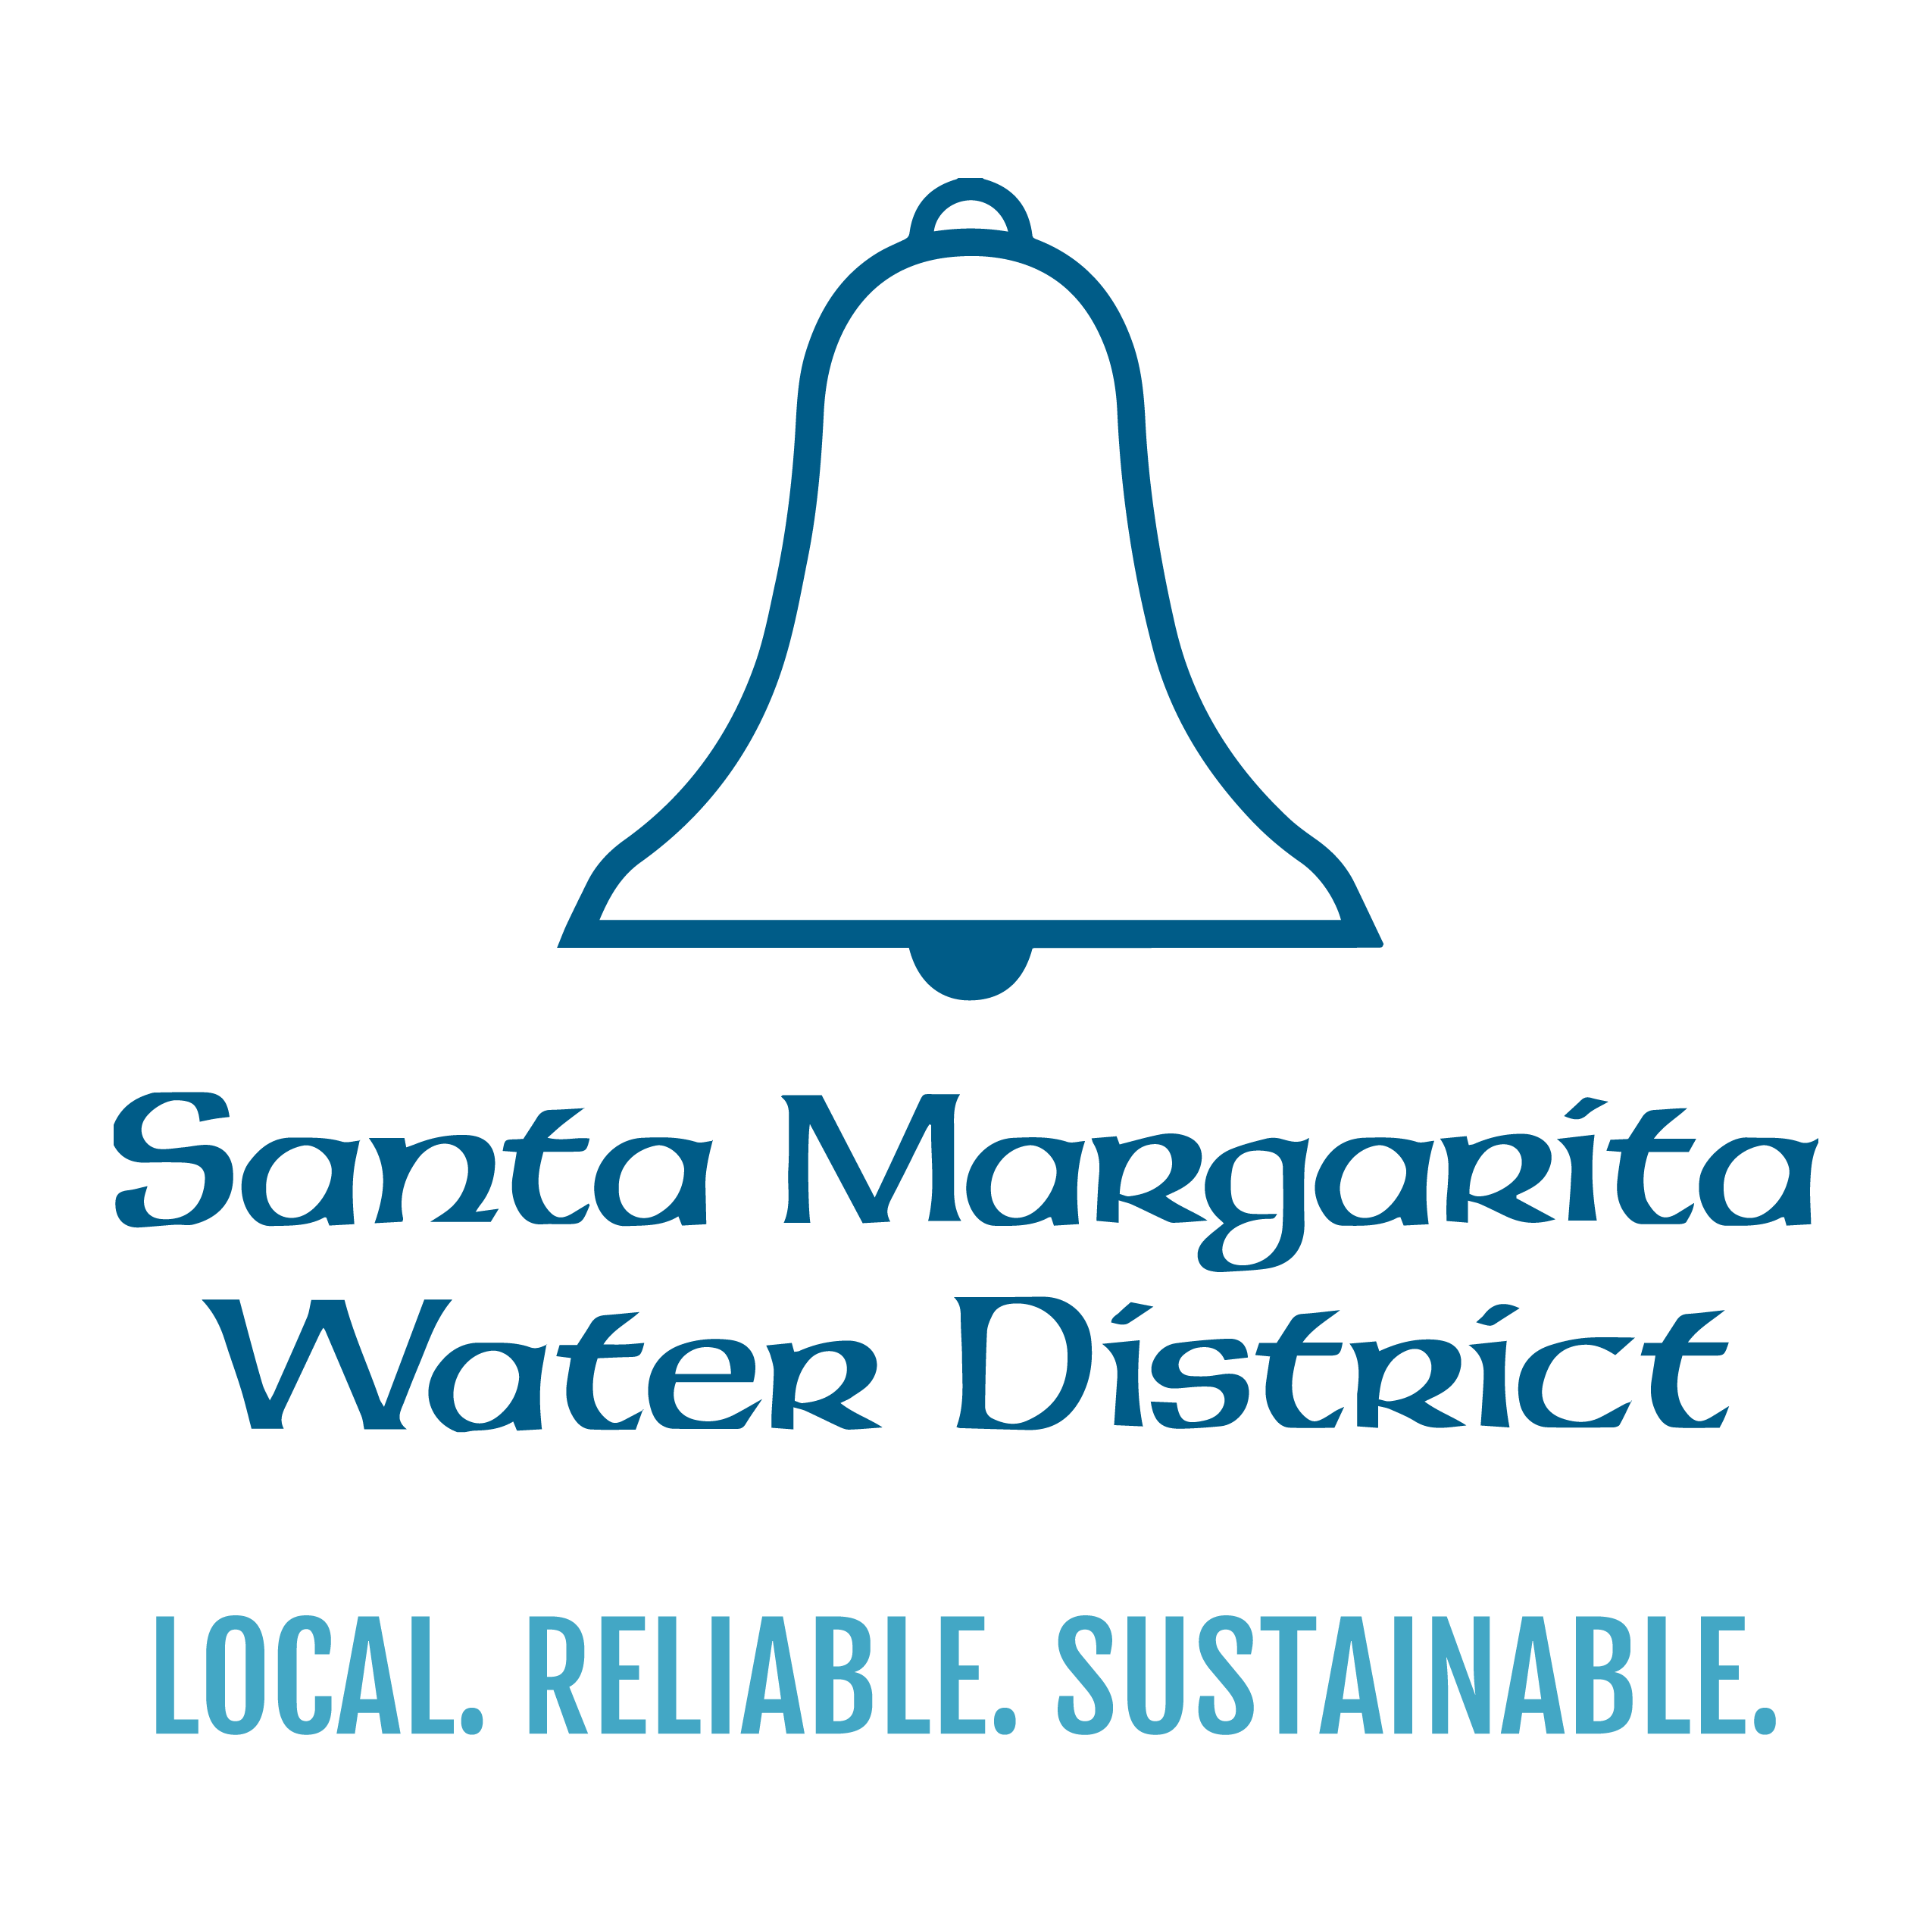
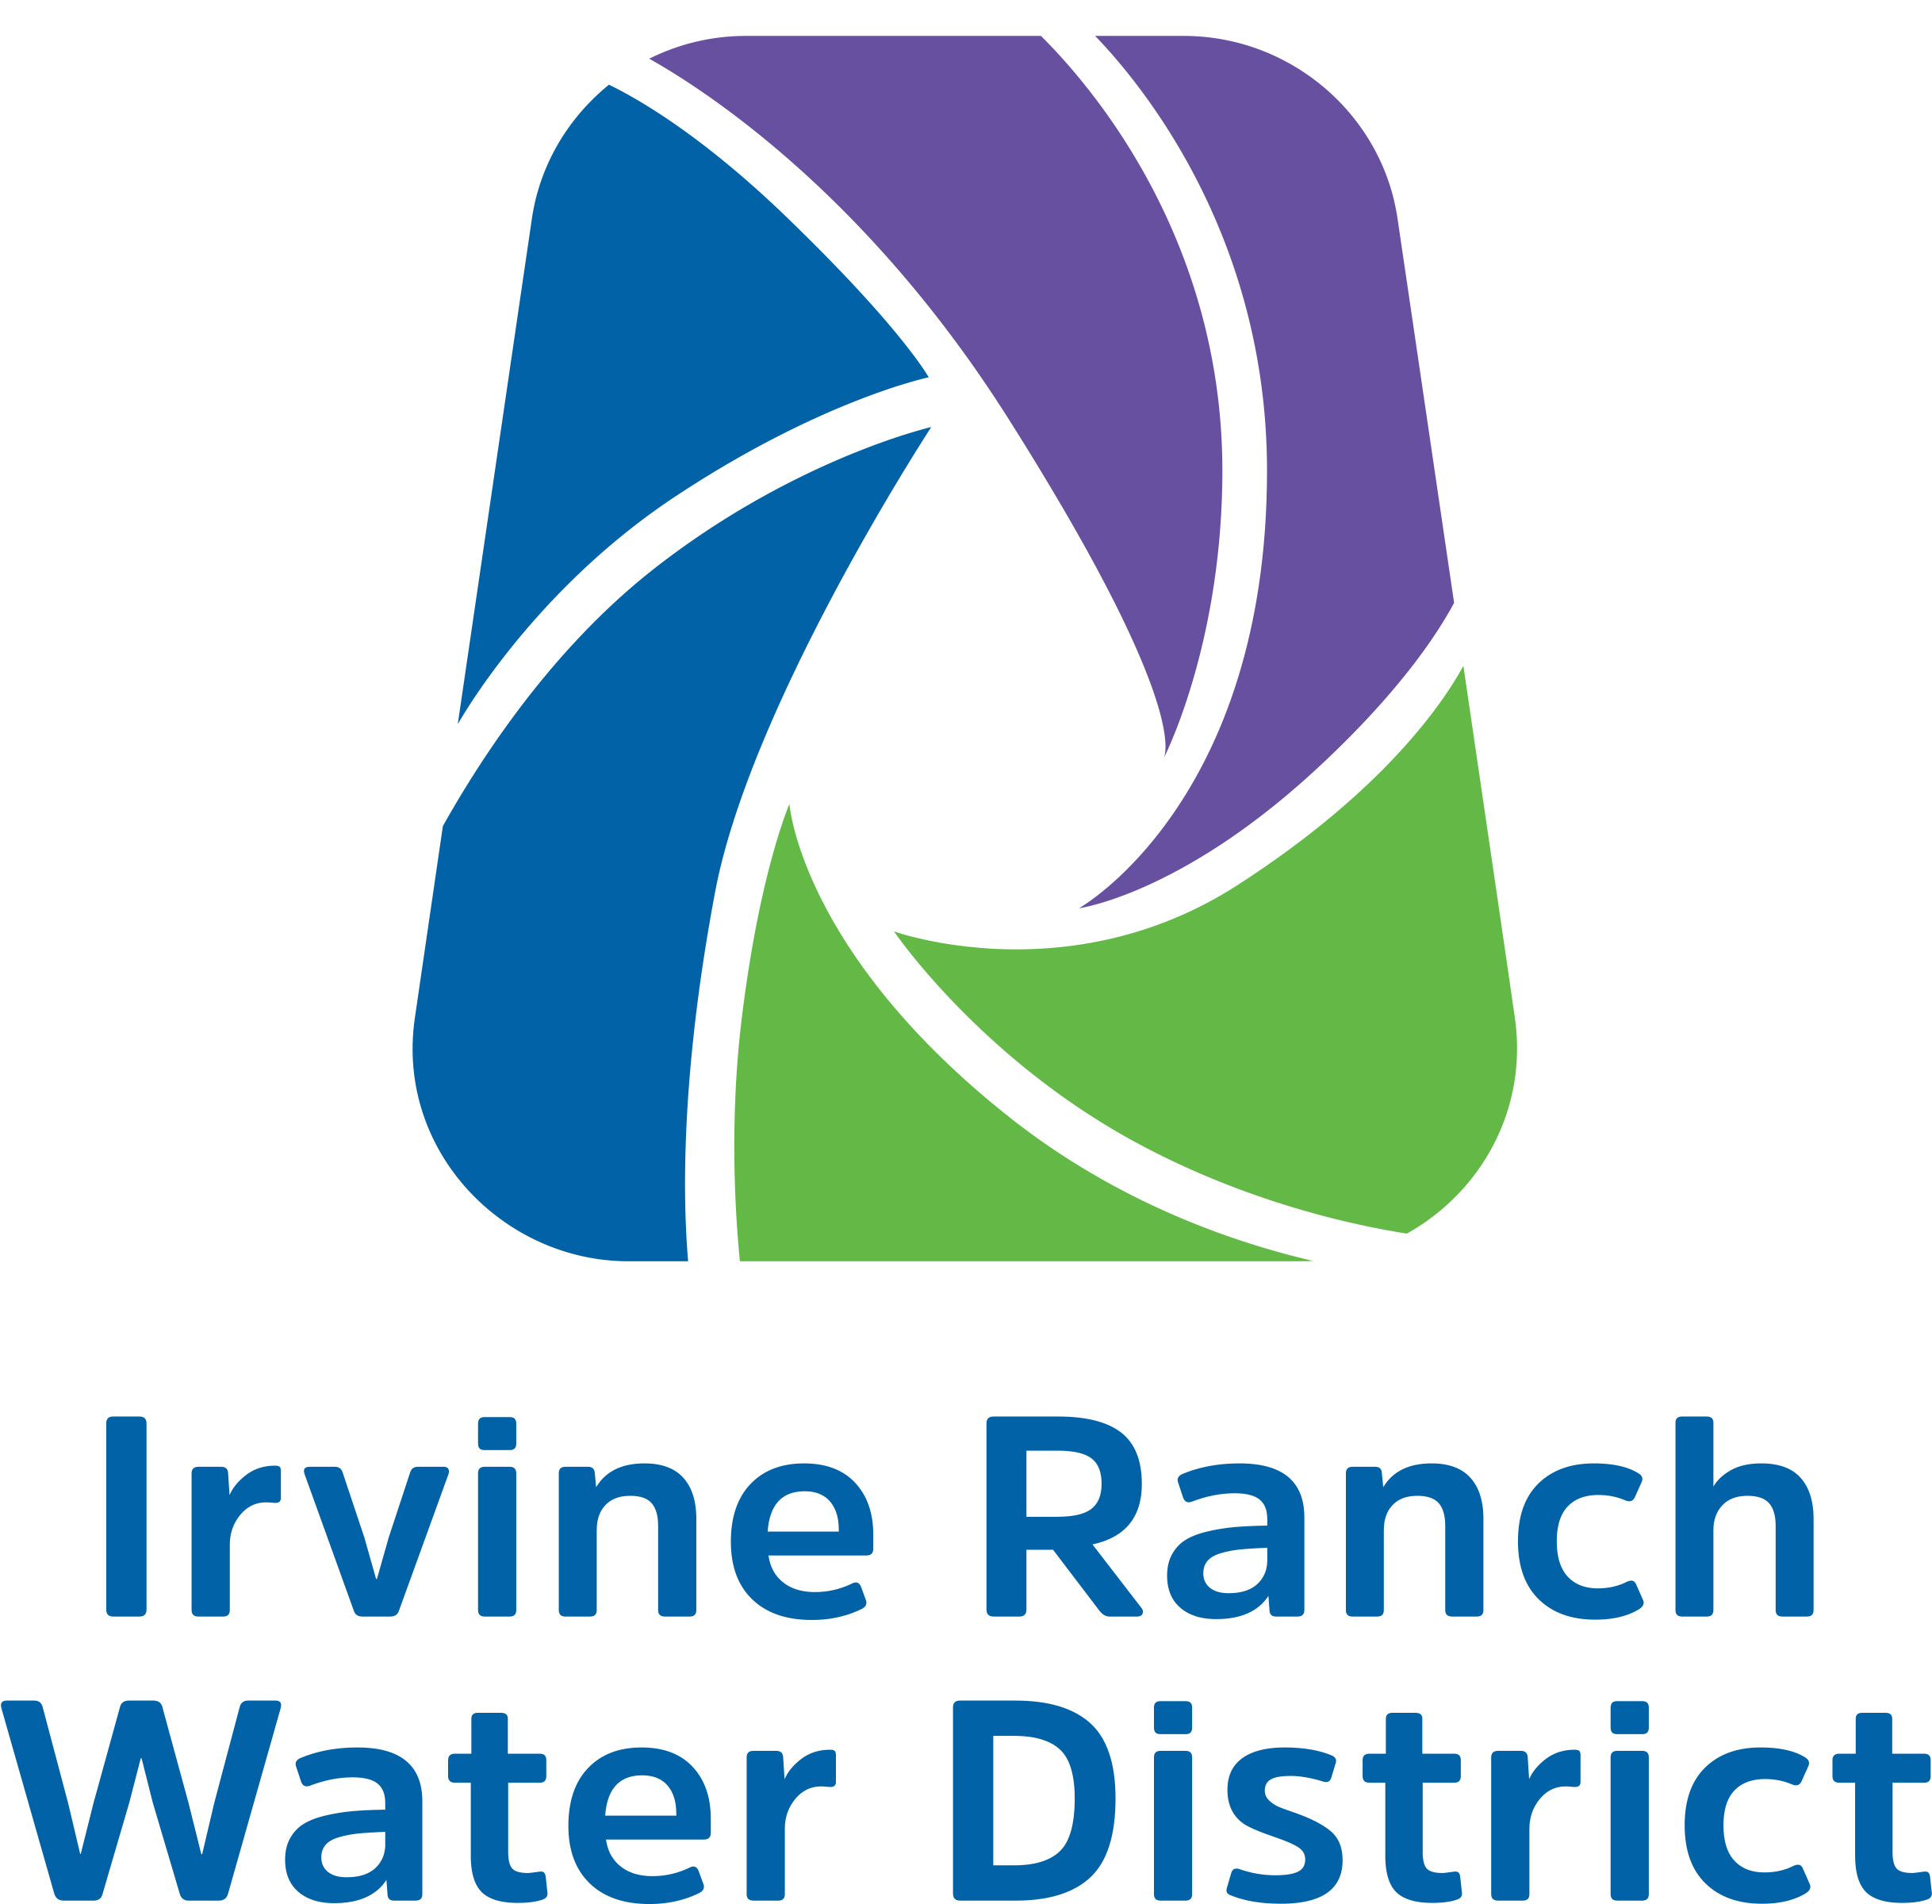
Thank you!
City of San Clemente BeachN@san-clemente.org (949) 361-8354 | El Toro Water District District@ETWD.com (949) 837-0660
Laguna Beach County Water District jgallardo@lbcwd.org (949) 494-1041 | Moulton Niguel Water District conservation@mnwd.com (949) 448-4025
South Coast Water District custserv@scwd.org (949) 499-4555 | Trabuco Canyon Water District generalinformation@tcwd.ca.gov (949) 858-0277
Santa Margarita Water District efficiency@smwd.com (949) 459-6593 | Irvin Ranch Water District waterefficiency@irwd.com (949) 453-5300
Notes:
Quick thank you and also contact information from our water supplier partners:

