Slide 2
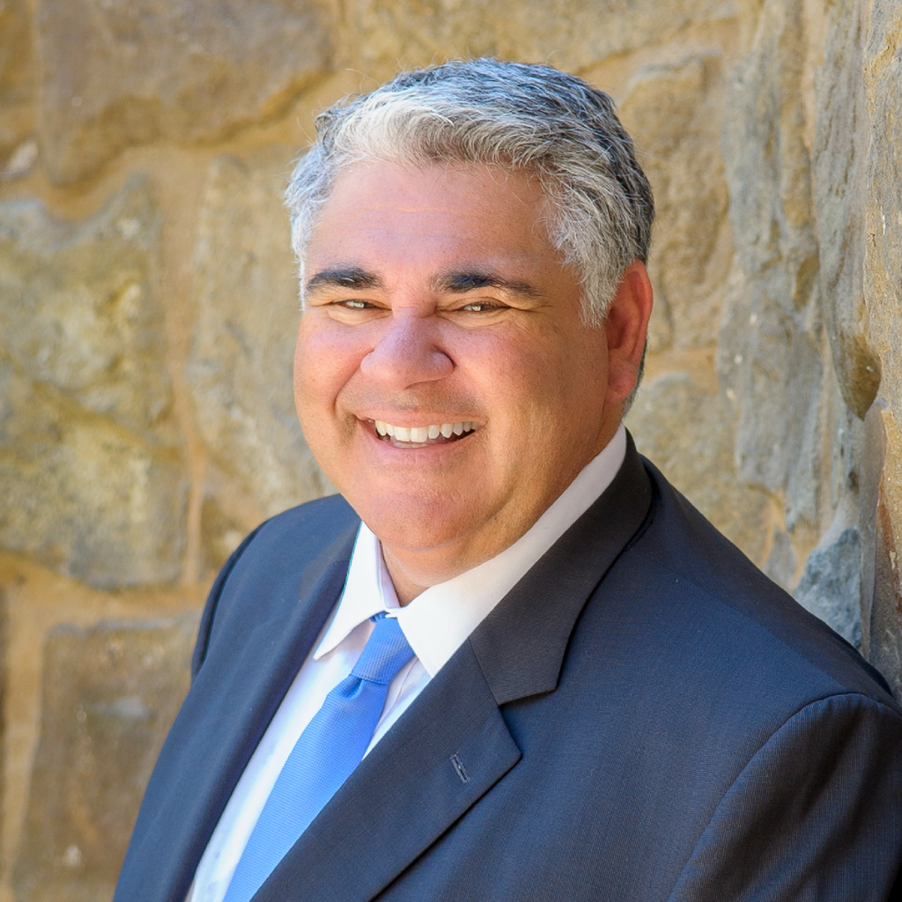
Robert M. DeNichilo, Esq., CCAL
Robert M. DeNichilo is the Managing Partner at Nordberg|DeNichilo, LLP, and represents community associations across the state of California.
Robert is an active member of the Community Associations Institute (CAI) and has been awarded Author of the Year on multiple occasions for his articles on community association issues.
He has served as the CAI Orange County Regional Chapter’s delegate and liaison to CAI’s Legislative Action Committee (CLAC) for over a decade, and regularly meets with state and federal legislators to discuss issues related to community associations.
Robert served on Orange County CAI Chapter’s Board of Directors and was the 2022 Chapter President. Additionally, Robert is a Fellow of CAI’s College of Community Association Lawyers (CCAL). CCAL Fellows are recognized for committing themselves to high standards of professional and ethical conduct.
Robert also regularly speaks at educational and training events for industry organizations, property management companies, and board members.
Email: Robert@NDHOALaw.com
Office: 949.654.1510
Direct: 949.994.8201
Scan for my contact info

Slide 3
Disclaimer
The information in this presentation has been prepared for general informational purposes only and should not be construed as legal advice on any subject matter or to answer specific legal problems or questions you may have.
While we try to ensure the accuracy of the information, we cannot guarantee that all the information is accurate. You should be aware that the law is constantly changing and varies by circumstance. Therefore, information on a given law or legal issue may not be current or apply to your particular situation. You should not act or refrain from acting upon this information without seeking the advice of an attorney.
Viewing and/or using any of this information does not create an attorney-client relationship.

Slide 4
AB 572 Limitation on Assessment Increases on Affordable Housing Units
Prohibits an association that records its original declaration on or after January 1, 2025, from imposing an increase of a regular assessment on the owner of a deed-restricted affordable housing unit that is more than 5% greater than the preceding regular assessment for the association’s preceding fiscal year or more than the percentage change in the cost of living, whichever is larger, not to exceed 10%, as specified.
Notes:
“percentage change in the cost of living” means the percentage change from April 1 of the prior year to April 1 of the current year in the regional Consumer Price Index for the region where the residential real property is located, as published by the United States Bureau of Labor Statistics. If a regional index is not available, the California Consumer Price Index for All Urban Consumers for all items, as determined by the Department of Industrial Relations, shall apply.

Slide 5
AB 572 Limitation on Assessment Increases on Affordable Housing Units
This subdivision does not apply to any of the following:
(A) A development where the percentage of the units, exclusive of a manager’s unit or units, that are deed-restricted affordable housing units exceeds the percentage required by an applicable zoning ordinance in effect at the time the development received final approval.
(B) A development that is located within a city, county, or city and county that does not have an applicable zoning ordinance requiring a percentage of deed-restricted affordable housing units and meet either of the following conditions:
(i) The percentage of the units, exclusive of a manager’s unit or units, that are deed-restricted affordable housing exceeds 10 percent of the total number of units in the development at the time the development received final approval.
(ii) If the development met the requirements described in subparagraph (B) of paragraph (1) of subdivision (b) of Section 65912.122 of the Government Code and was approved pursuant to Section 65912.124 of the Government Code, the percentage of the units, exclusive of a manager’s unit or units, that are deed-restricted affordable housing exceeds 15 percent of the total number of units in the development at the time the development received final approval.
(C) A development of 20 units or fewer.
Notes:
“percentage change in the cost of living” means the percentage change from April 1 of the prior year to April 1 of the current year in the regional Consumer Price Index for the region where the residential real property is located, as published by the United States Bureau of Labor Statistics. If a regional index is not available, the California Consumer Price Index for All Urban Consumers for all items, as determined by the Department of Industrial Relations, shall apply.

Slide 6
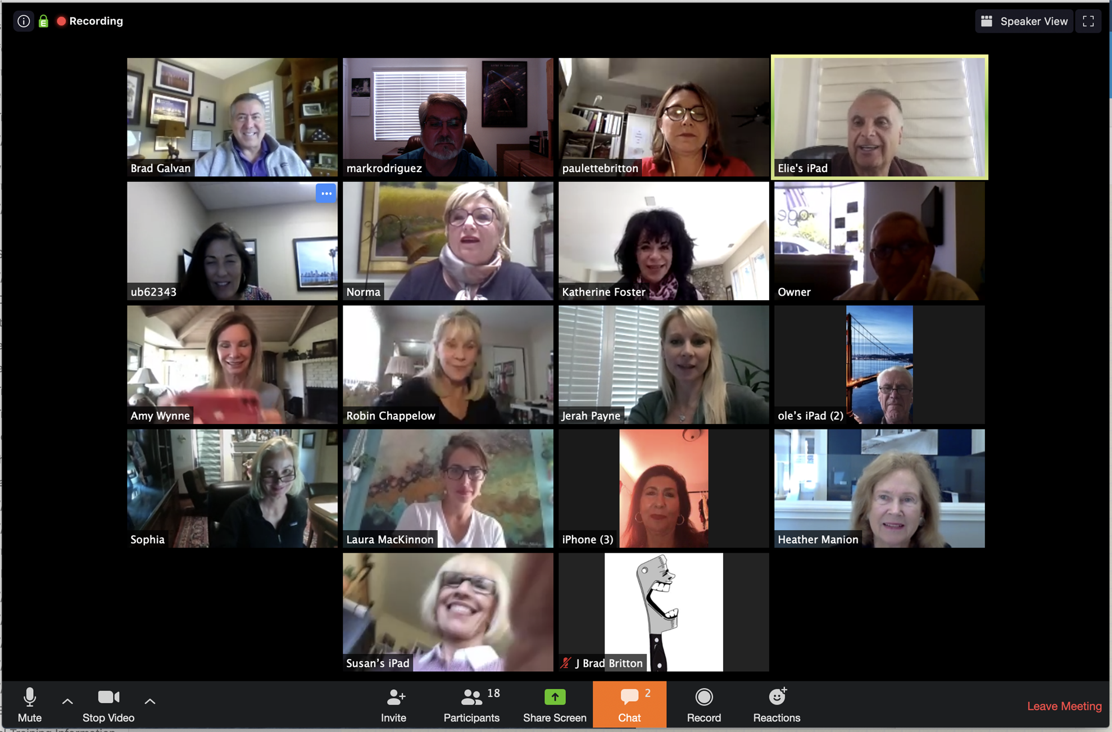
AB 648 Virtual Meetings
Allows for board and member meetings to be conducted entirely virtually without needing to designate a physical location.
Exception: Meetings at which ballots are counted and tabulated still must have a physical location designated (hybrid allowed)
Notes:
Need to add requirments

Slide 7
AB 1458 – Lower Quorum Requirement
Lowers the quorum requirement for adjourned member meetings to elect Board of Directors to no more than 20%
If the Association’s Governing Documents allow for a lower quorum requirement (e.g. 15% or 10%) then a lower quorum applies

Slide 8
AB 1458 – Lower Quorum Requirement
Notice Requirements:
No less than 30 days prior to ballots being distributed in elections for Board of Directors or recall elections:
(1) The date and time by which, and the physical address where, ballots are to be returned by mail or handed to the inspector or inspectors of elections.
(2) The date, time, and location of the meeting at which a quorum will be determined, if the association’s governing documents require a quorum, and at which ballots will be counted.
(3) The list of all candidates’ names that will appear on the ballot.
(4) Individual notice of the above paragraphs shall be delivered pursuant to Section 4040 if individual notice is requested by a member.
(5) If the association’s governing documents require a quorum for election of directors, a statement that the board of directors may call a subsequent meeting at least 20 days after a scheduled election if the required quorum is not reached, at which time the quorum of the membership to elect directors will be 20 percent of the association’s members voting in person, by proxy, or by secret ballot.

Slide 9
AB 1458 – Lower Quorum Requirement
No less than 15 days prior to an election authorized pursuant to paragraph (2), the association shall provide general notice of the membership meeting, which shall include:`
(A) The date, time, and location of the meeting.
(B) The list of all candidates.
(C) A statement that 20 percent of the association present or voting by proxy or secret ballot will satisfy the quorum requirements for the election of directors and that the ballots will be counted if a quorum is reached, if the association’s governing documents require a quorum.

Slide 10
AB 1572 – Potable Water
Prohibit the use of potable water for the irrigation of nonfunctional turf located on homeowners’ associations beginning January 1, 2029
Just codifies current regulations restricting the watering of nonfunctional turf

Slide 11
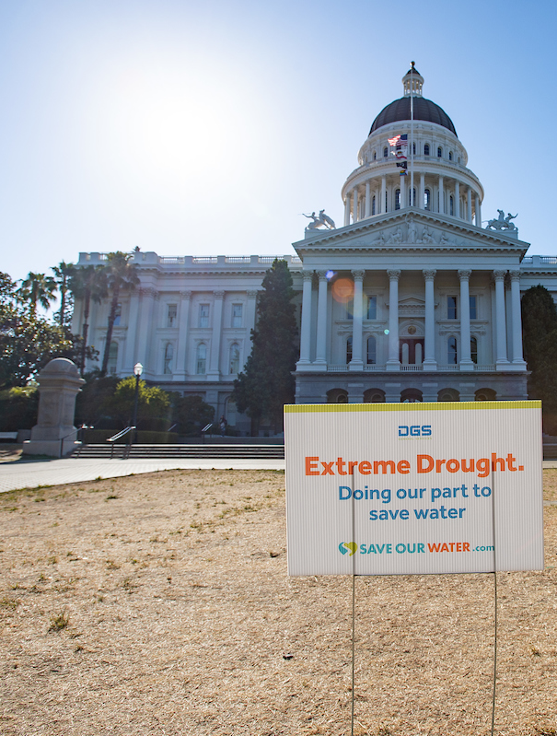
Drought Restrictions
Check state website:
https://drought.ca.gov/state-drought-response/statewide-emergency-water-conservation-regulations/
Restrictions apply to HOAs
Decorative grass should not be watered*
Give all trees just what they need: avoid overwatering
Follow the local requirements of your water supplier
Note: Unless otherwise allowed in the regulation

Slide 12
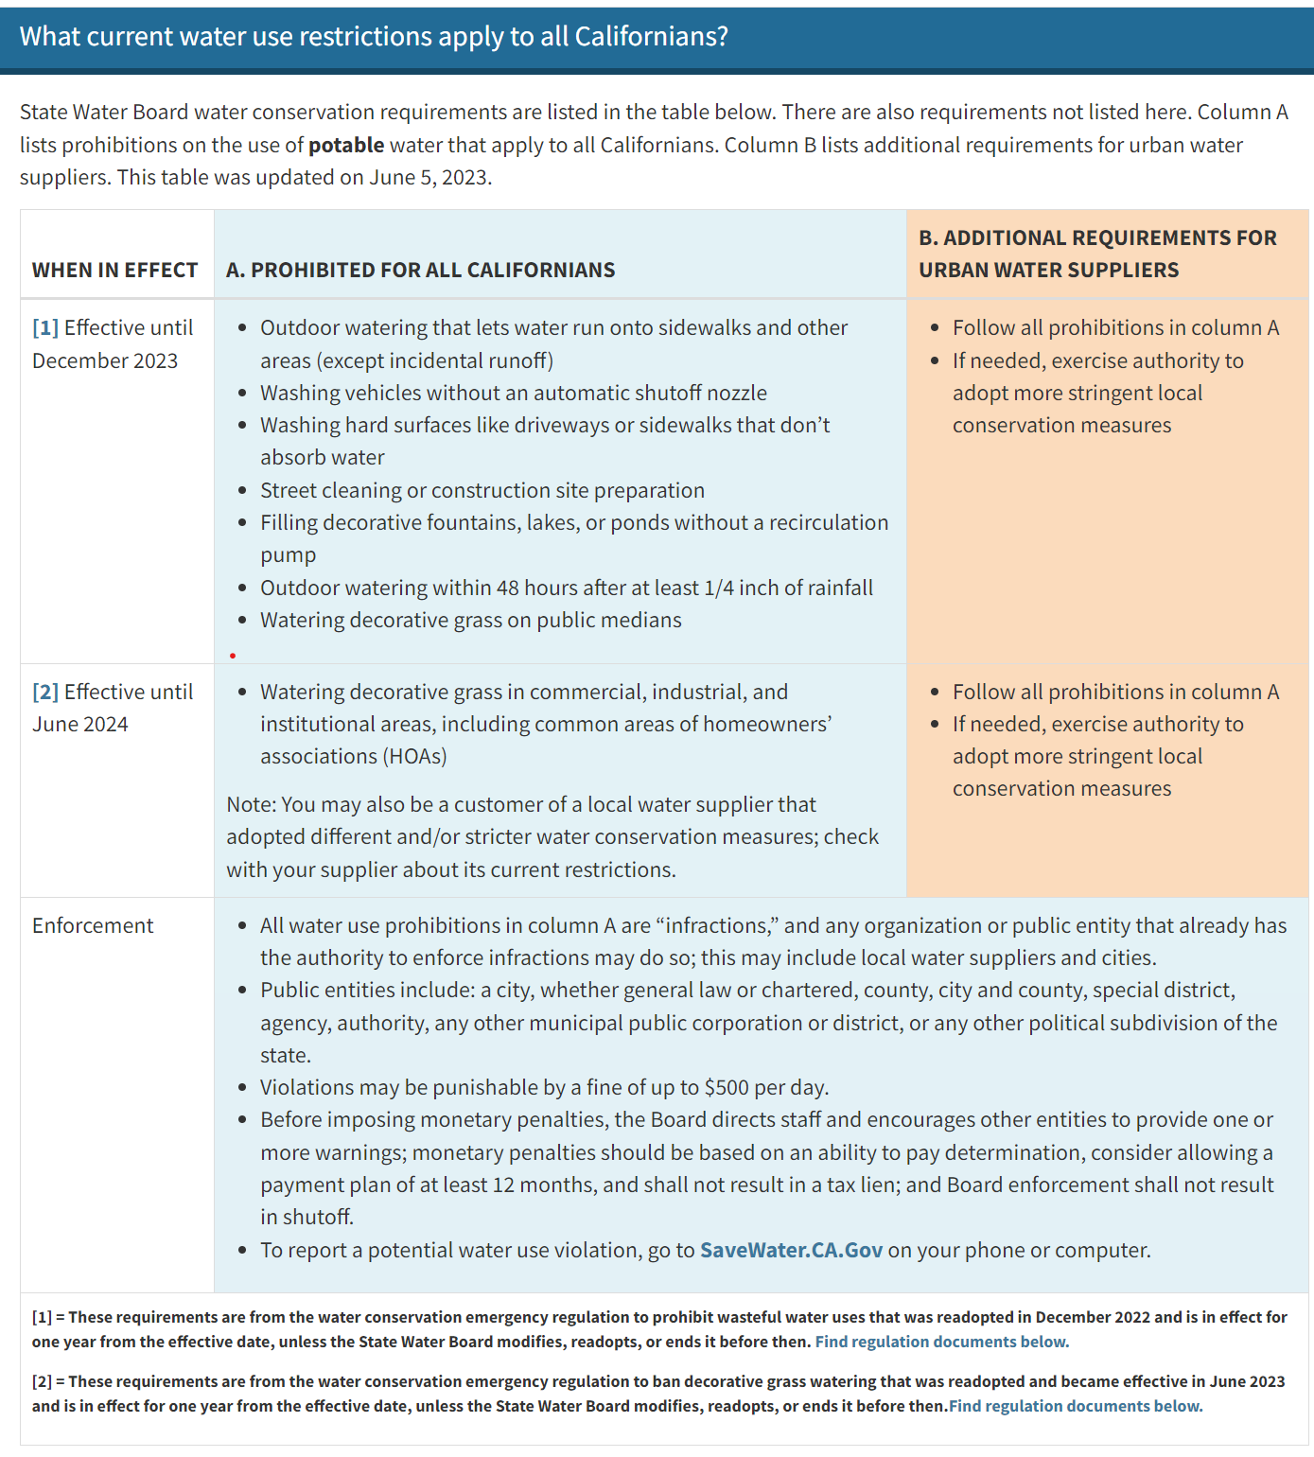
https://www.waterboards.ca.gov/water_issues/programs/conservation_portal/regs/emergency_regulation.html

Slide 13
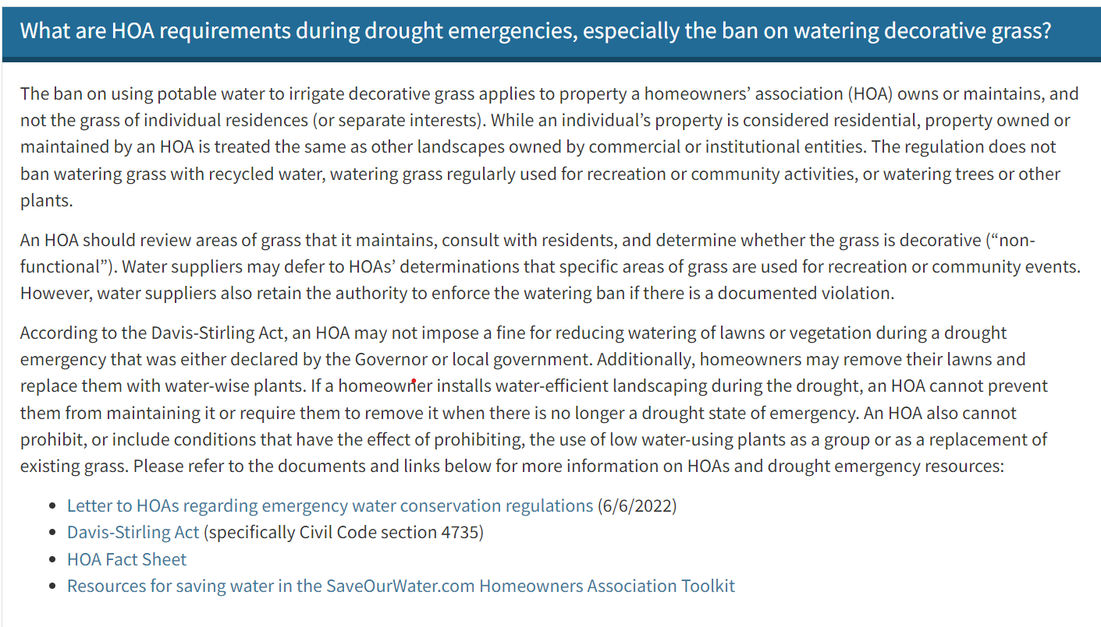
https://www.waterboards.ca.gov/water_issues/programs/conservation_portal/regs/emergency_regulation.html

Slide 14
Questions
Robert M. DeNichilo, Esq., CCAL
Robert@NDHOALaw.com
949.654.1510
949.994.8201

