Slide 1
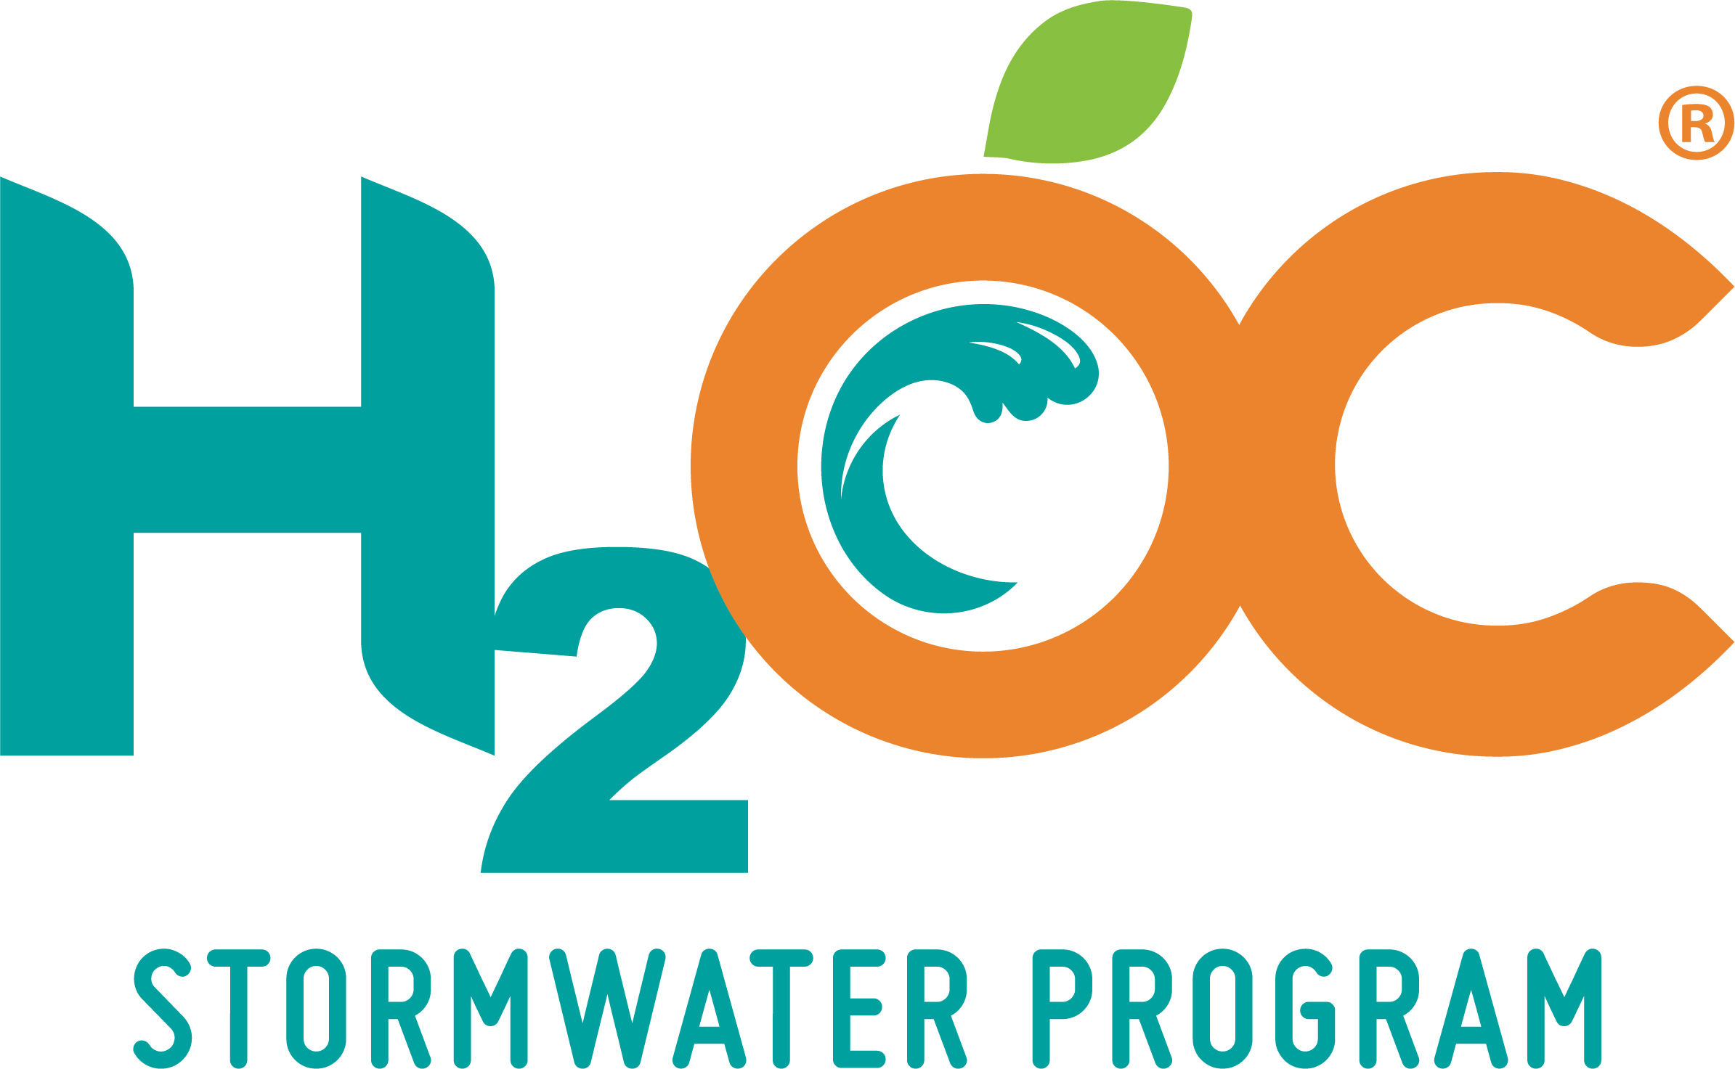
How HOAs can Protect Water Quality through Efficiency
Christy Suppes
County of Orange – OC Watersheds
H2O for HOAs
October 26, 2023

Slide 2
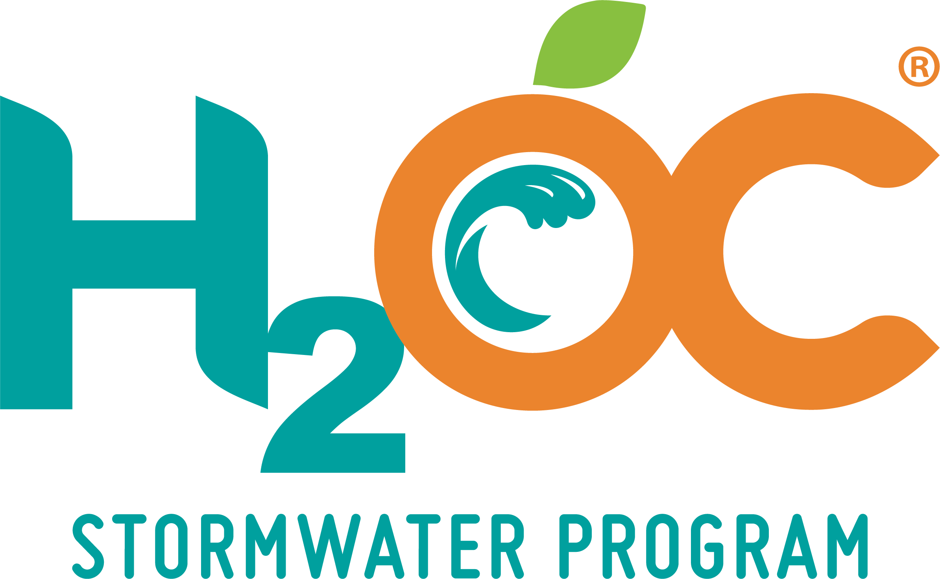
OC Stormwater Program (H₂OC)
Protects surface water quality and maintains compliance with National Pollution Discharge Elimination System Permits through stormwater and urban runoff management
Cooperative Effort
All 34 cities in Orange County
County of Orange
Orange County Flood Control District

Slide 3
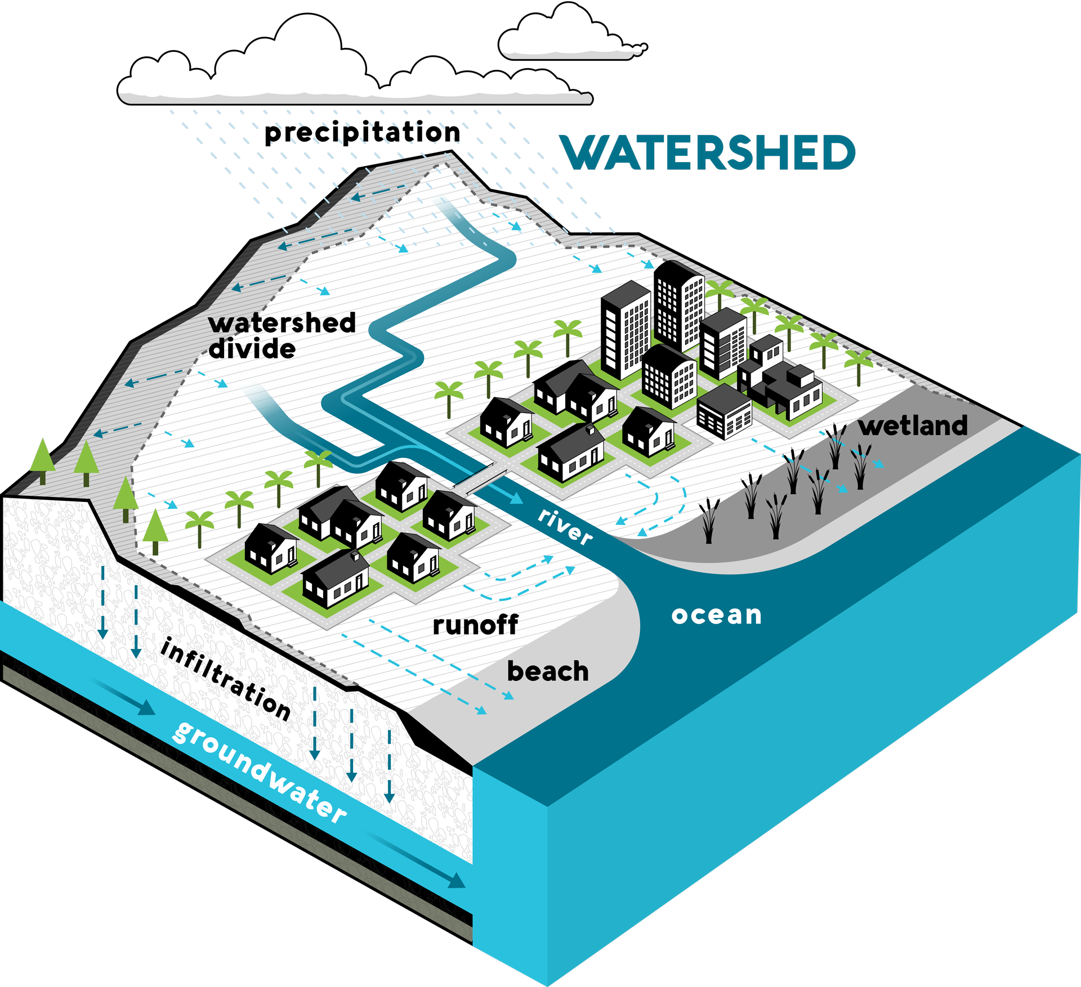
Protecting Our Water Resources
Water quality is more than a coastal issue
Pollution is picked up by stormwater and urban runoff and transported through watersheds to our receiving waters via the storm drain system
A watershed is an area of land that channels rainfall to creeks, rivers, bays, and the ocean
Notes:
The quality of our surface waters is a reflection of how we treat our watersheds

Slide 4
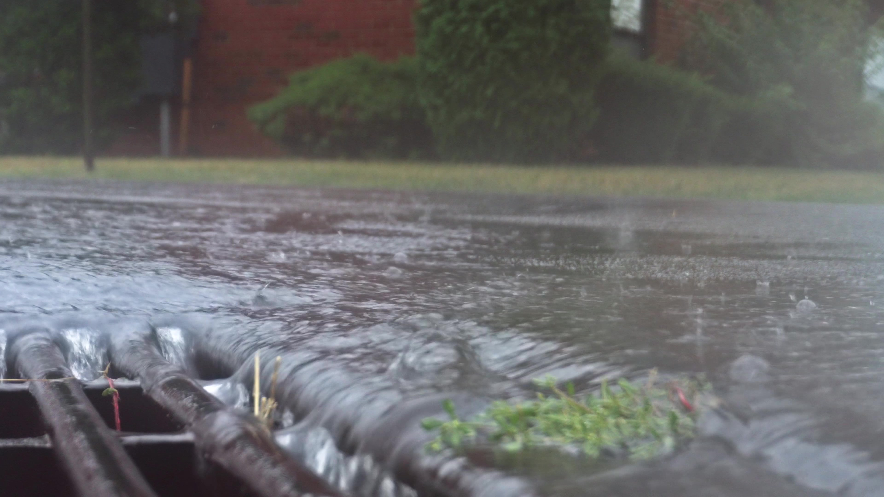
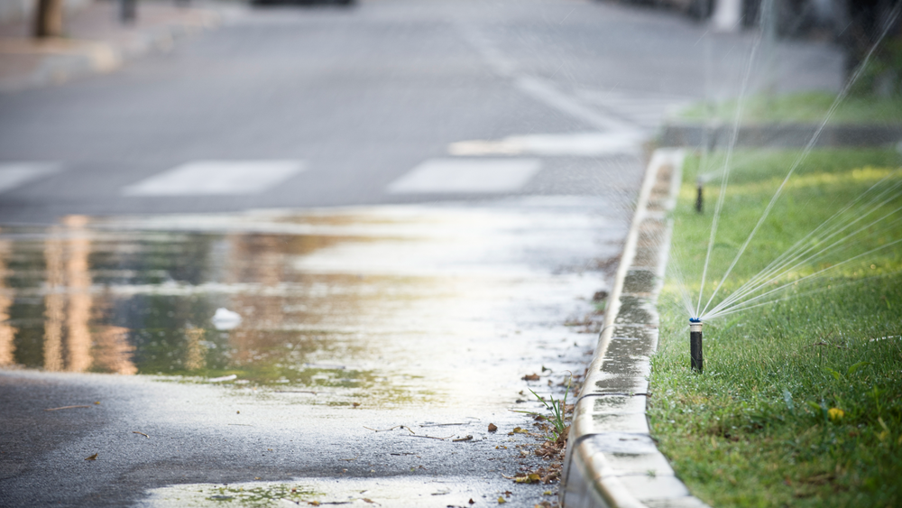
What is Runoff?
Stormwater runoff is water from rain events that runs off roofs, driveways, parking lots, yards, and other surfaces, and does not absorb into the ground
Urban runoff is water from outdoor water use that does not soak into the ground Sources of urban runoff can include:
Overwatering your lawn – landscape irrigation runoff is prohibited in South Orange County
Washing your car on impermeable surfaces
Spraying off your driveway or sidewalks

Slide 5
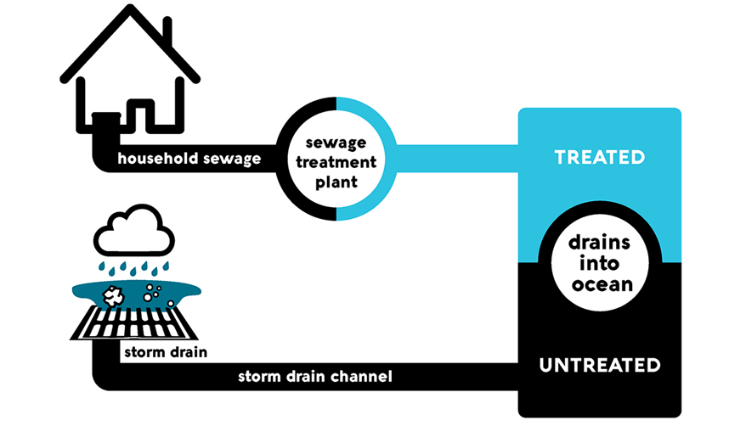
What is the Storm Drain System?
The storm drain system collects excess runoff from paved streets, parking lots, sidewalks, and roofs and discharges it to our waterways
Built for the purpose of flood control, the storm drain system intentionally and effectively moves water from the urban environment out to the ocean
Water that enters the storm drain system is not treated before entering our waterways and should never contain pollutants

Slide 6
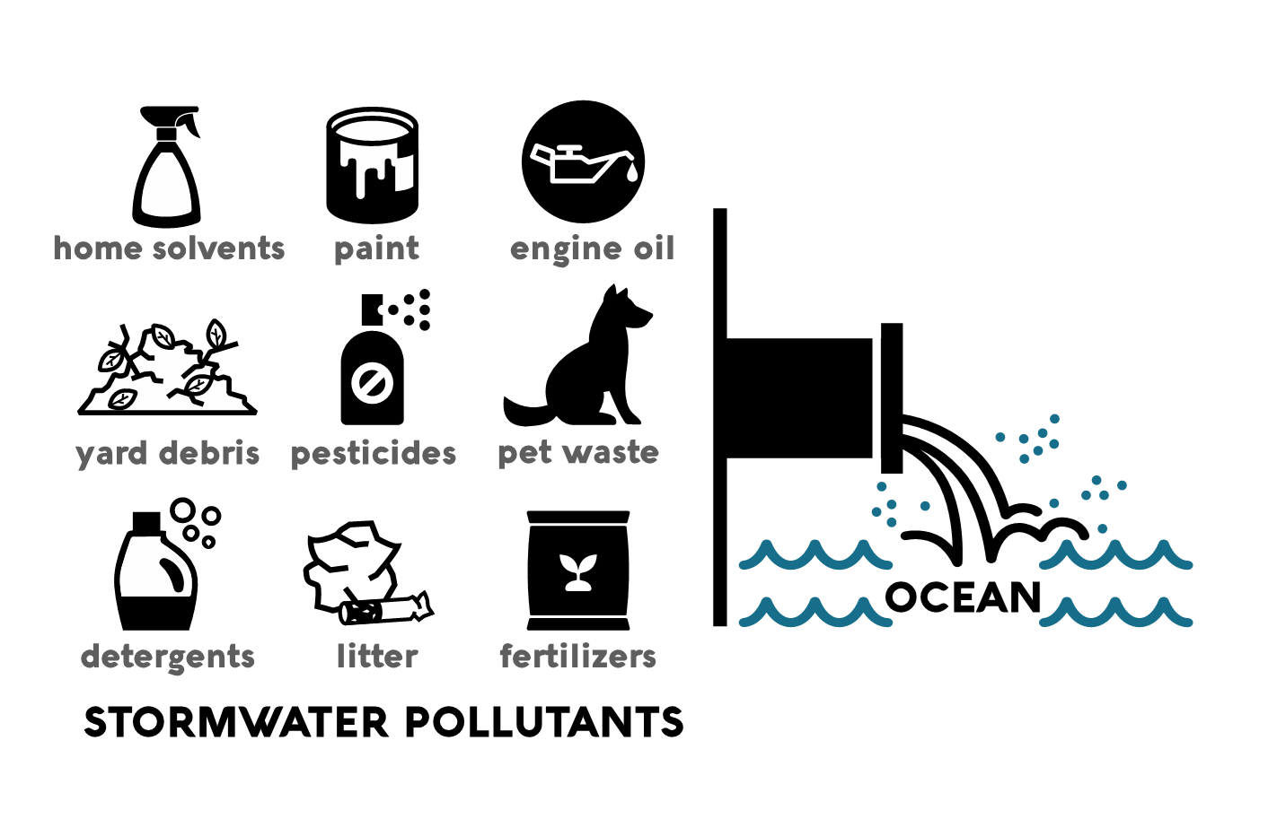
Common Pollutants in Runoff

Slide 7
How do We Protect Water Quality?

Slide 8
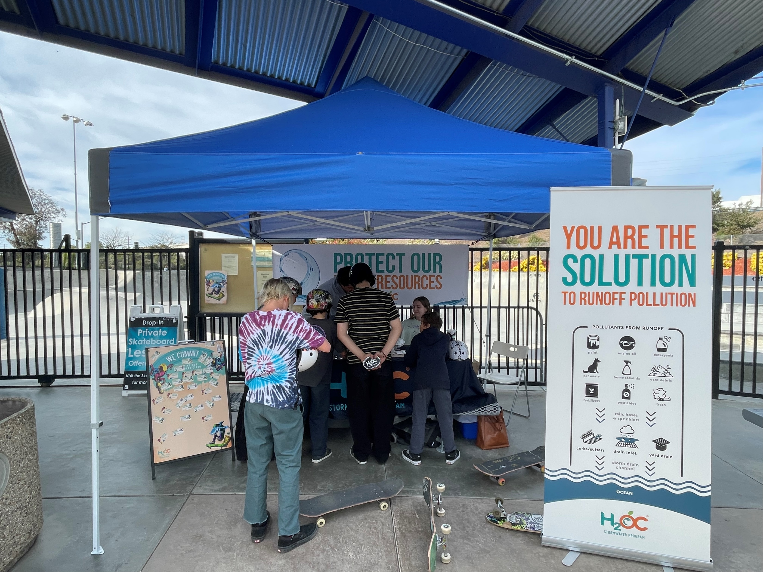
Community Based Efforts
Education and Outreach – Raise knowledge and awareness regarding stormwater pollution through events, ad campaigns, and social media
Behavior Change Research – Understand the barriers and benefits to adopting stormwater-safe behaviors
Pollution Prevention – Working with the community to stop stormwater pollution before it starts

Slide 9
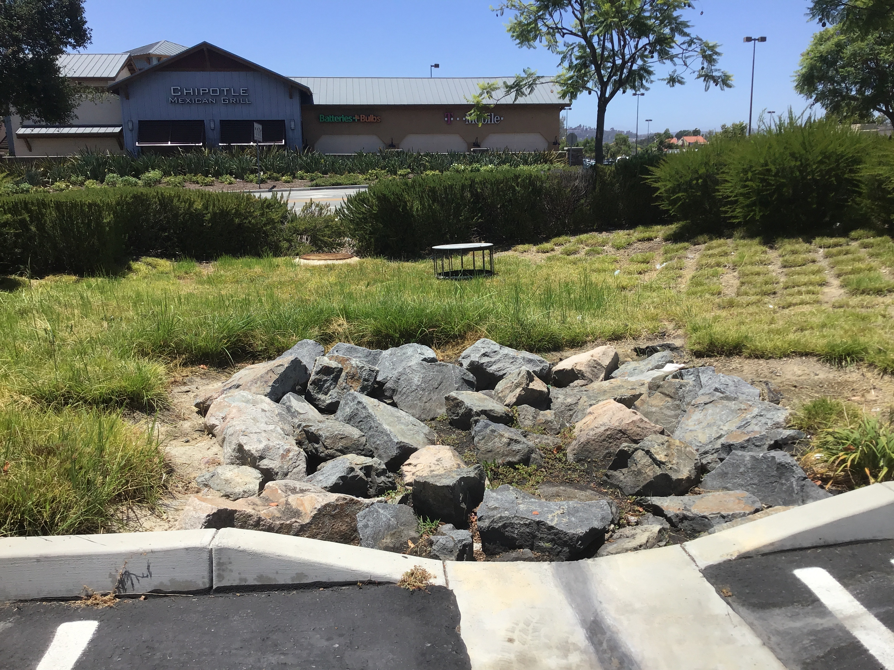
Runoff Relief
Capture – Landscape features like dry creek beds and rain gardens allow stormwater to infiltrate instead of run off
Treatment – Localized filtration and treatment systems remove pollution before dry weather runoff enters receiving waters
Reuse – Captured dry weather runoff can be treated and reused as recycled water

Slide 10
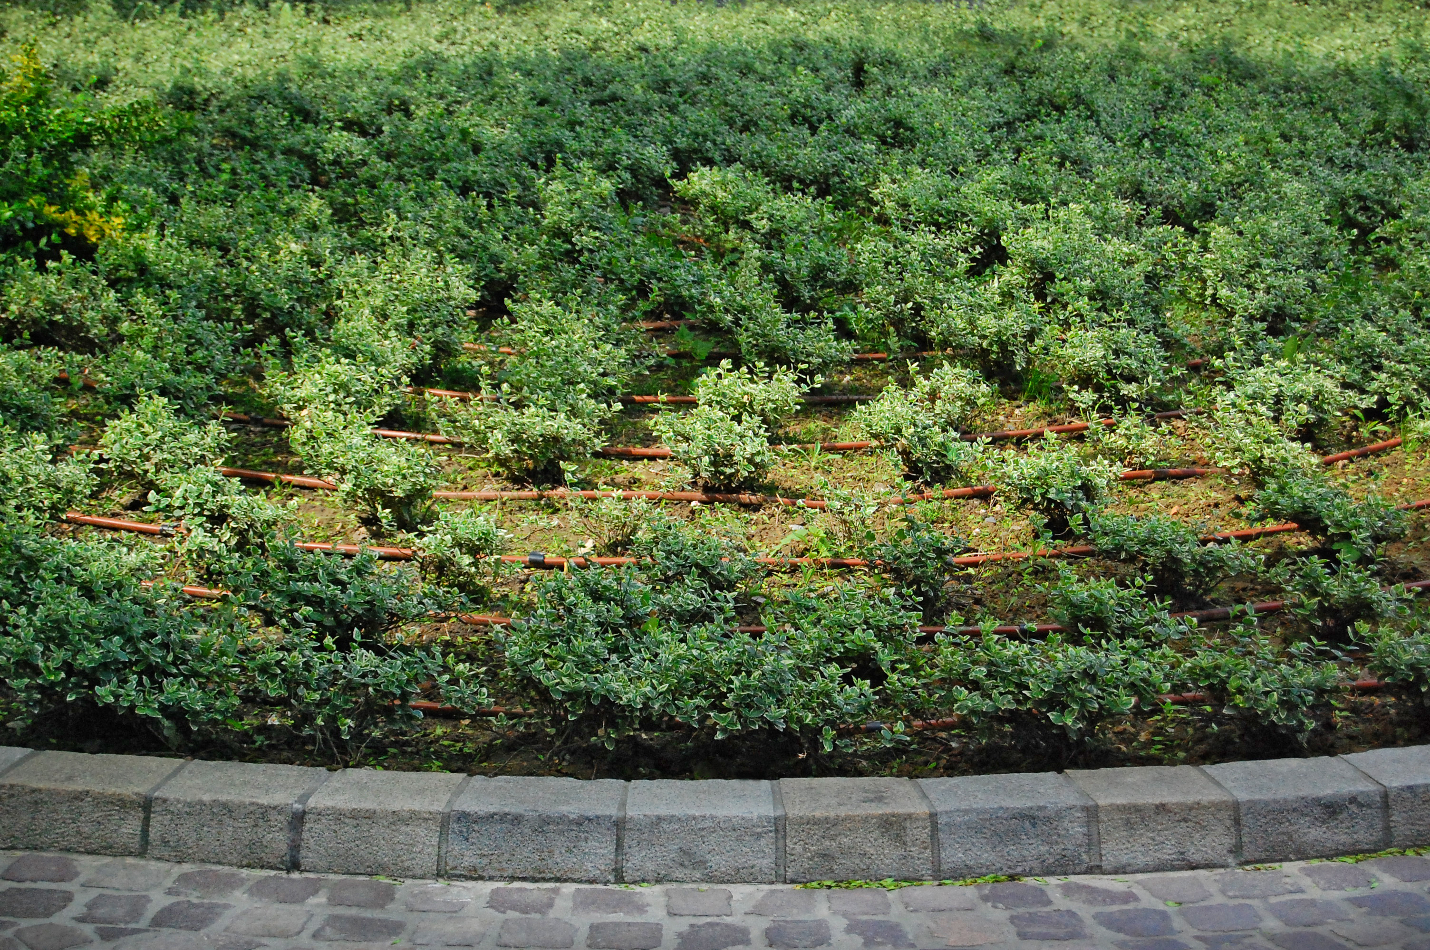
The Results Are In…
In South Orange County’s Watersheds:
Dry weather runoff has reduced around 50% when compared to the early 2000’s
Bacteria loading has reduced more than 90% in dry weather when compared to baseline data from early 2000’s
This could not have happened without the actions taken in our communities

Slide 11
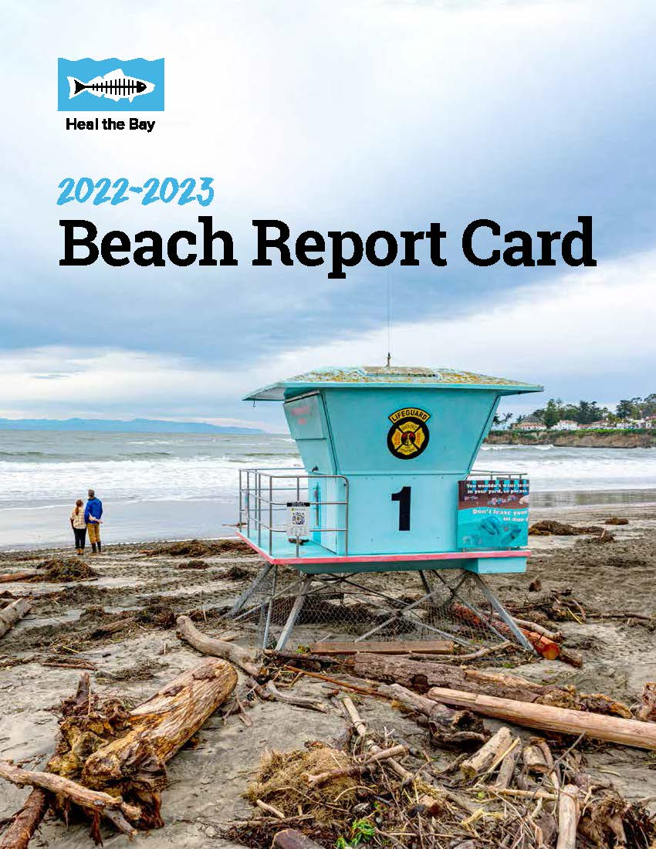
We’re All Making A Difference
Orange County beaches surpassed state averages in the 2022-23 Heal the Bay Report Card
98% received A and B summer dry weather grades
94% received A and B winter dry weather grades
63% received A and B wet weather grades

Slide 12
How can YOU be Part of the Solution?

Slide 13
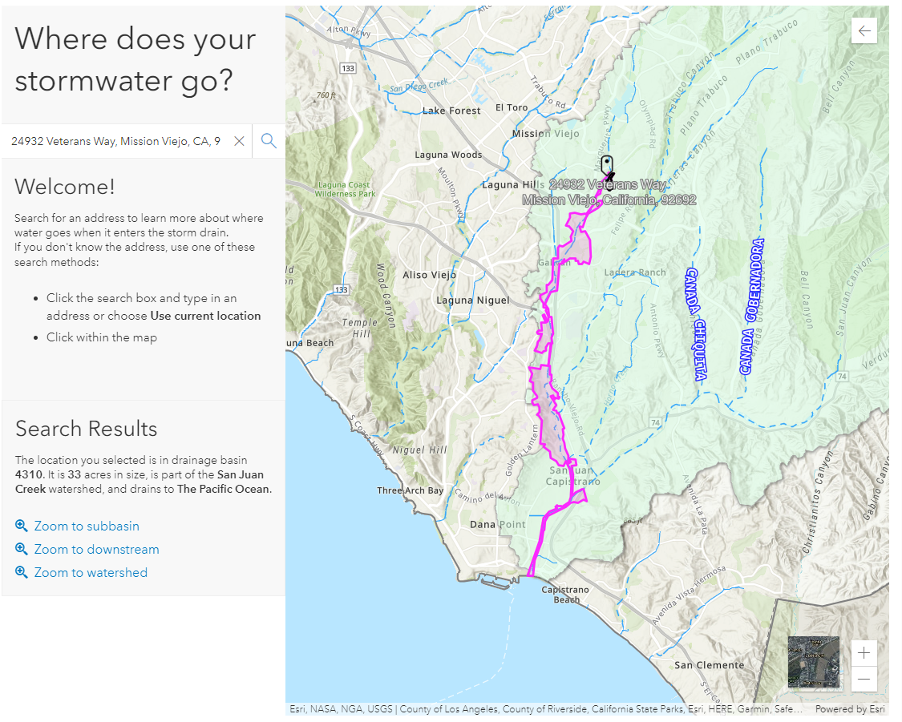
Where Does Our Water Go?
Visit www.h2oc.org to learn about how you can prevent polluted runoff from entering our waterways
Our ‘Where does your stormwater go?’ tool tells you which watershed your HOA is in and shows you the path runoff takes from your property to the Ocean

Slide 14
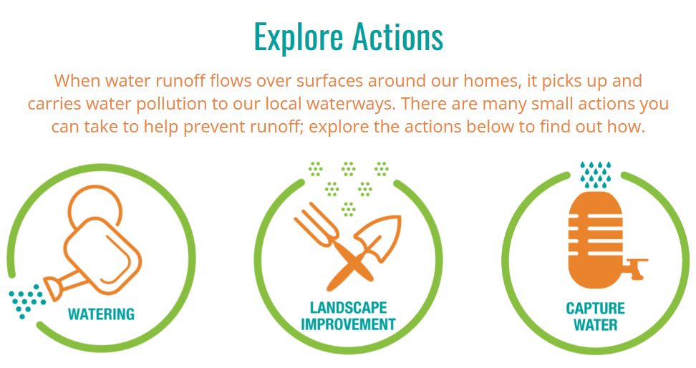
Accept the Challenge
Keeping water from leaving your property keeps pollutants out of our waterways
Take the Overwatering is Out Challenge by:
Seasonally updating your watering schedule
Getting a weather-based irrigation controller
Checking for leaks and misaligned sprinklers
Planting drought-tolerant landscaping

Slide 15
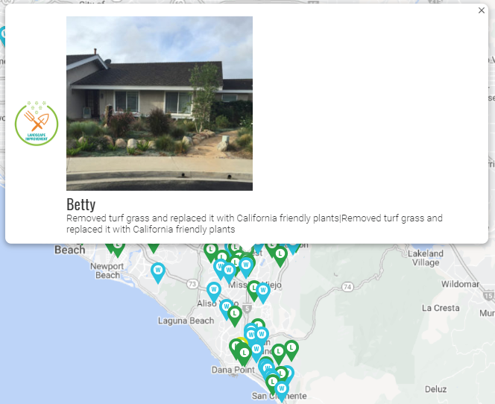
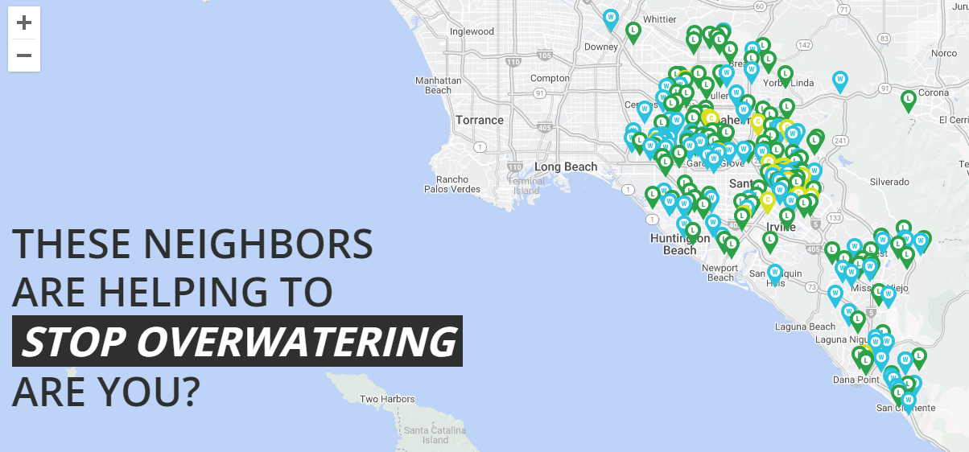
Share Your Efforts

Slide 16
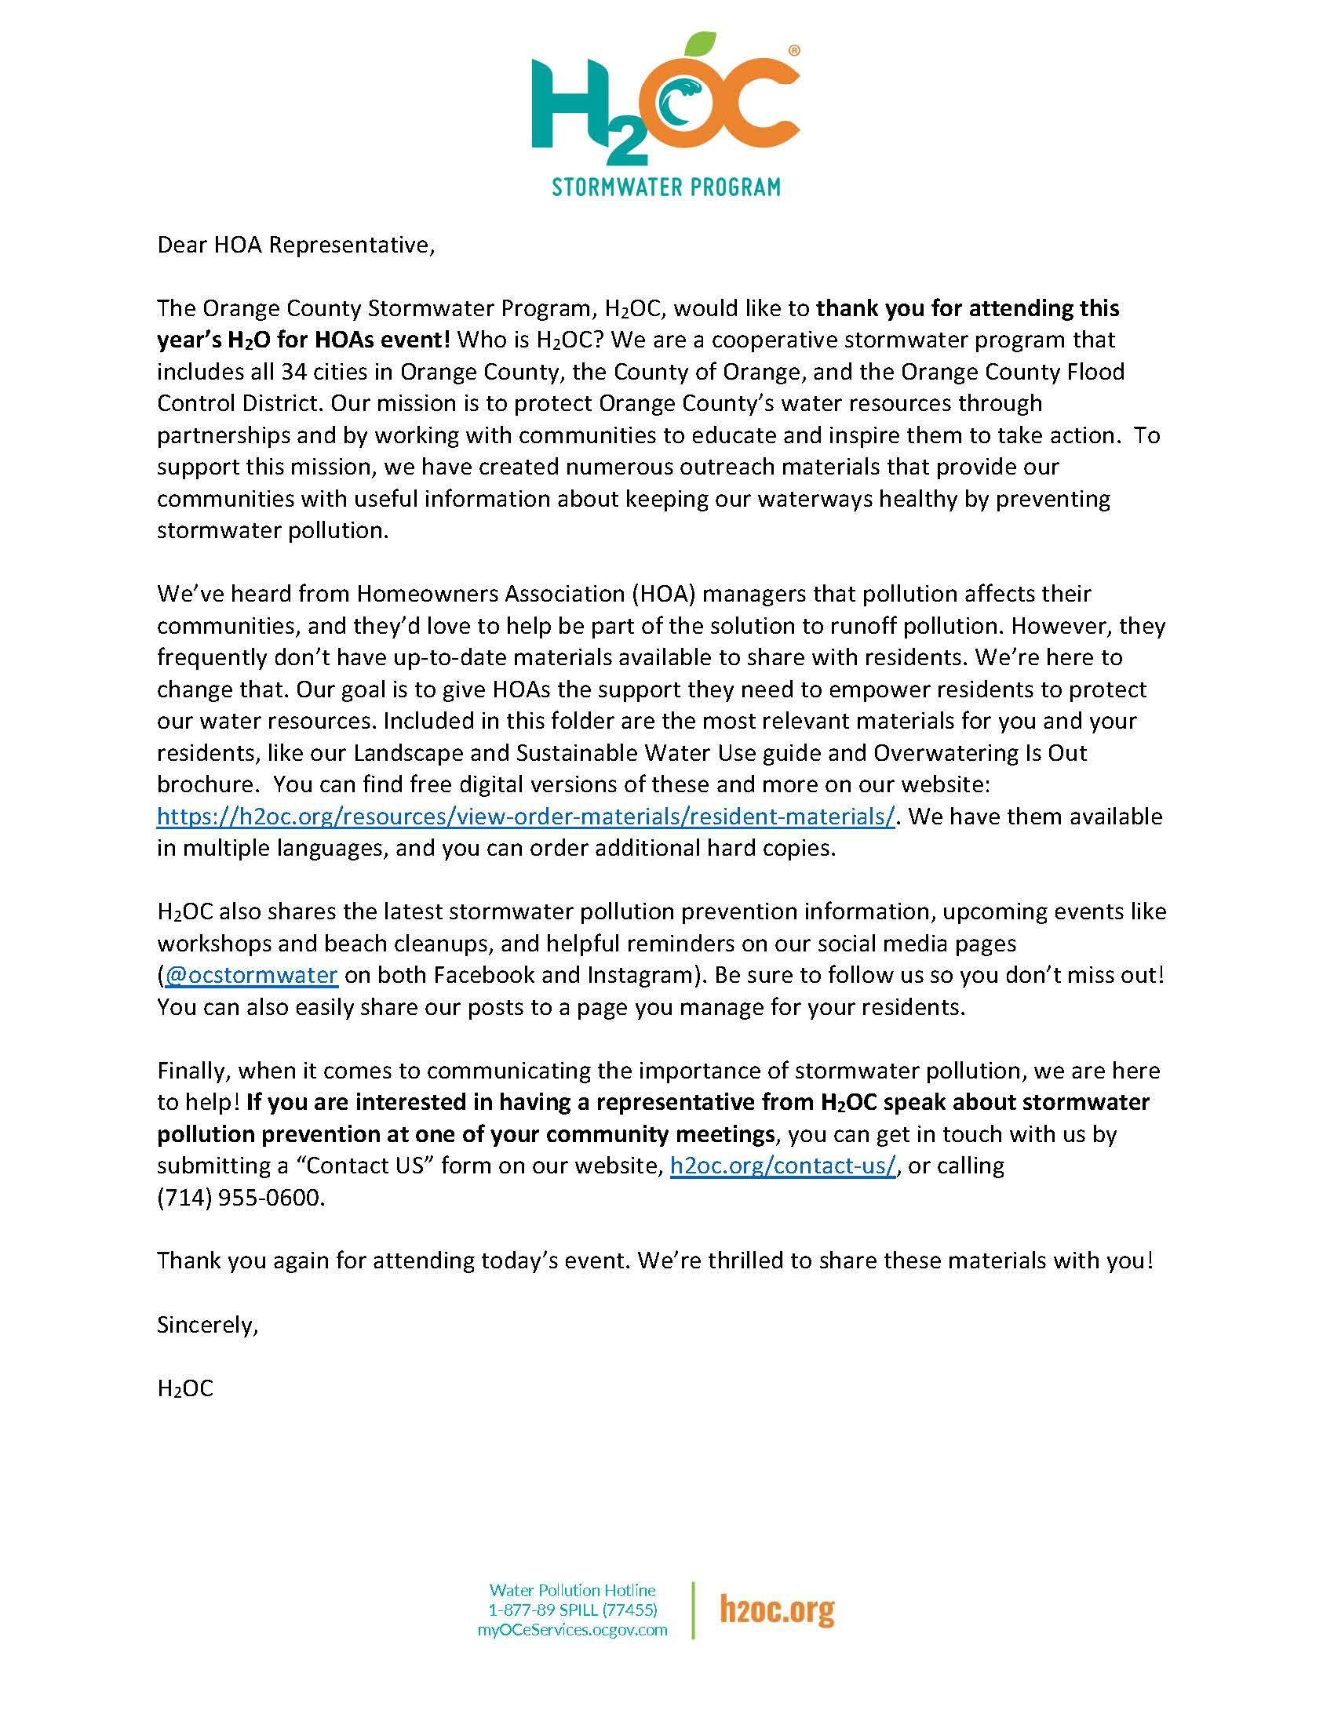
Spread the Word
As an HOA board member, you are in a unique position to affect behavior change
Provide residents with resources
Set an example for others in your community
Start the conversation regarding water use efficiency in your HOA’s common areas
Investments now can save money and precious resources in the future

Slide 17
Resources Available
At H₂OC we’ve developed a suite of materials that can help you in conversations with residents
Cover common issues such as pet waste, irrigation runoff, home improvement – a selection has been included in your folder
Digital and print versions available
Visit h2oc.org/resources/view-order-brochures

Slide 18
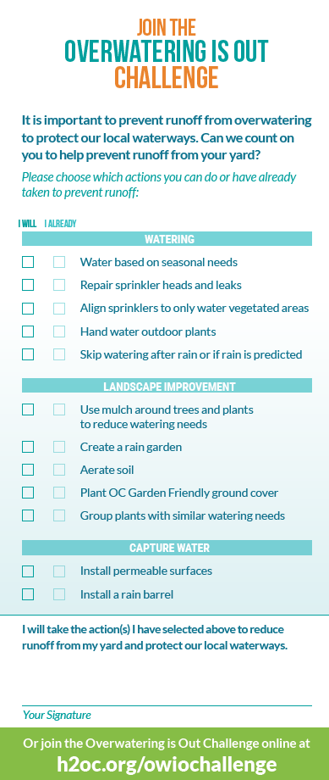
Set an example
Make a commitment today to eliminate irrigation runoff from your community
Commitment cards are in your folder
12 different actions that prevent runoff – what are you already doing and what you will commit to do in the future
Consider these actions for your HOA’s common areas
Include your address so we can add you to our map on h2oc.org

Slide 19
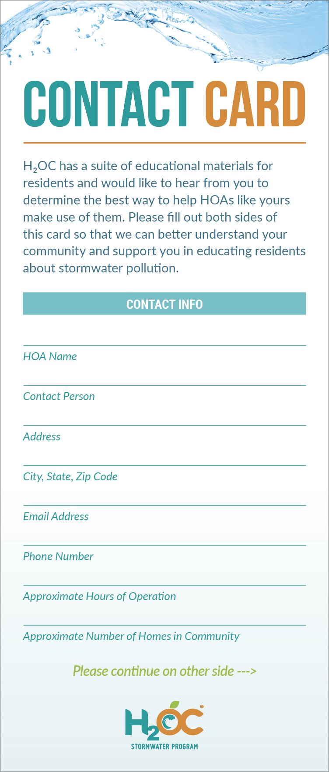
We’re Here to Help!
We are regularly updating our materials and would like your input on what would be most helpful
Contact cards are at the H₂OC table
Fill out your HOA’s contact information
Indicate your interests
We will reach out to provide what you need

Slide 20
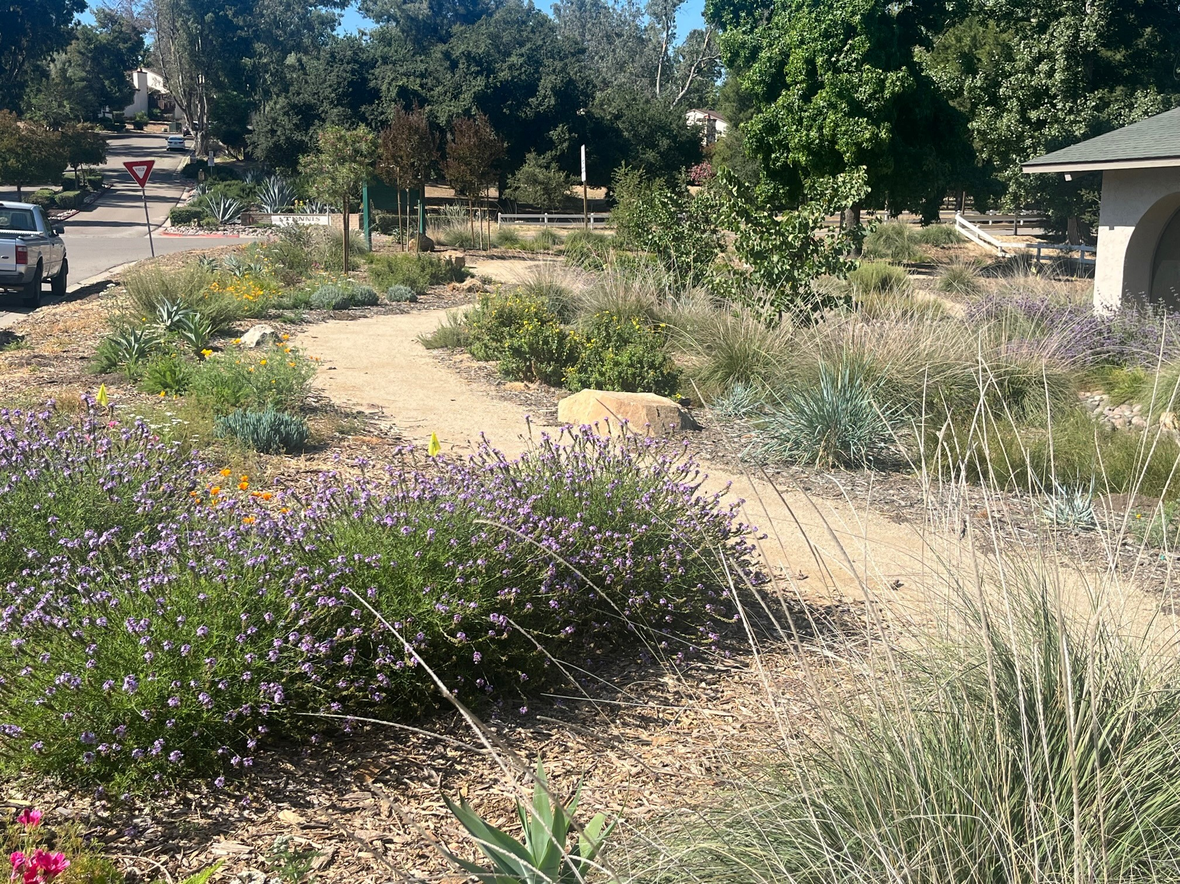
New HOA Program Available
LARGE LANDSCAPE UPGRADE PILOT
Expert Assistance to complete a turf replacement project
Design incentives
Rebates starting at $4/sqft
Stormwater feature incentives
Learn more and apply:
Email Megan Chery (mchery@enviroincentives.com)
Share your information at the H₂OC table
Notes:
We're also excited to announce a new pilot program we're bringing to Orange County this fall in partnership with our water supply agencies.
This Large Landscape Upgrade pilot will offer HOAs assistance with project completion, and extra incentives for landscape design, turf replacement, and stormwater features.
The program will help HOAs to convert large amounts of grass to low water use landscaping that can help our water supply and quality goals
We will be recruiting a first set of participants this Fall. Please contact Megan at the email here if your HOA could be interested, or stop by our table to leave us with your name for more information.

Slide 21
Thank you!
Christy Suppes
Senior Environmental Resources Specialist
County of Orange - OC Watersheds
Email: Christy.Suppes@ocpw.ocgov.com

