Slide 1
H2O for HOAs
Maintaining landscape trees during drought

Slide 2
Fred Roth, Ph.D.
Taught at Cal Poly for 33 years
Consultations on trees since 1990

Slide 3
So---when is the drought gonna end?
Probably never!
We need to adapt to it.

Slide 4
Full disclosure statement!
These recommendations are for keeping established trees healthy. Young trees will need more water to survive in their first year. Also, if you need to grow your trees, the more water you apply, the faster your tree will grow.
My recommendations are based on a medium textured soil, or LOAM. If you have a clay soil (fine texture) or a sandy soil (coarse texture), get the help of an irrigation technician to modify my suggestions.
Loam soils are the most common in Southern California, so most of you will be working with a medium textured soil.

Slide 5
Accepted model for tree root systems:

Slide 6
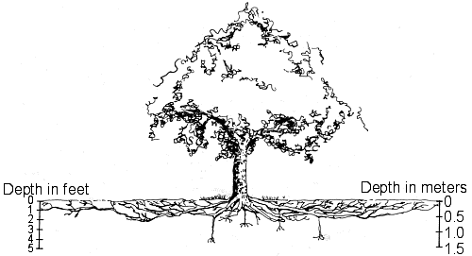

Slide 7
What does tell us about where the root are?
Close to the surface
Few below 3 feet
Well beyond the spread of the tree’s crown (drip line)

Slide 8
Trees and turfgrass do not like each other! -Grass doesn’t like the shade -Trees don’t like the competition/some grasses can produce toxic materials
Trees can do well on half of what turf requires to look good
If the water is cut off, grass will suck the soil dry as it dies

Slide 9
How water moves in soil
Mostly downward by gravity
Some water will move sideways, but much slower than downward. (Think about a stubby carrot)
From a single emitter, over the time it takes to get water down to 3 feet, it will travel only one foot outward.
If using a drip system (I recommend) and you want to wet just half the surface, the drip lines should be four feet apart.

Slide 10
First step:
Get rid of the turf under the crown of the trees
Replace it with up to 4 inches of mulch (chopped tree waste is good)
Apply the mulch from the base of the tree to the edge of the tree’s crown (DO NOT PILE UP against the trunk!)

Slide 11
Next step
Install an irrigation system that will wet half the area under the tree’s crown.
Don’t irrigate closer than 3 feet from the trunk (can promote a fungus)
The system must apply water slow enough that it doesn’t puddle – run off. (It will take hours)
Turn it on once a month during the warm months (may be longer than summer)

Slide 12
Drip irrigation is ideal for tree applications
Netafim is a flexible tube with emitters placed inside the tube.
It is easy to arrange in any pattern you choose.
Google the following for more information:
https://ccuh.ucdavis.edu/tric
TRIC = Tree Ring Irrigation Contraption

Slide 13
Here’s what not to do!
Do not use a watering needle – if fully inserted in the soil you will put the water below the root system
Forget about porous tubes that are supposed to get the water to the deep roots – they don’t work as they are designed to.

Slide 14
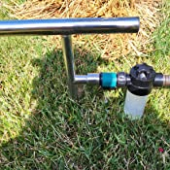
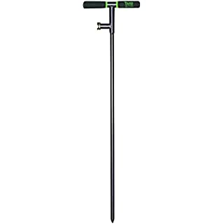

Slide 15
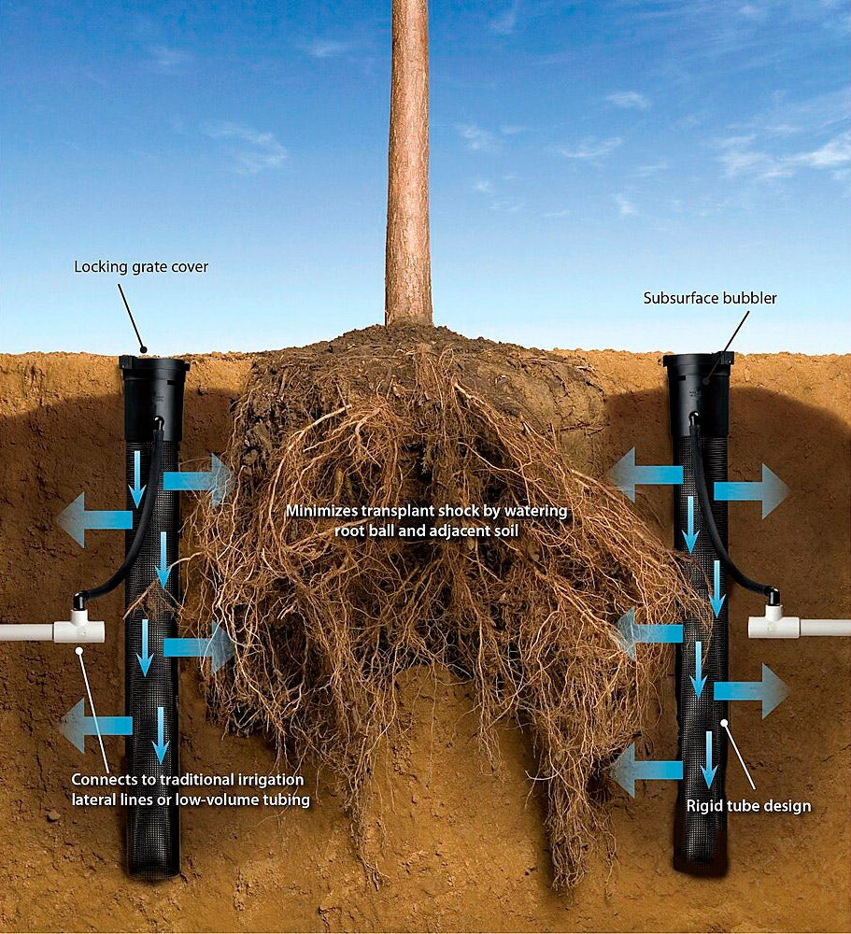
Not exactly!

Slide 16
Just a bit about pruning

Slide 17
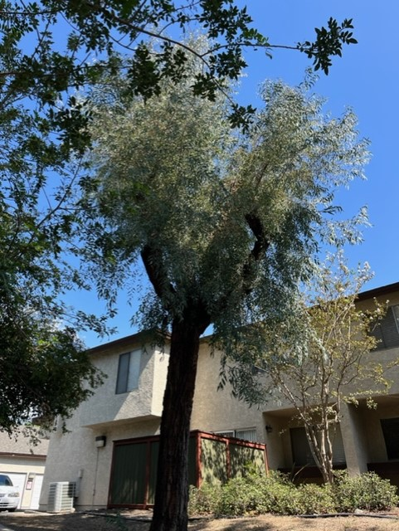

Slide 18
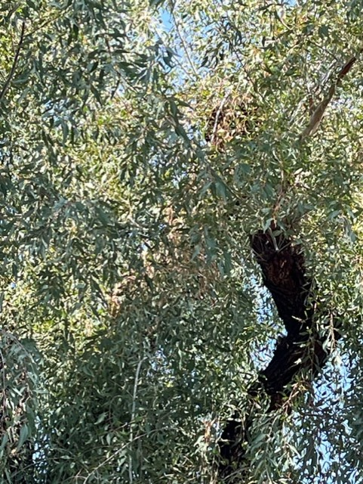

Slide 19
https://inlandurbanforestcouncil.org/

