Slide 1
Integrated Pest Management Experience with Biological Control in OC
Presented by Christian Galindo
Saddleback College Adjunct Faculty
VPGM at BrightView Landscape Services OC

Slide 2
Integrated Pest Management
IPM is an ecosystem-based strategy that focuses on long-term prevention of pests or their damage through a combination of techniques such as biological control, habitat manipulation, modification of cultural practices, and use of resistant varieties.
Pesticides are used only after monitoring indicates they are needed according to established guidelines, and treatments are made with the goal of removing only the target organism.
Pest control materials are selected and applied in a manner that minimizes risks to human health, beneficial and nontarget organisms, and the environment.
UC IPM

Slide 3
Well Developed Plant Health Care and IPM
Will lead to a healthy plants and healthy ecosystem where pests live in quantities that minimally impact landscapes.
Water quality is preserved.
Water use is optimized.

Slide 4
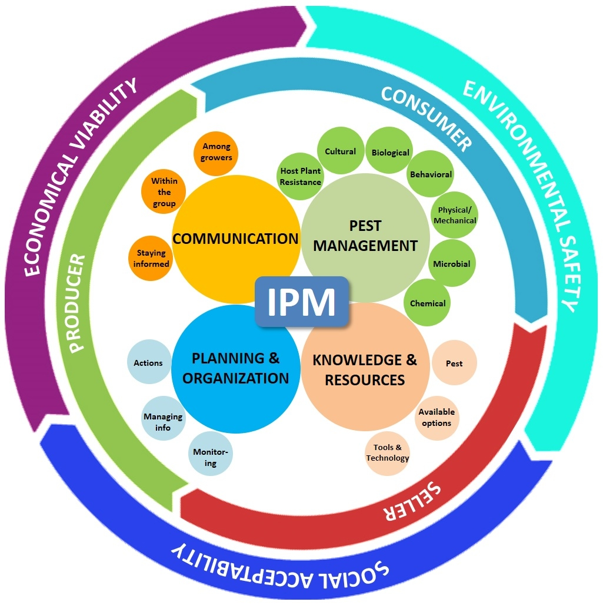
https://ucanr.edu/blogs/blogcore/postdetail.cfm?postnum=28210

Slide 5
Economic Viability is part of the puzzle
Without a consideration of the cost of the practice and the environmental impact IPM is likely to fail.
An economically sound program, with tangible benefits is more likely to thrive.

Slide 6
Social Acceptability
What drives social acceptability?
Information: News, science, social media.
Marketing
Education
Lack of Information or fear?
How do we make sure our programs have buy-in with our customer?
We inform and educate!

Slide 7
Control Methods and Management Practices in IPM
Biological
Chemical
Cultural
Mechanical
Physical

Slide 8
Biological Control
Pest management tactic involving the deliberate use of natural enemies to reduce a pest’s population.
Natural Control may involve other agents other than natural enemies and no purposeful manipulation is involved. Its efficacy may be affected by weather, food, etc.

Slide 9
Biological and Natural Control
Natural Enemies (Insects)
Predatory Insects
Parasitoids
Biological agents
Vertebrates: Reptiles, Amphibians, Birds and Mammals.

Slide 10
Cultural Control Practices
Modifications of planting and maintenance that reduce pest problems.
Good design (hydro-zones), proper system installation and management.
Plant selection (choosing plants resistant or with pest tolerance)
Good maintenance practices
Eliminating host plants and vectors
Sanitation
Mulch
Soil conditioning to improve soil structure.

Slide 11
Mechanical and Physical Control
Uses labor, materials (not pesticides) and machinery to reduce pest abundance.
Weed removal with string trimmer, hoe, or hand pull.
Sticky traps for insects
Barriers or cages
Removal or raking of infected foliage.

Slide 12
Chemical Control the LAST Option
Pesticides should be the last option. When nothing else works and your crop/landscape is at risk. Choose a product that best controls your target pest, with minimal impact on other non-target organisms and environment.

Slide 13
Experiences with natural enemies in Orange County
Pests migrate easily. What your neighbor does impacts the results of what you do. You can’t win in isolation!
The more people working in IPM the better the ecosystem will be.
I have noticed communities/cities that use less pesticides tend to build their environment’s immunity, as well as healthy natural enemy populations.

Slide 14
Take them in Account
Don’t scout for pests only, scout for natural enemies. Let them be part of the equation.
If you don’t, they won’t thrive.
Can you let them do their job?

Slide 15
Management with Natural Enemies
Focus on developing a landscape that helps nature take control. If they are not abundant you can help by adding to the natural populations. Many are available for purchase and release.
Natural enemies reduce pest reproductive potential.
They host or prey on the organism, promoting their own population at the expense of the population they feed on.
Know your pests and select natural enemies that will help.

Slide 16
Management with Natural Enemies
Understand natural enemies so that they can be manipulated to your advantage. Know what they feed on, when and how do they move?
Chemical control may affect populations of beneficial organisms.
It takes time to build Natural Enemy populations. Protect them.

Slide 17
Agents of Biological Control
Parasites
Parasitoids
Non beneficial parasites or Hyper-parasites
Predators

Slide 18
White Grub Control with Beneficial Nematodes

Slide 19
Parasitoids
These natural enemies have been used most frequently in biological control than any other agent.
The most significant group of parasitoids are the Wasps and Flies.
They lay their eggs on any life stage of their victim, and consumer them. You can purchase for release.
However, they already exist, so its best to monitor for them.
If you have them avoid chemicals that can kill them.

Slide 20
IPM Example: Lady Bugs Predators eliminate pests
Widely distributed throughout the world
One of the most beneficial group of insects.
Adults and larvae are voracious predators
Have a wide range of prey including aphids, scales, mites, and thrips.

Slide 21
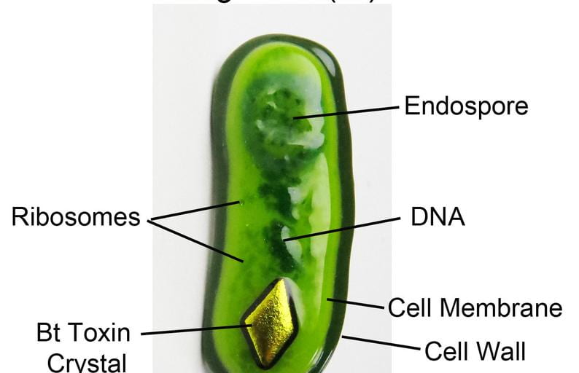
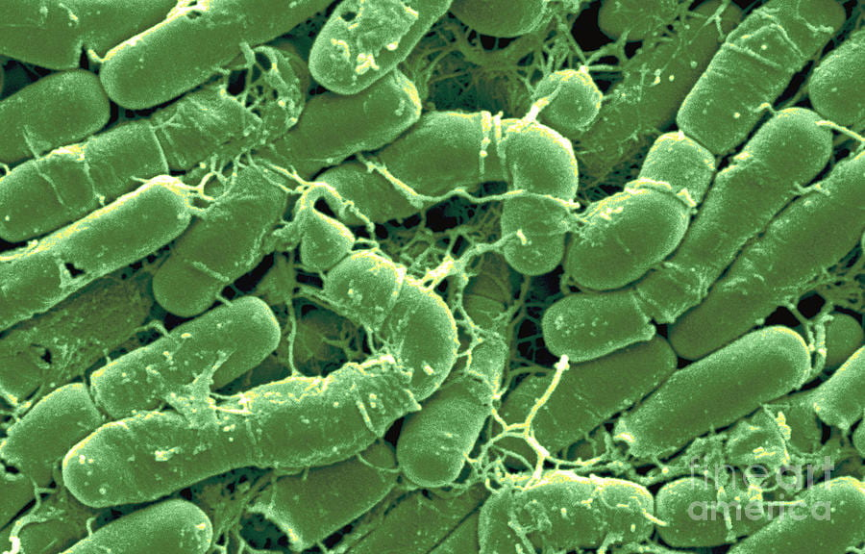
Pathogenic Microorganisms in IPM can help control pests
There are products that help disperse pest diseases
We have used BT (Gram Positive Bacteria) in OC to control caterpillar problems.
BT will help control young larvae. So having a good scouting program is critical.
These products are part of a good organic IPM program.

Slide 22
Closing Remarks
Pest Management should not focus on controlling the pest rather preventing them from becoming problematic.
It should focus on building a healthy environment
Maintaining healthy landscapes where plants are more resilient to common pests so they can coexist.

Slide 23
Questions

