Slide 1
Adapting to Climate Change
Metropolitan Water District
    H2O for HOAs
    October 26, 2023
Notes:
INTRODUCTION TITLE SLIDE

Slide 2
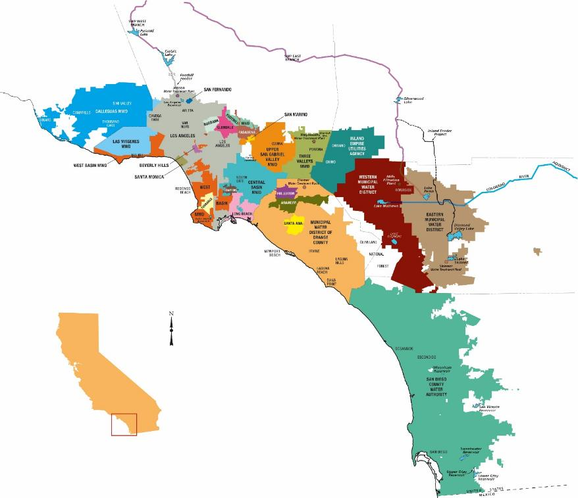
Metropolitan Water District of Southern California
Nation’s largest wholesale water provider
Service area: 19 million people, 5,200 square miles, parts of six counties
26 member agencies
Supports $1.4 trillion regional economy
(ranks 13th in the world)
Already experiencing severe climate impacts

Slide 3
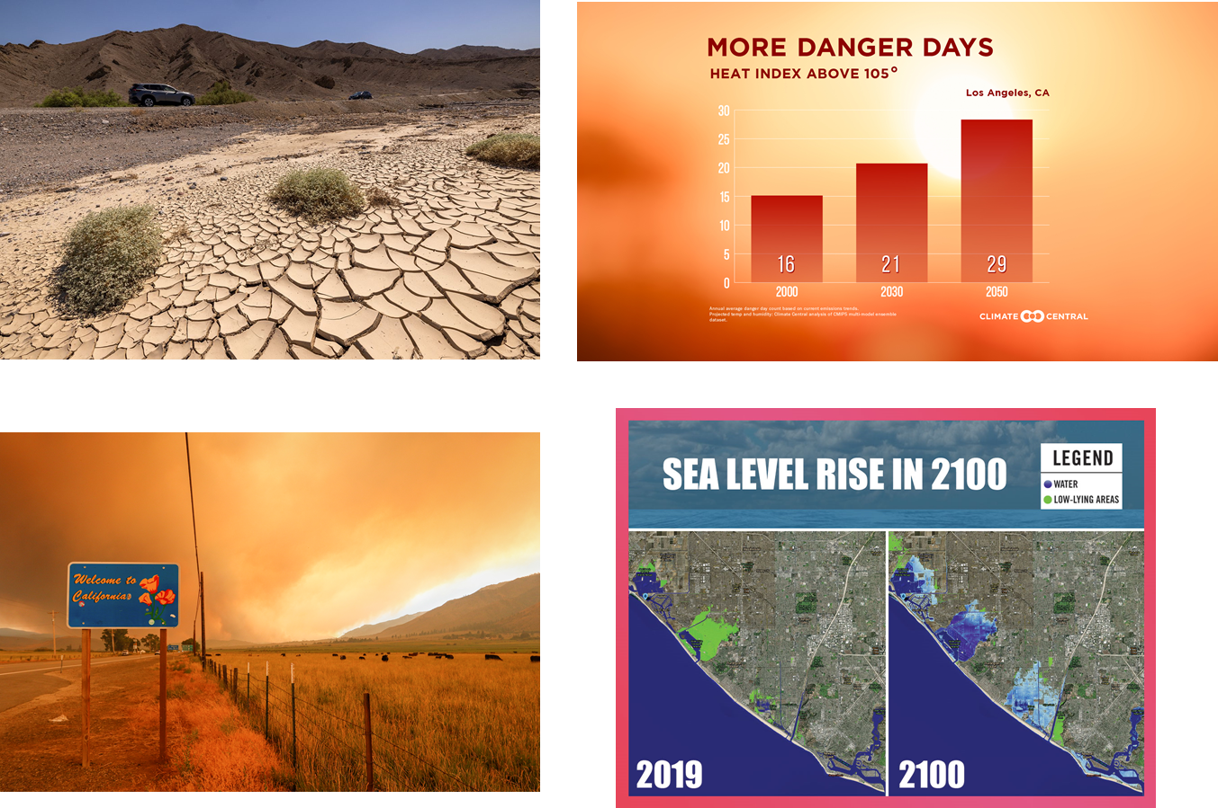
Impacts Beyond Drought

Slide 4
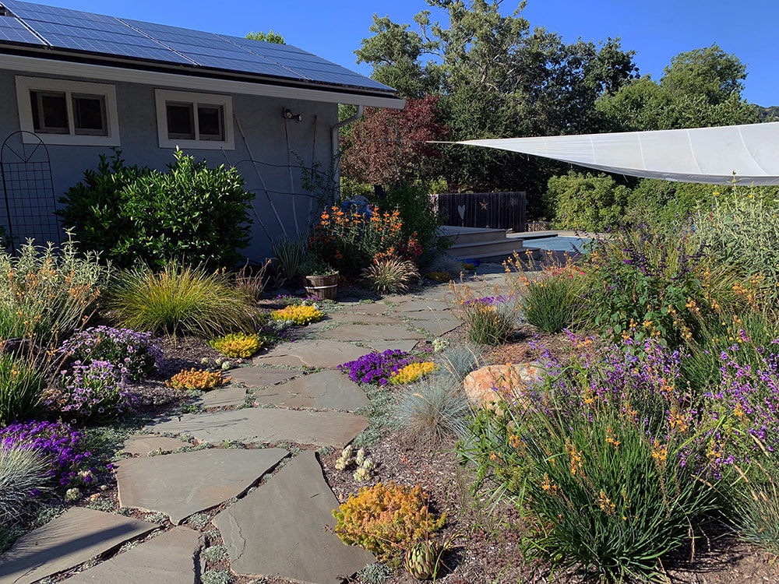
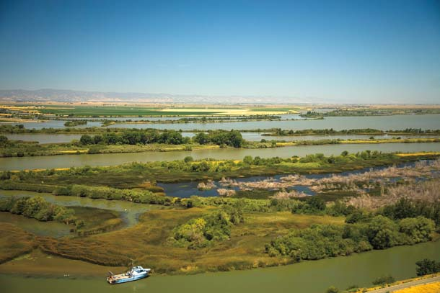
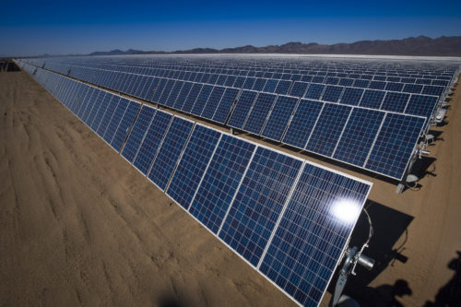
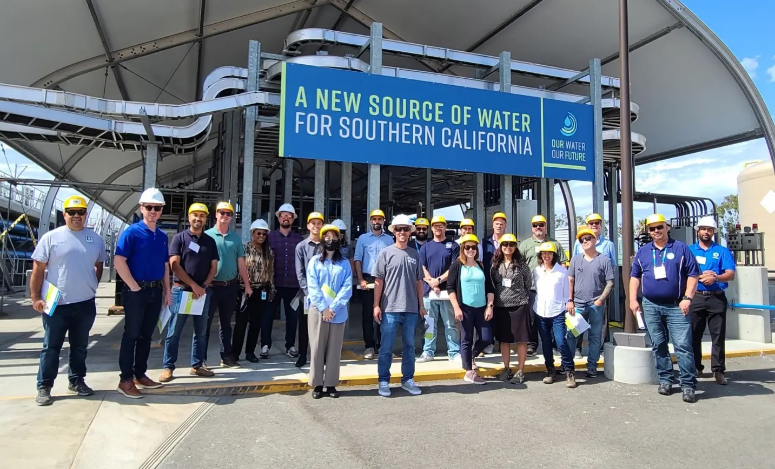
“In the midst of every crisis, lies great opportunity.”
Albert Einstein

Slide 5













Resilience
Increasing Climate Resilience
CLIMATE MITIGATION
Reducing the emissions that cause climate change
CLIMATE ADAPTATION
Addressing the impacts of climate change on Metropolitan
Metropolitan builds climate resilience by continuing to reduce its GHG emissions & by investing to manage more frequent & severe climate hazards.
  Water conservation from turf replacement
  Battery Storage Systems at WTPs
  Phase out natural gas usage
  Increase water storage and banking during wet years
  Replace/ refurbish pumps along CRA
  Incentivize more sustainable commutes
  Operational Flexibility
  Conversion to LED
  ZEV-First Policy & charging infrastructure
  Harden infrastructure & redundancies
  Increase use of renewable energy
  Local water projects to increase supply

Slide 6
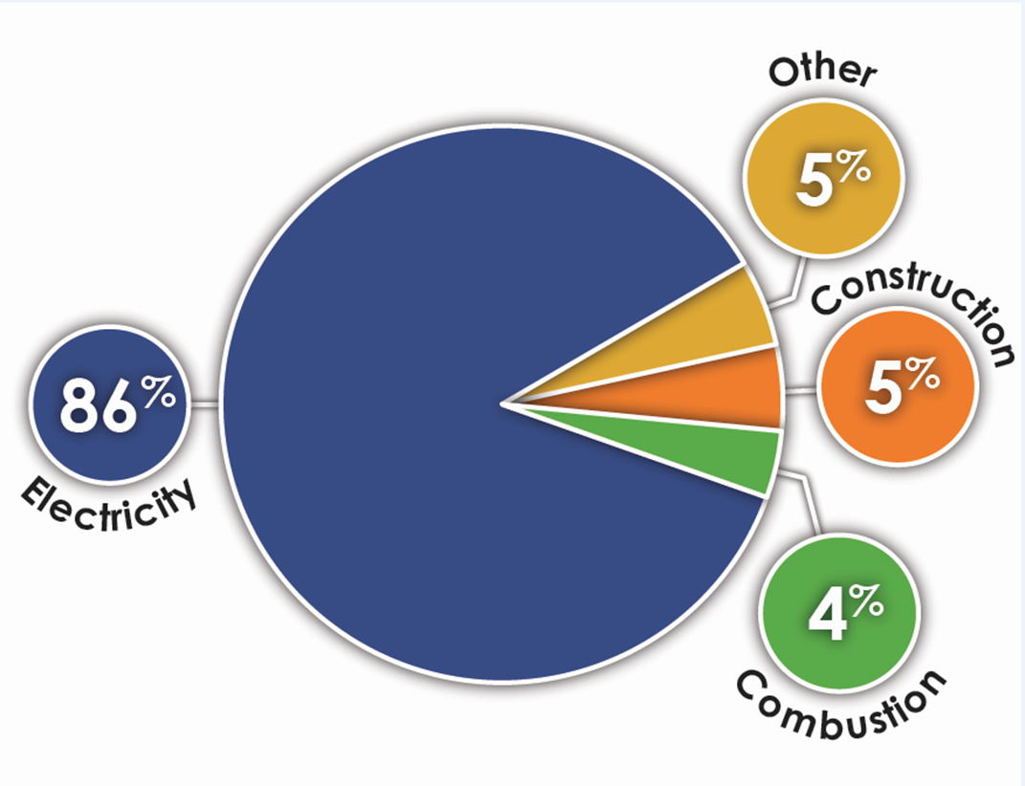
Climate Action Plan GHG Reduction Targets
MWD Emissions by Sector
  Established an emissions target:
  Carbon neutrality by the year 2045
  Interim target to ensure compliance:
  40% below 1990 levels by 2030
MWD GHG Emissions Over Time

Slide 7

Greater Imported Supply Stability
A
B
Scenario planning acknowledges uncertainties
Planning focused on severe climate change; investments based on real-world conditions
Most variability is related to water demands which is impacted by:
  Water use efficiency and behavioral conservation
  Economic conditions
  Weather
  Water use standards and regulations
  Population growth and/or loss
Low Demand Stable Imports
High Demand Stable Imports
Lower Demand on MWD
Higher Demand on MWD
C
D
Severe Climate Change
High Emissions Future
RCP 8.5
Low Demand Reduced Imports
High Demand Reduced Imports
Less Imported Supply Stability
Internally consistent, plausible future conditions
based on the drivers of change

Slide 8
  Mutual Goals of CAMP4W
  Year One Outcomes
  Establish decision-making framework
      Includes climate scenarios, evaluative criteria and project portfolios
  Develop CAMP4W 2045 Roadmap
      Includes GO projects for implementation, policy recommendations, adaptive management framework, business model next steps
Reliability
Financial Sustainability
Resilience
Affordability
Equity

Slide 9

The mission of the Sustainability, Resilience, and Innovation Office is to empower Metropolitan to deliver its core mission by inspiring and implementing solutions that benefit people, nature, and the climate.​

