Slide 1
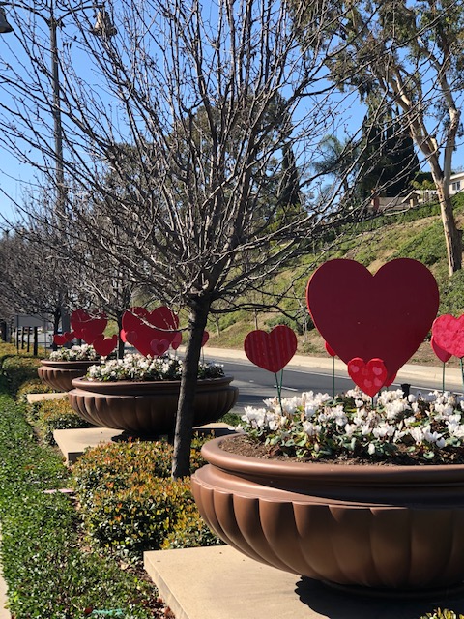
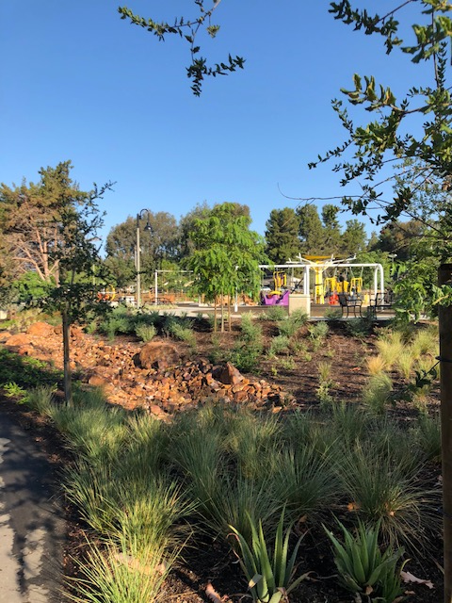
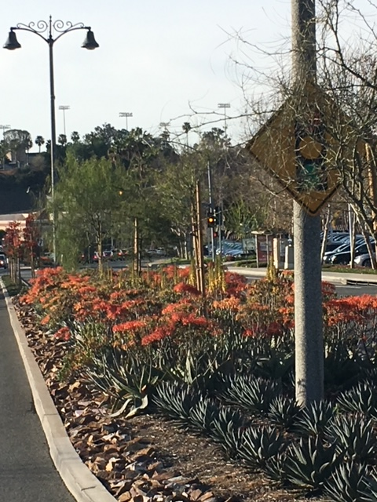
City of Mission Viejo Conservation Projects
Presented By:
Brian Goodell, Council Member
Keith Rattay, Assistant City Manager

Slide 2
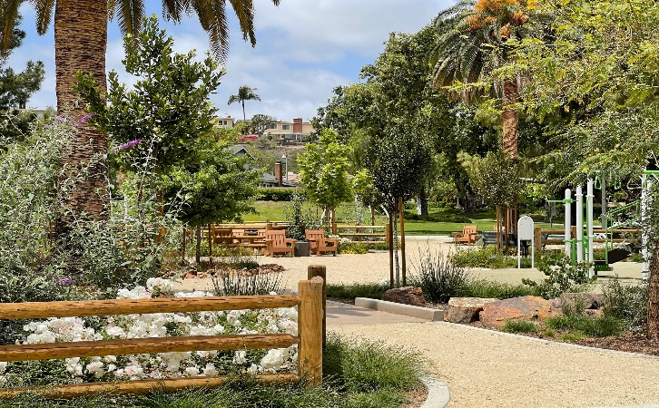
MISSION VIEJO CONSERVATION PROJECTS
MEDIAN ISLANDS
2012 - ½ ACRE OF TURF REMOVAL
2013 - ½ ACRE OF TURF REMOVAL
2014 - ½ ACRE OF TURF REMOVAL
2015 -3 ACRES OF TURF REMOVAL
2016 - 1 ACRE OF TURF REMOVAL
2017 - 1 ACRE OF TURF REMOVAL
2018 - 1 ACRE OF TURF REMOVAL
PARKS
2015 - 2.1 ACRES (SEVERAL PARKS)
2018 - ½ ACRE Cordova Park
2019 - ¾ ACRE Christopher Park
2021 - ¾ ACRE Coronado Park
2022 - .5 ACRES Cultural Arts Center
TOTAL REMOVED - Over 12 Acres of Turf
MISSION VIEJO
AT-A-GLANCE
MISSION VIEJO HAS OVER 1,300 ACRES OF LANDSCAPE AND OPENSPACE
975 ACRES ARE IRRIGATED
- 87% OF THE IRRIGATED ACRES ARE IRRIGATED WITH RECLAIMED WATER

Slide 3
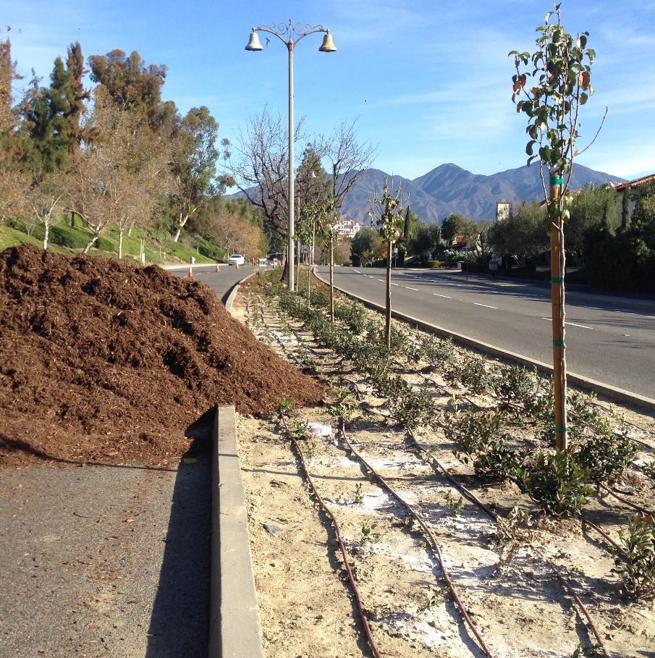
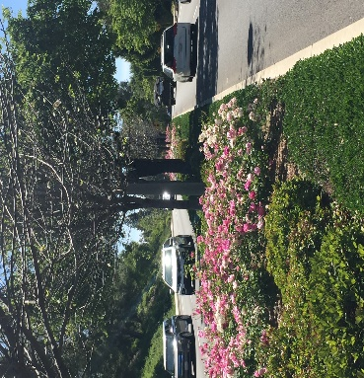
- THE ISLANDS ARE 1O MILES LONG
- TOTAL ACREAGE IS 13 ACRES
- 6.46 ACRES OF TURF REMOVED
- 50 MILES OF NETAFIM DRIP TUBING INSTALLED
- REDUCED RUNOFF AND REDUCTION OF
POLLUTANTS TO MUNICIPAL STORM SEWER
SYSTEM
- RENOVATION OVER 10 YEARS
FEATURED PROJECT
MARGUERITE PARKWAY MEDIAN ISLANDS

Slide 4
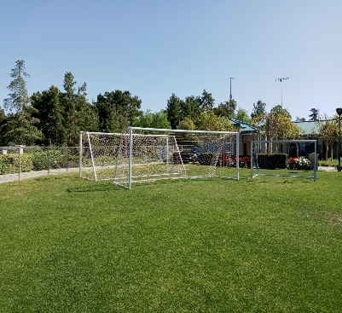
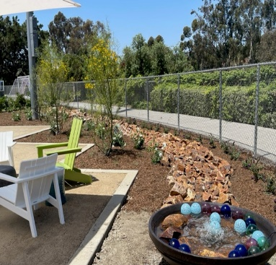
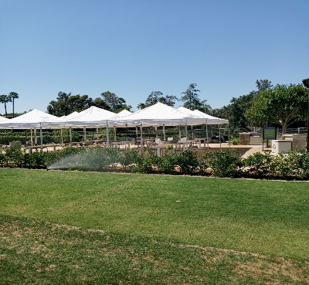
- THE POTOCKI CENTER FOR THE ARTS/WORLD CUP
SOCCER FIELDS TOTAL TURF 5 ACRES
- 1/2 ACRES OF TURF REMOVED
- 800 FT. OF NETAFIM DRIP TUBING INSTALLED
- AREA WAS UNPLAYABLE AND SOCCER GOAL STORAGE
- NEW OUTDOOR CULTURAL CLASSROOM
AND EVENT VENUE
- IRRIGATION WATER CONSUMPTION ELIMINATED
FEATURED
PROJECT
POTOCKI CENTER FOR THE ARTS

Slide 5
The Mission Viejo Program
WATER CONSERVATION
The City of Mission Viejo water conservation program includes managing many aspects of the landscape.
These include working with our contract maintenance staff to ensure irrigation systems are turned on weekly, managing and reducing runoff, detecting and addressing leaks, selecting low water consuming plants and mulching all planting beds twice a year. Additionally, a Citywide cloud based irrigation system has been implemented.
363
60
12
Irrigation Meters City-Wide
Miles of Point Source Tubing
Acres of Turf Removed
Mission Viejo aggressively manages water applications to ensure runoff is reduced. All systems are turned on each week to check coverage.
Mission Viejo has installed over 60 miles of Point Source Tubing “drip-tubing,” and is continuously looking for ways to irrigate using this product via continuous retrofitting.
Mission Viejo continues to aggressively look for turf removal throughout the community and makes it a priority each year to reduce unused turf.

Slide 6
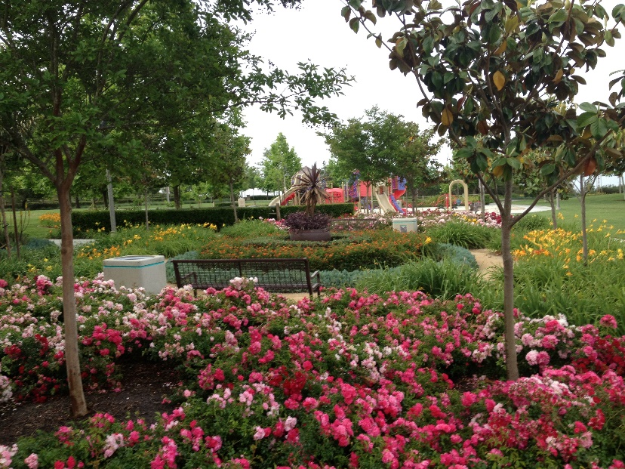
Our Gallery
About Gallery
THE MISSION VIEJO LANDSCAPE AND WATER CONSERVATION PROGRAM STRIVES TO REDUCE WATER CONSUMPTION, USING ORGANIC PRODUCTS WHEN APPROPRIATE, TO CREATE A DYNAMIC, BOLD AND COLORFUL LANDSCAPED ENVIRONMENT.

