Slide 1
Not all Turf is Created Equal: The why, where, and how to replacing non-functional turf with California Friendly Landscaping
Krista Guerrero
Water Efficiency Team
Metropolitan Water District of Southern California

Slide 2
Metropolitan Overview

Slide 3
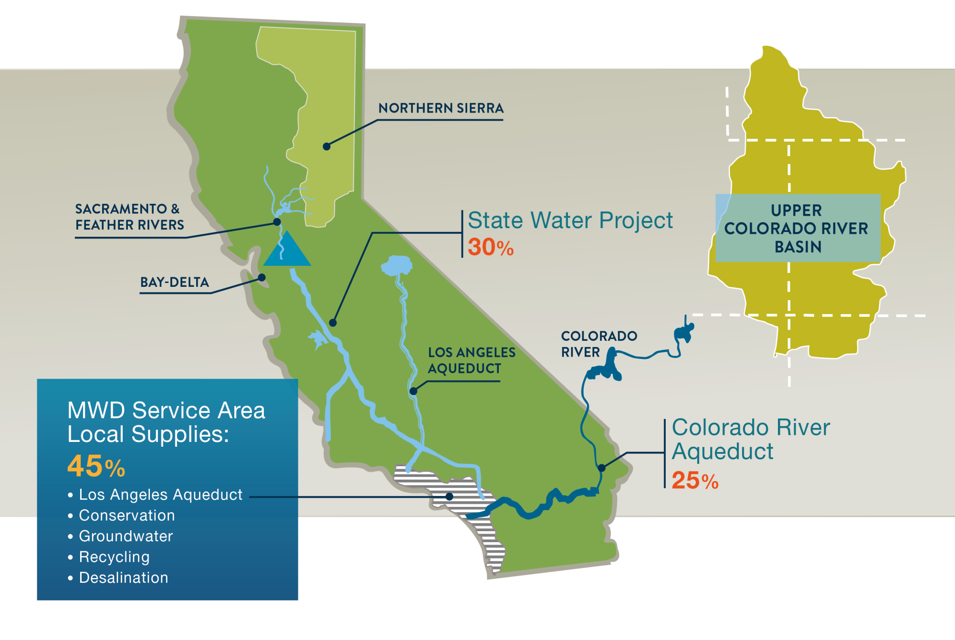
Sources of Water for Southern California

Slide 4
The Why
socalwatersmart.com

Slide 5
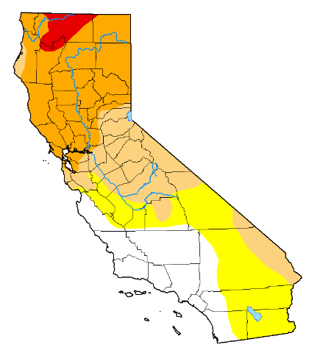
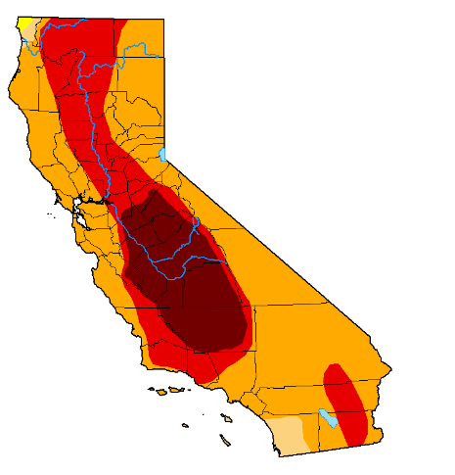
Yes, We are in a Drought!
U.S. Drought Monitor
(Aug 23, 2022; Data valid: Aug 25 at 8 a.m. EST)
August 25, 2020
August 23, 2022
ABNORMAL
MODERATE
SEVERE
EXTREME
EXCEPTIONAL

Slide 6
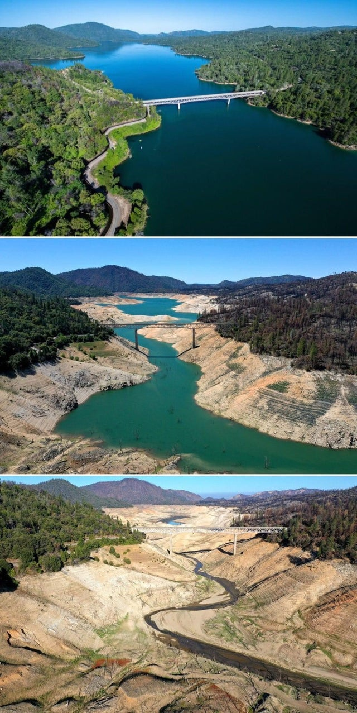
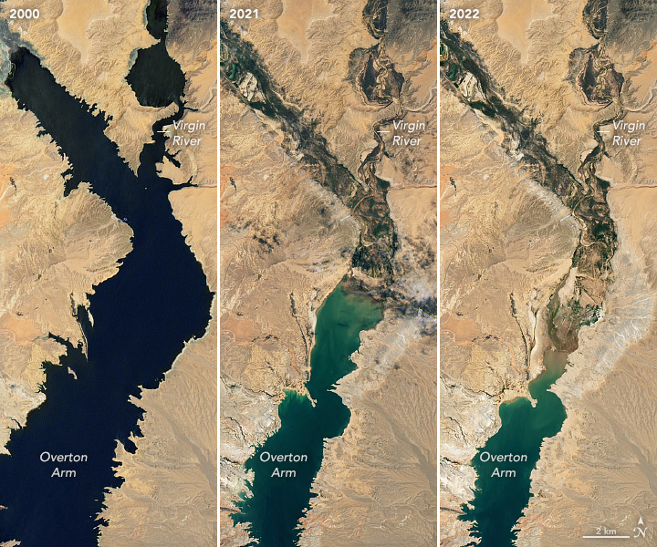
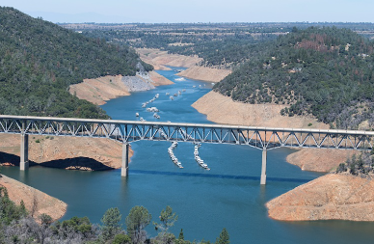
Yes, We are in a Drought!
State Water Project
Colorado River Basin
2018
Spring 2021
Spring 2022

Slide 7
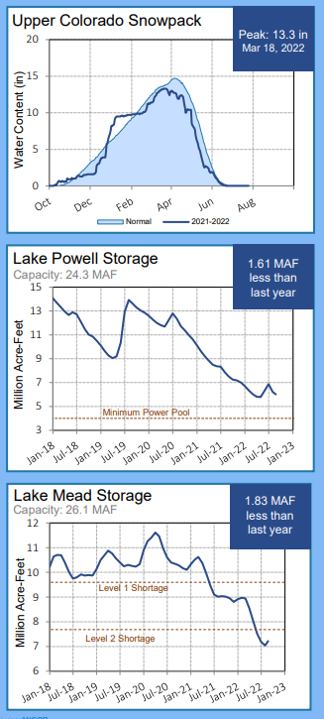
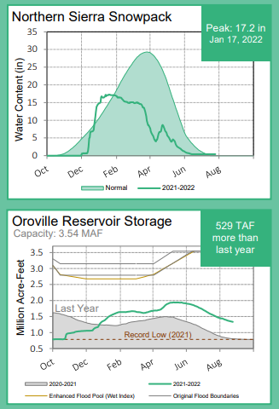
Colorado River Basin
Yes, We are in a Drought!
State Water Project

Slide 8
Drought Response
October 19, 2021
Gov Newsom declares statewide drought
November 9, 2021
MWD Board declares regional drought emergency
March 28, 2022
Gov Newsom calls for local water suppliers to move to Level 2 of their Water Shortage Contingency Plans
May 24, 2022
State Water Resources Control Board bans irrigating non-functional turf at CII properties with potable water
April 26, 2022
MWD Board declares first ever Water Shortage Emergency and approves Emergency Conservation Program
June 1, 2022
MWD Emergency Conservation Program begins
June 10, 2022
Statewide ban on irrigation of non-functional with potable water for CII turf begins. State enforced.
June 14, 2022
Reclamation Commissioner Camille Touton calls for Colorado River Basin states to conserve 2-4 million AF of water in 2023 to preserve elevations in Lake Mead and Lake Powell Reservoirs

Slide 9
What The Ban Means For You
Emergency Regulation - expires June 10, 2023
Only applies to NFT irrigated with potable water
Includes HOA areas except:
Community gathering spaces / recreation areas
Front yard residential areas irrigated by HOA
Enforced by SWRCB
Municipality/water agency enforcement is voluntary
socalwatersmart.com

Slide 10
Current Efforts: Colorado River
MWD signed a MOU on August 24, 2022
Signatories promise to:
Introduce a program to reduce the quantity of non-functional turf grass by 30% through replacement with drought- and climate-resilient landscaping, while maintaining vital urban landscapes and tree canopies that benefit our communities, wildlife, and the environment
MWD Board Resolution encouraging municipalities to ban irrigation of NFT with potable water
socalwatersmart.com

Slide 11
The Where
socalwatersmart.com

Slide 12
Finding NFT On Your Property
Turf areas:
Not used for recreation or community gathering purposes
Sloped areas
Medians / parkways / other small turf areas
Neighborhood entrances and sign areas
Areas with significant irrigation runoff
Areas around buildings / pools
socalwatersmart.com

Slide 13
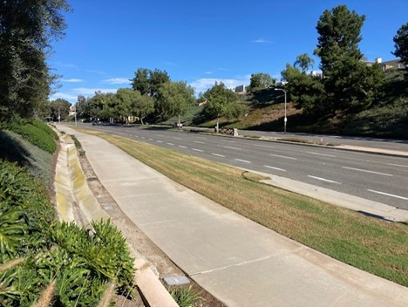
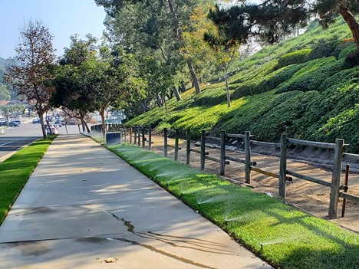

Slide 14
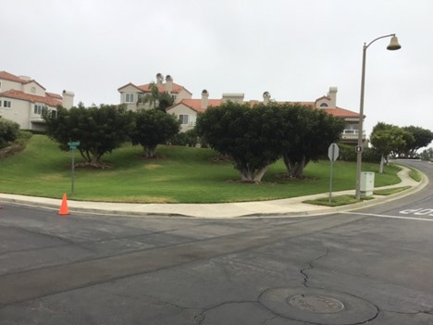
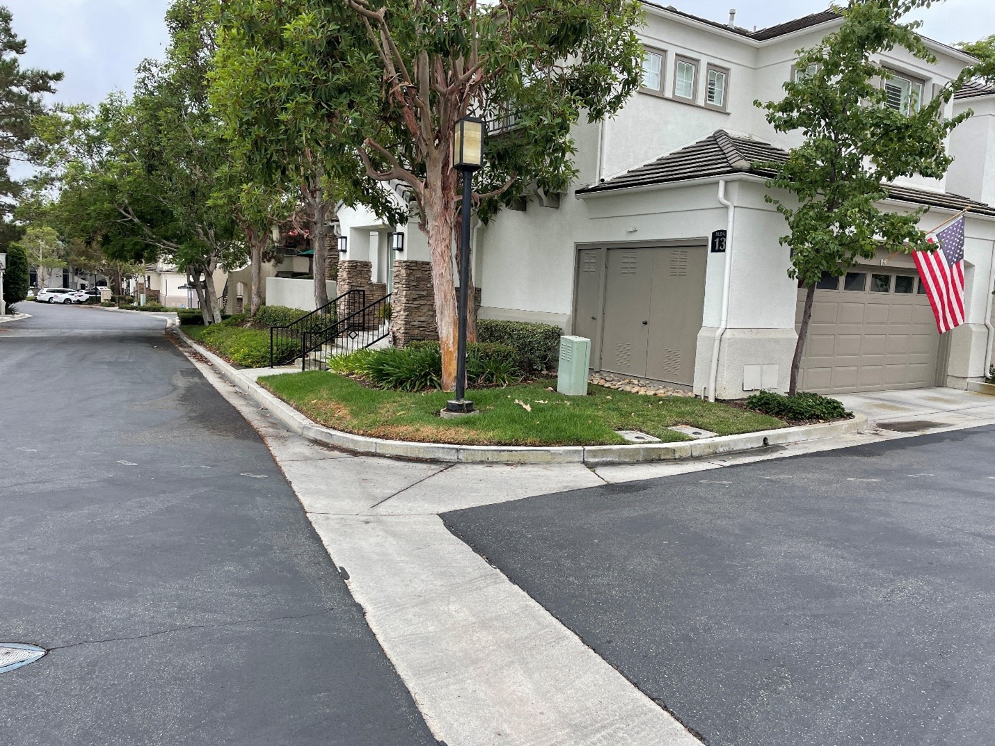
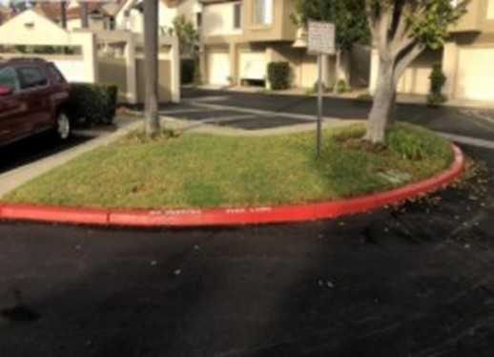

Slide 15
The How
socalwatersmart.com

Slide 16
Turf Replacement Program
Multi-pronged approach to maximize water utilization and conservation
Incorporates watershed components to retain stormwater
Incentives available for residential, commercial and public agency customers
200
Million
Square-Feet
Removed
8 Billion
Gallons Saved
Per Year
socalwatersmart.com

Slide 17
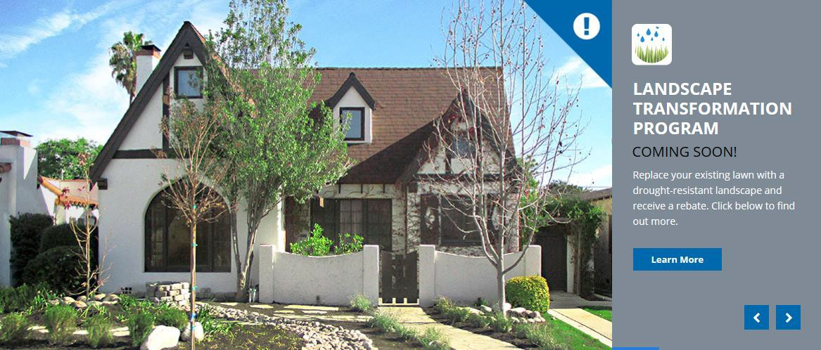
Turf Replacement Program
Customer Type | Incentive | Max Square Footage Per Meter Per Year
Residential | $2/square foot | 5,000 square feet
Commercial |  | 50,000 square feet
Public Agency | $3/square foot | 200,000 square feet
socalwatersmart.com

Slide 18
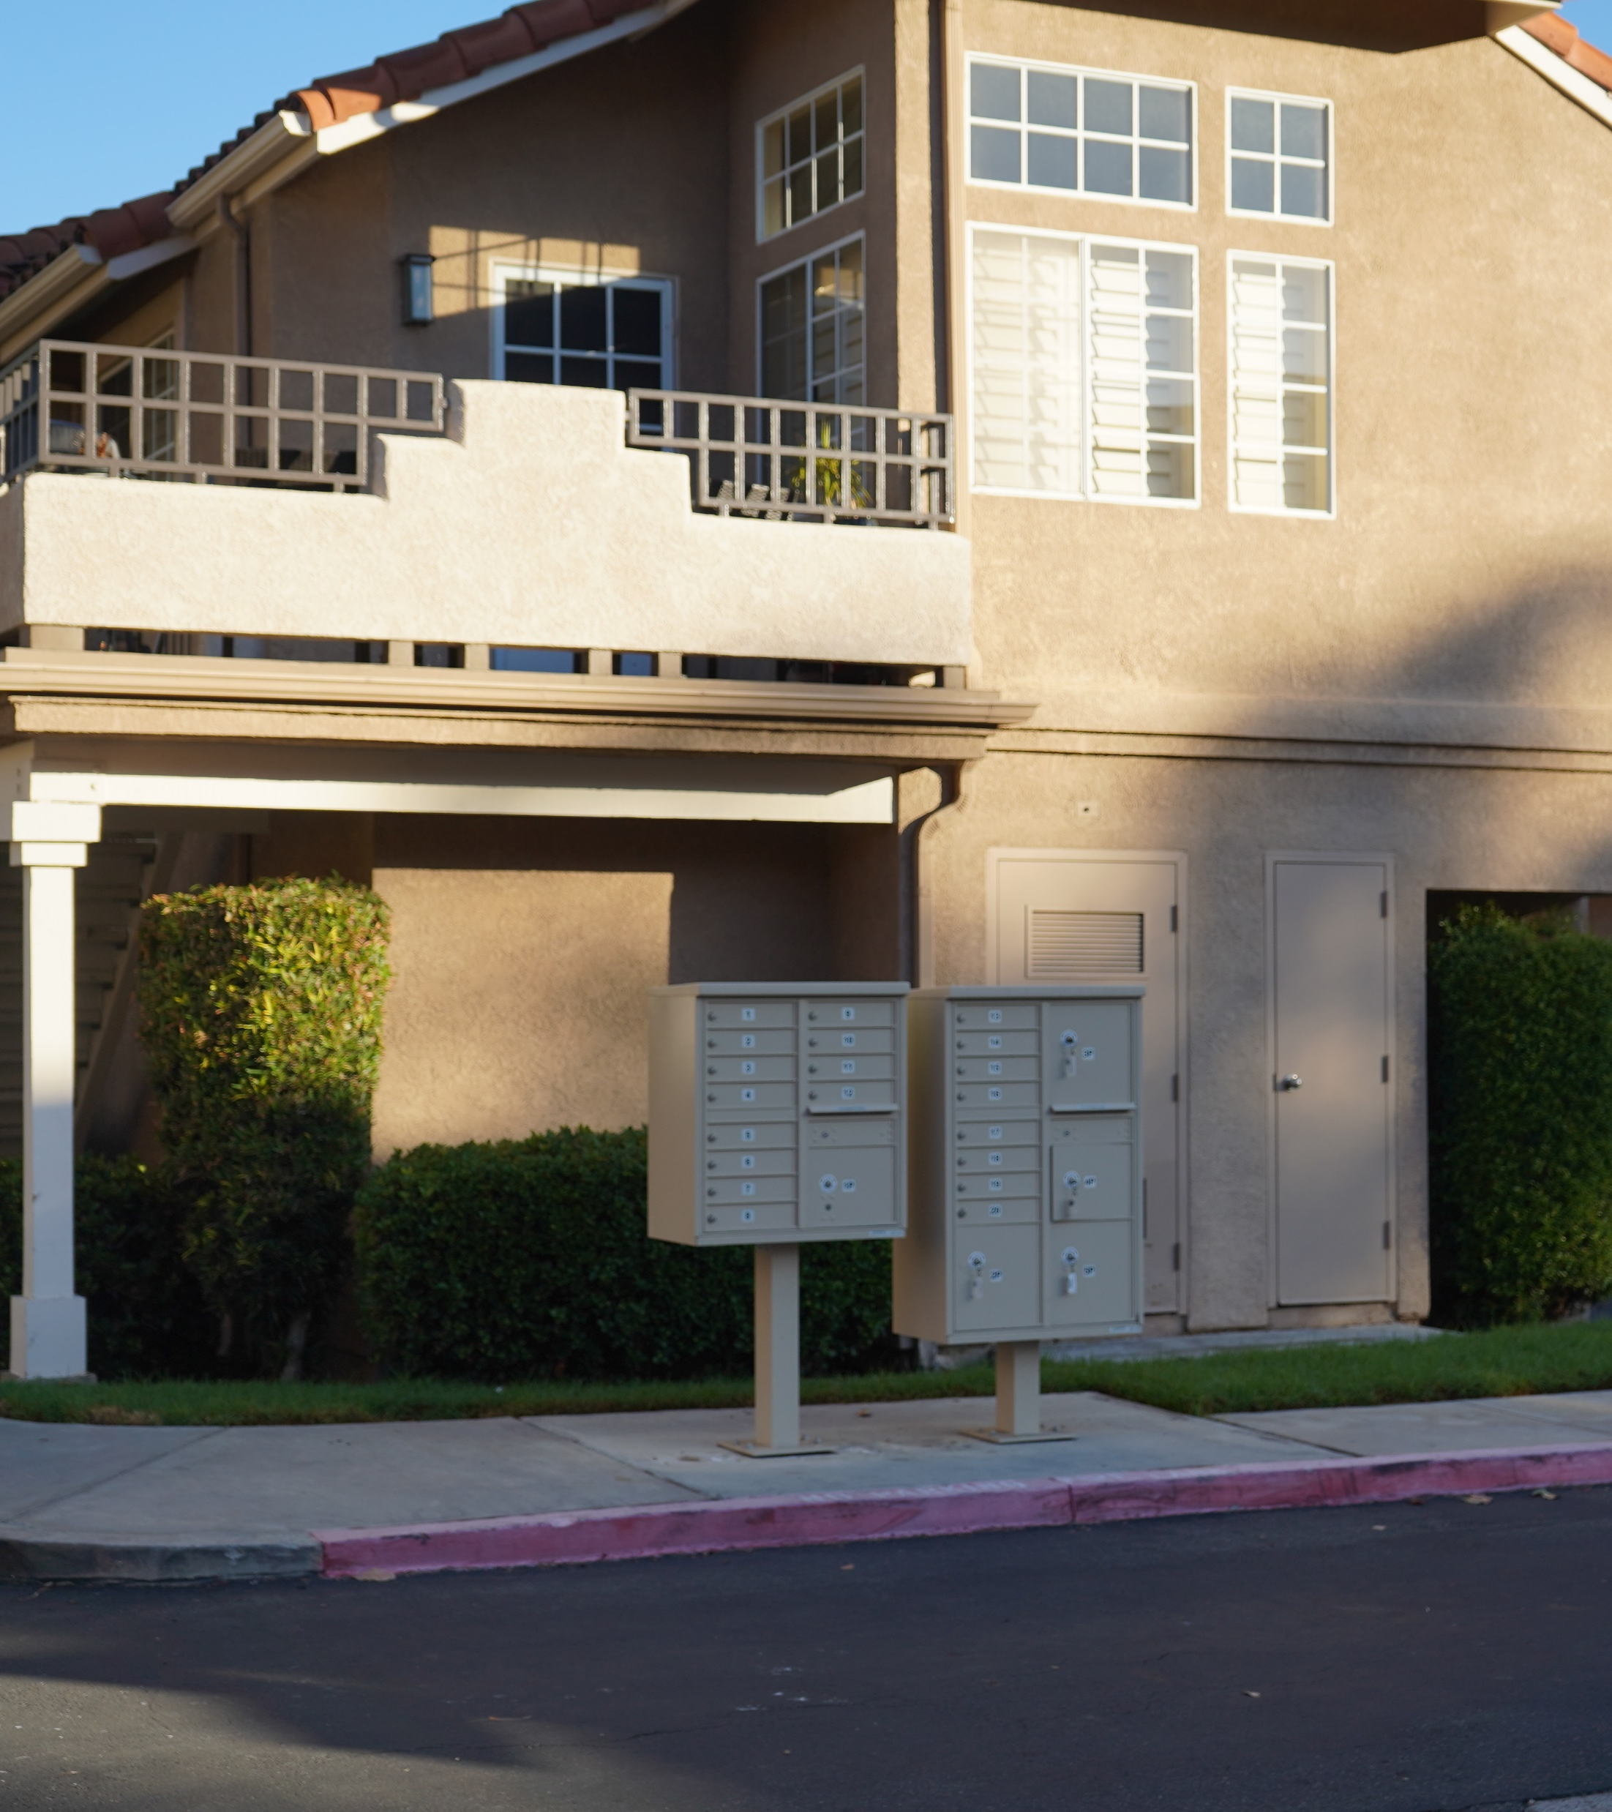
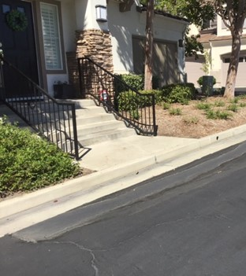

Slide 19
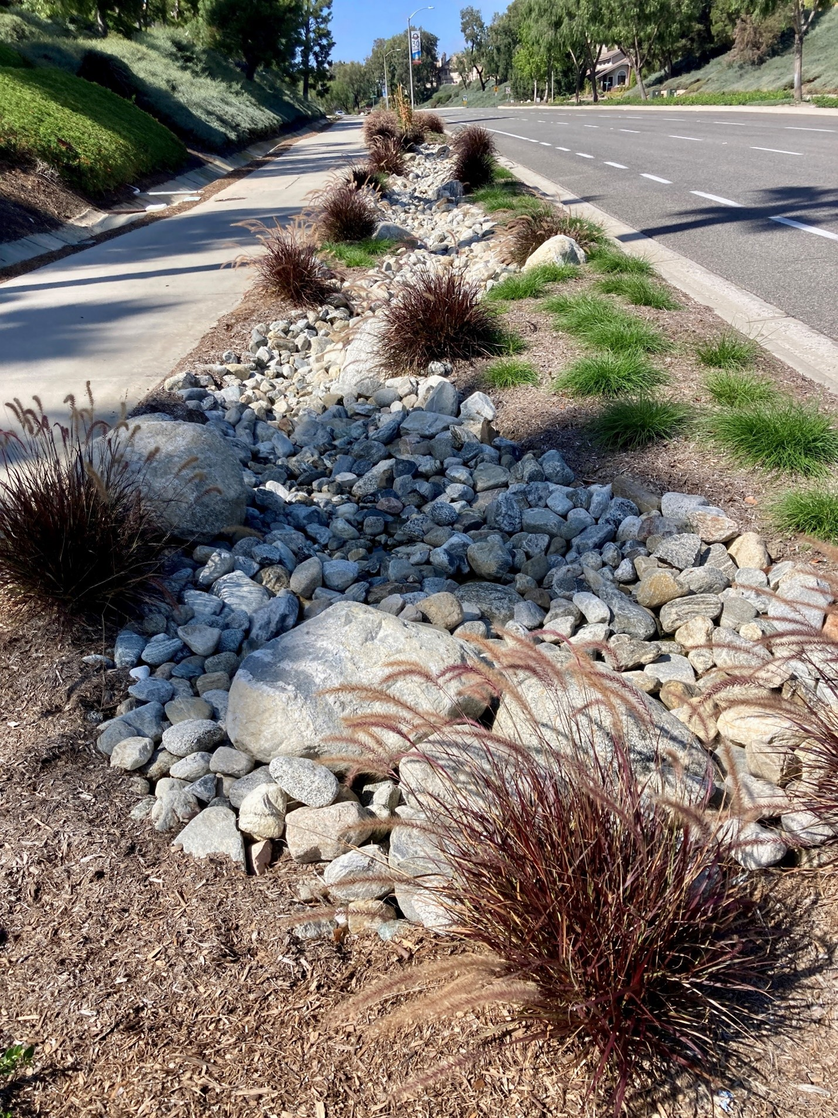

Slide 20
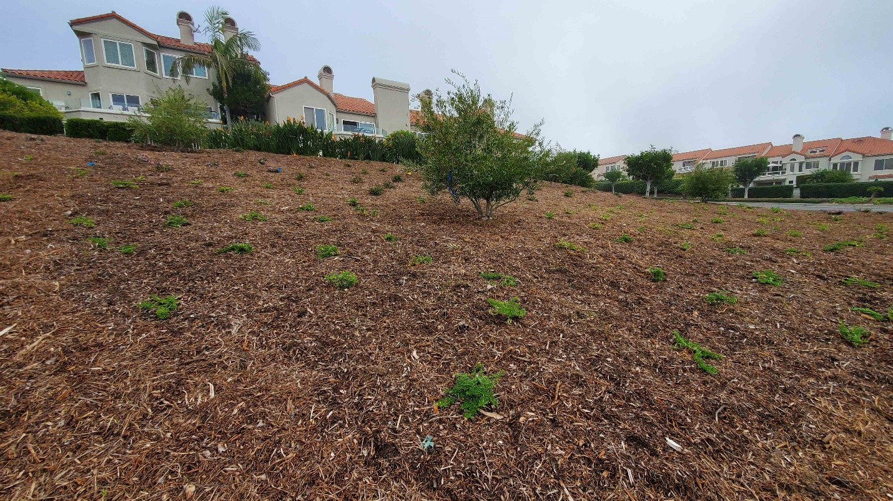

Slide 21
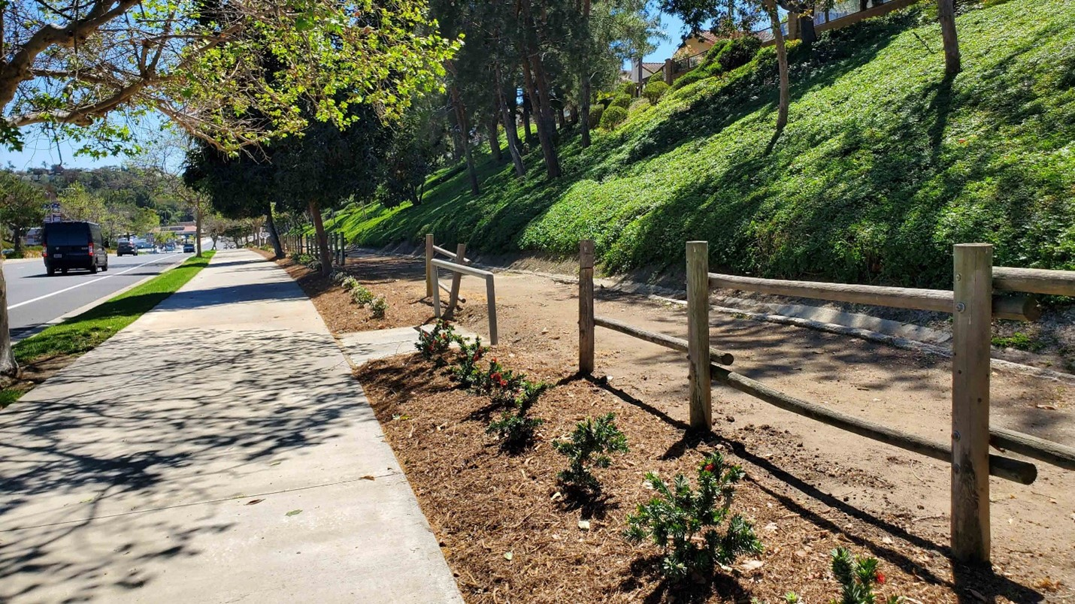

Slide 22
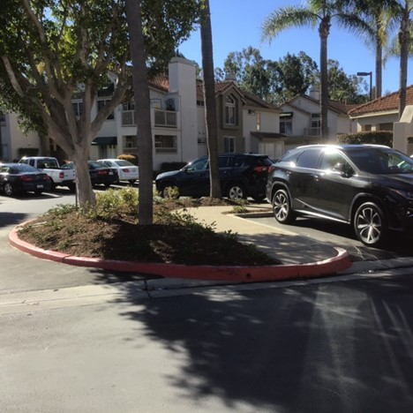

Slide 23
Additional Landscaping Resources
Monthly Maintenance Checklist (Collaboration with TreePeople)
Maintaining a Healthy Landscape During a Drought
California Friendly ® Landscape Maintenance Guide
The Waterwise Garden Guidebook
Top 10 California Friendly ® Plant List
50 Favorites for California Friendly ® Landscapes
Quick Tips for a California Friendly ® Garden
How to Make a Rain Garden
Municipal Guides for Waterwise Gardening
Taking the First Step for a California Friendly ® Garden
Resources available at:

Slide 24
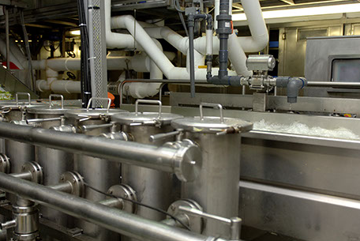
Water Savings Incentive Program (WSIP)
MWD’s Pay for Performance Program
Encourages long-term water management
Incentivizes non-residential, customized projects that aren’t standard rebates (examples):
Retrofits of existing equipment
Industrial process improvements
Agricultural and Landscape Irrigation System Improvements
Water Management Services

Slide 25
WSIP Incentive
Provides funding for up to 50% of eligible projects costs
Up to $0.60 per 1,000 gallons saved per year, up to 10 years
Payments are phased after implementation and monitoring (proof of savings)
Eligible Costs |  | Ineligible Costs
Audit | Equipment | Direct Labor
Engineering | Materials | Sales Tax
Software | Shipping | Permitting
Hardware | 3rd Party Labor | Environmental Compliance
Construction | Contract Water Management Services | Land Acquisition

Slide 26
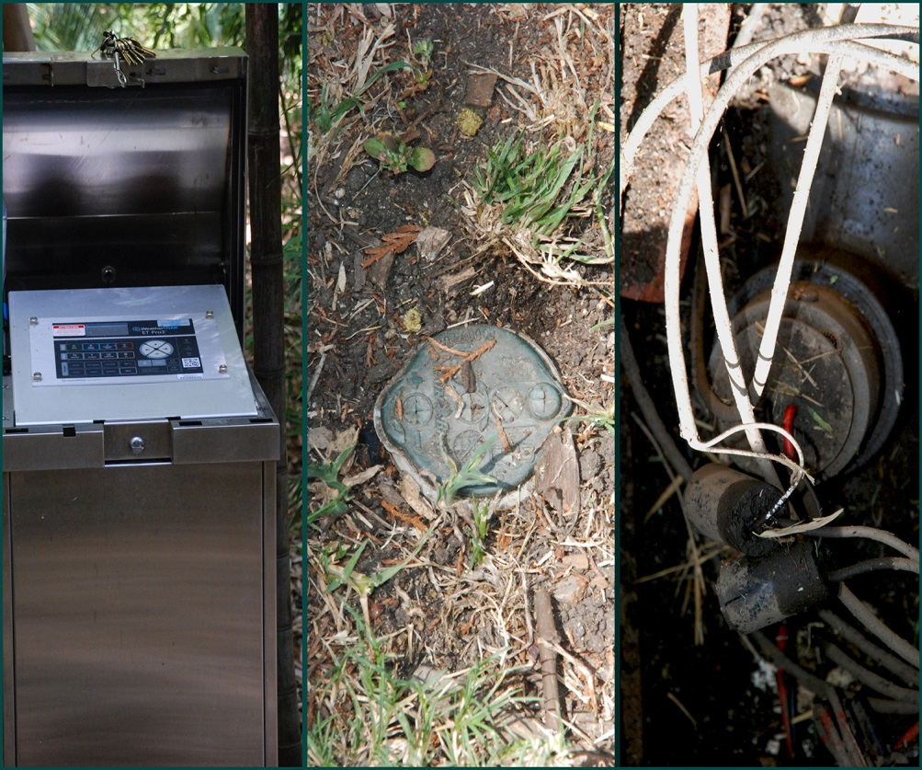
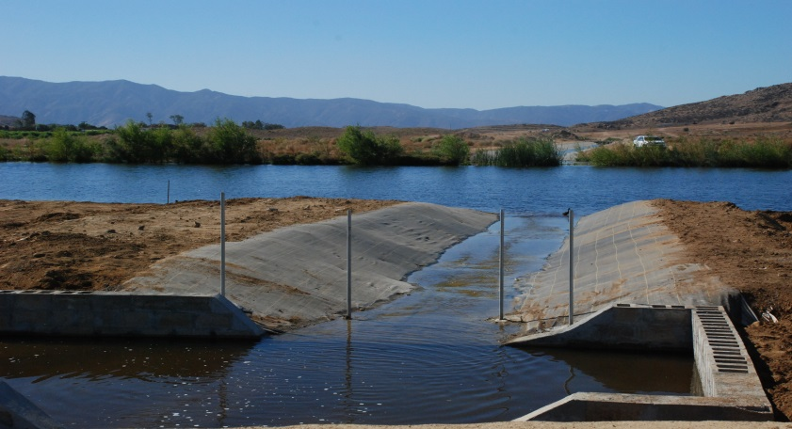
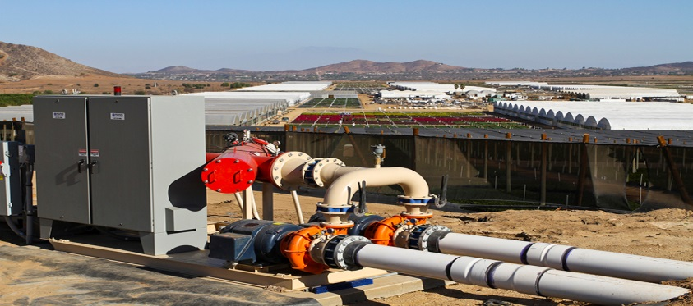
Landscape/Agriculture WSIP Projects
LA County Arboretum
Altman Specialty Plants
Irrigation System Upgrades
650 AF Saved /year = 35.5 million gallons/year
$141,000.00
Capture, Treat and Reuse Nursery Runoff
3,421 AF Saved /year = 111 million gallons/year
$458,000.00

Slide 27
Krista Guerrero kguerrero@mwdh2o.com

