Slide 1
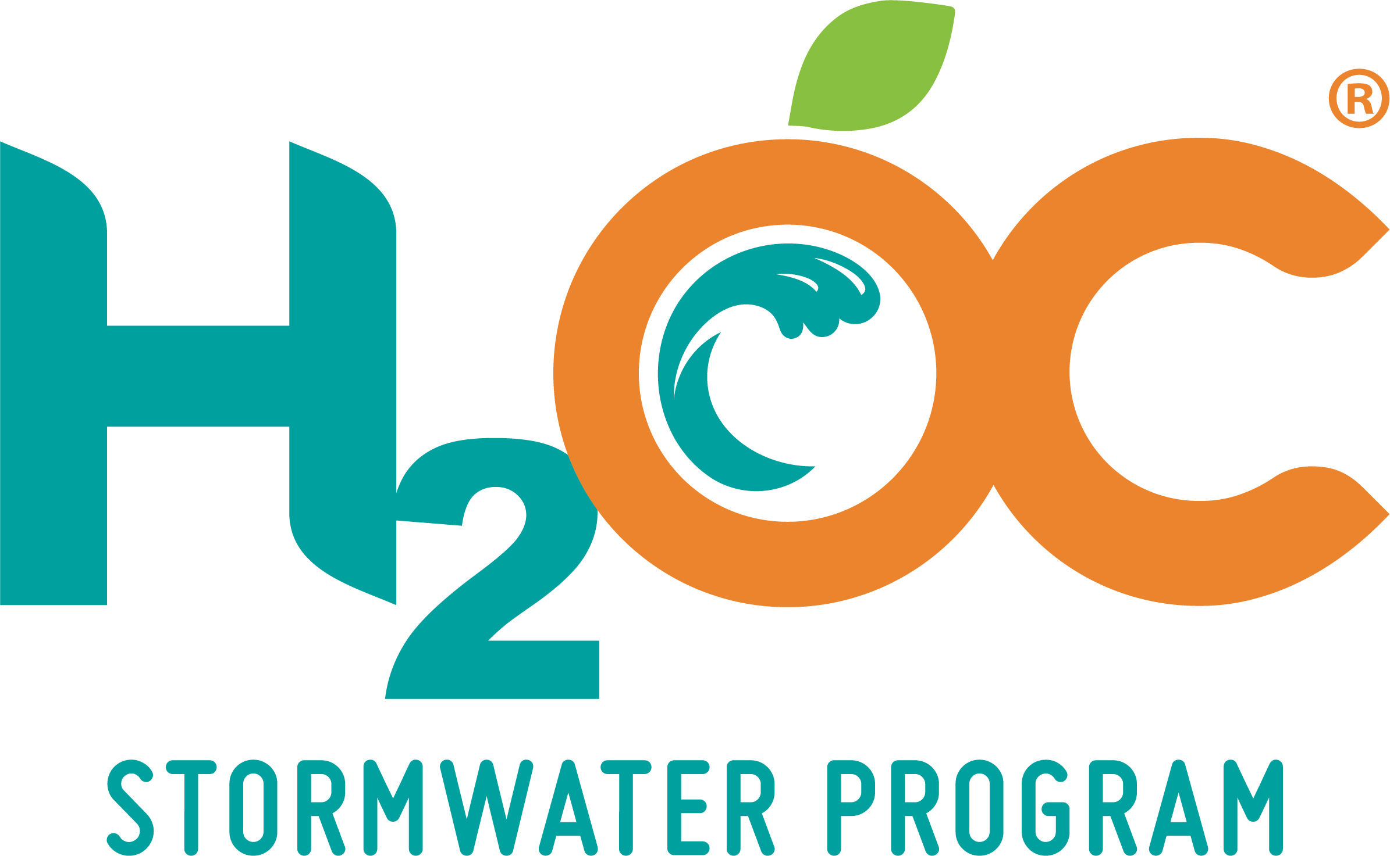
How HOAs can Protect Water Quality through Efficiency
Andrew McGuire
County of Orange – OC Watersheds
H2O for HOAs
October 11, 2022

Slide 2
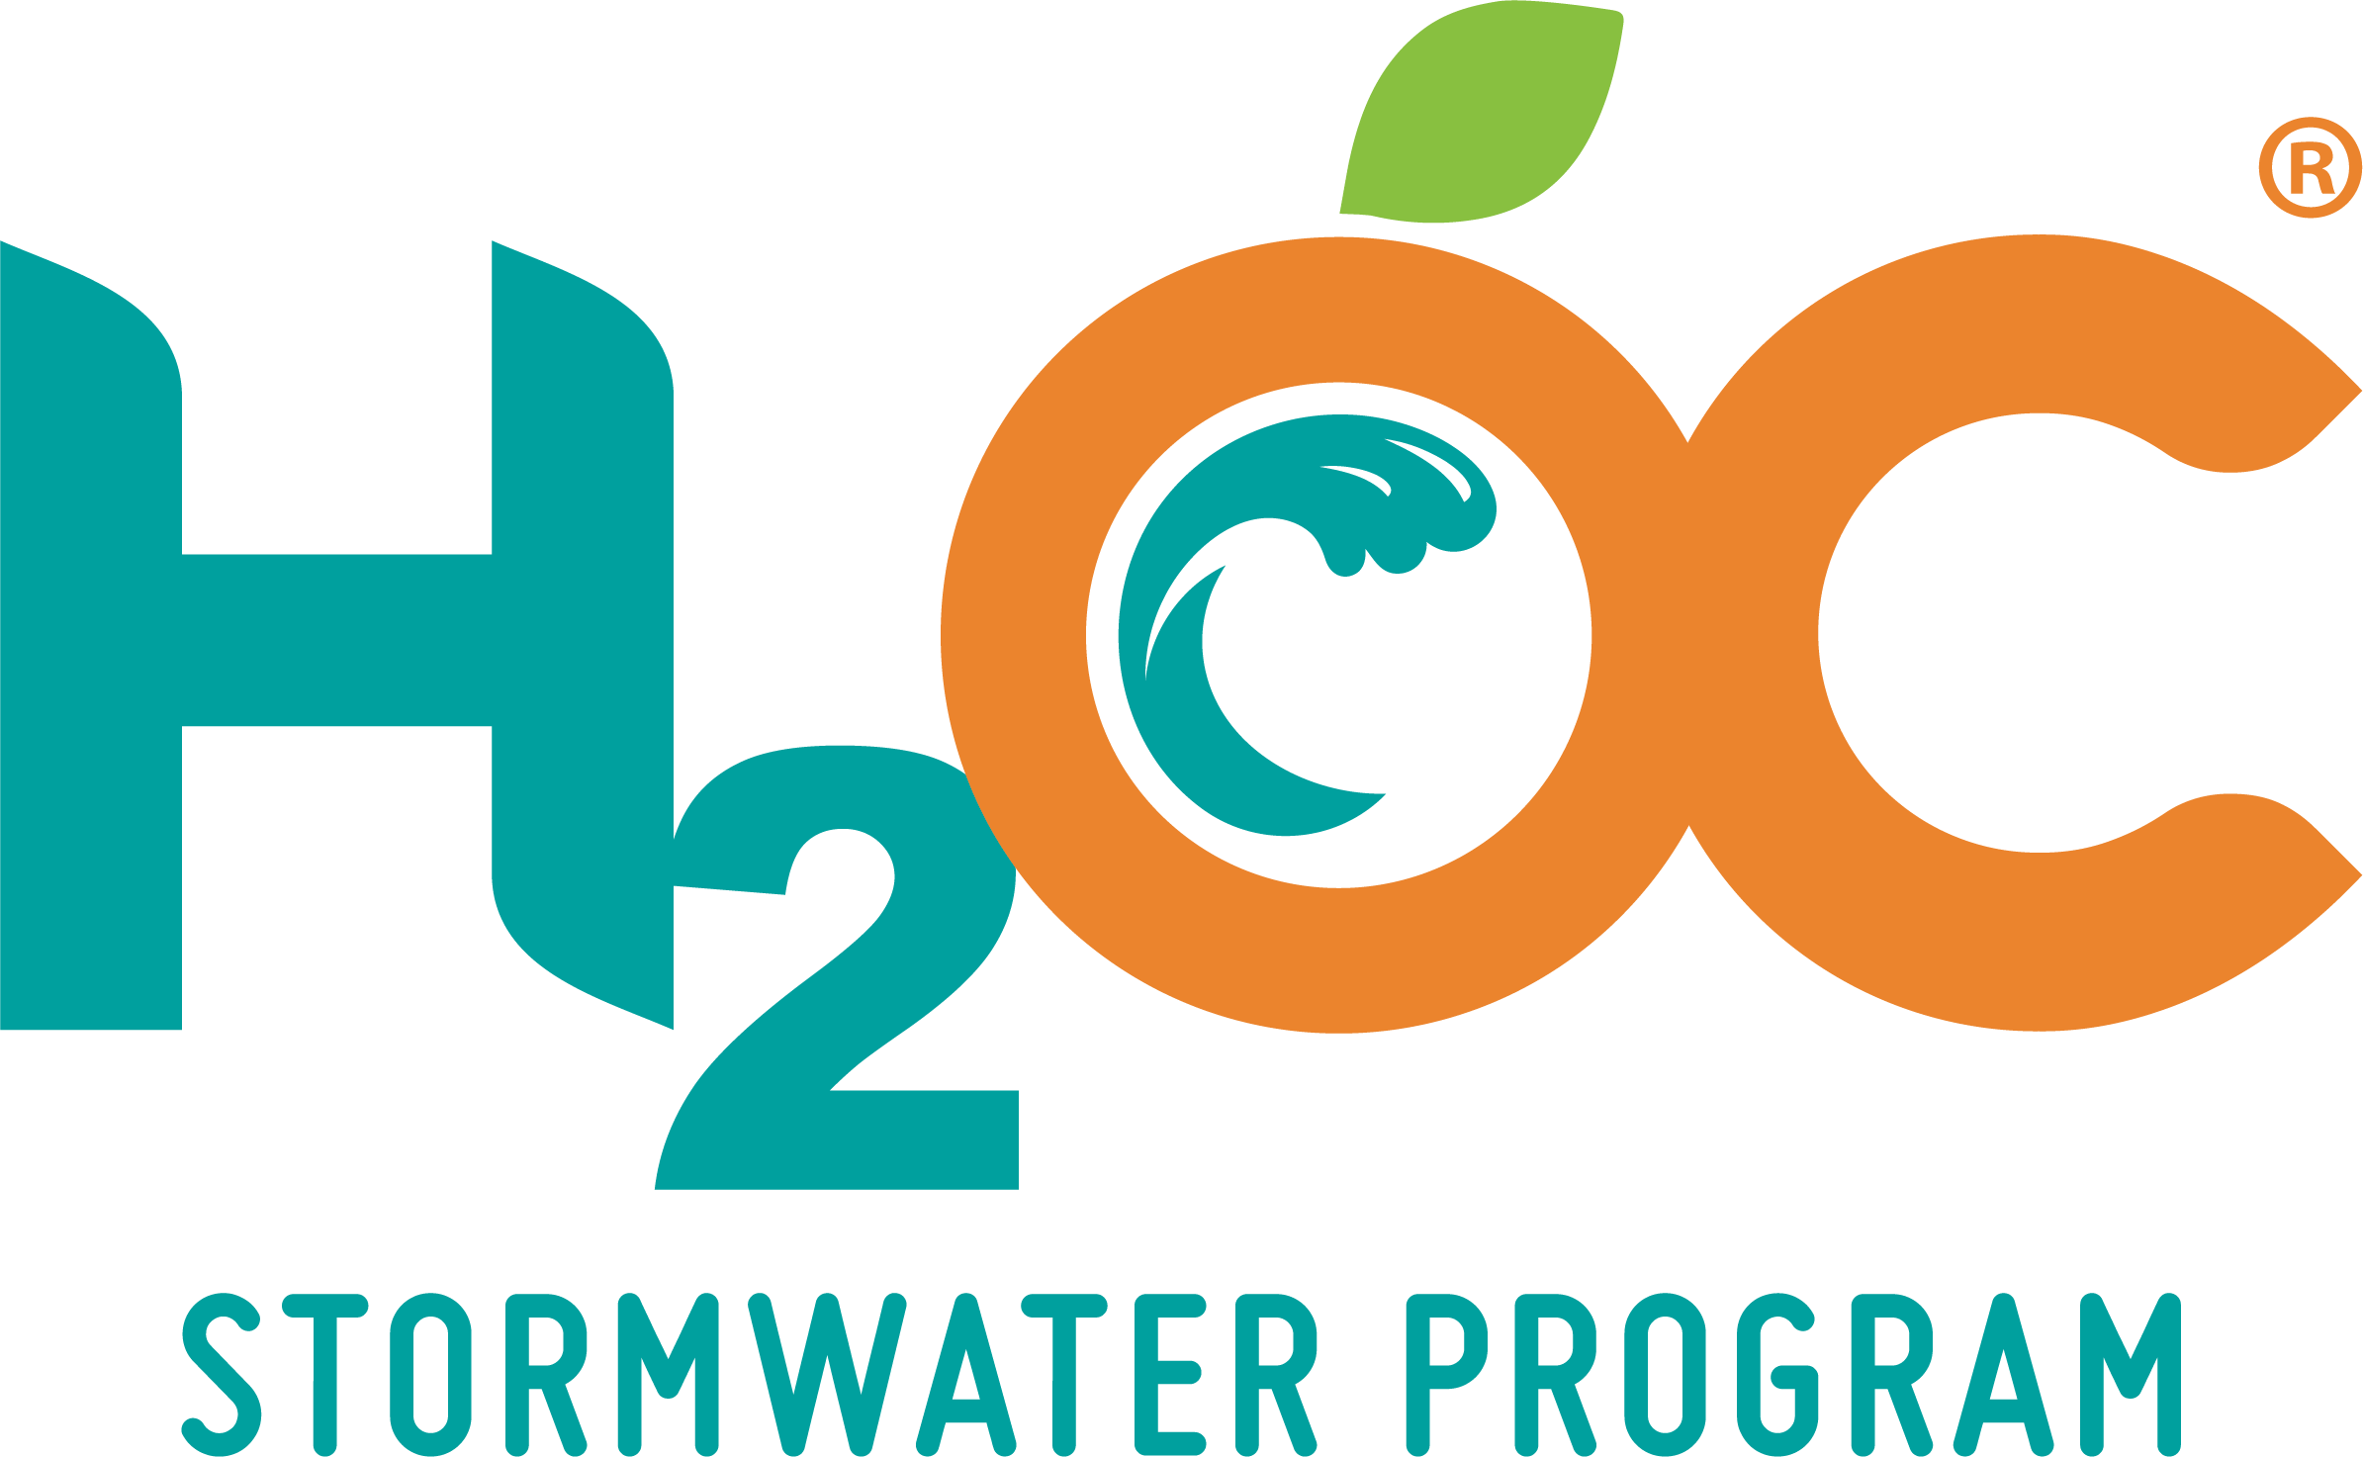
OC Stormwater Program (H₂OC)
Protects surface water quality and maintains compliance with National Pollution Discharge Elimination System Permits through stormwater and urban runoff management
Cooperative Effort
All 34 cities in Orange County
County of Orange
Orange County Flood Control District

Slide 3
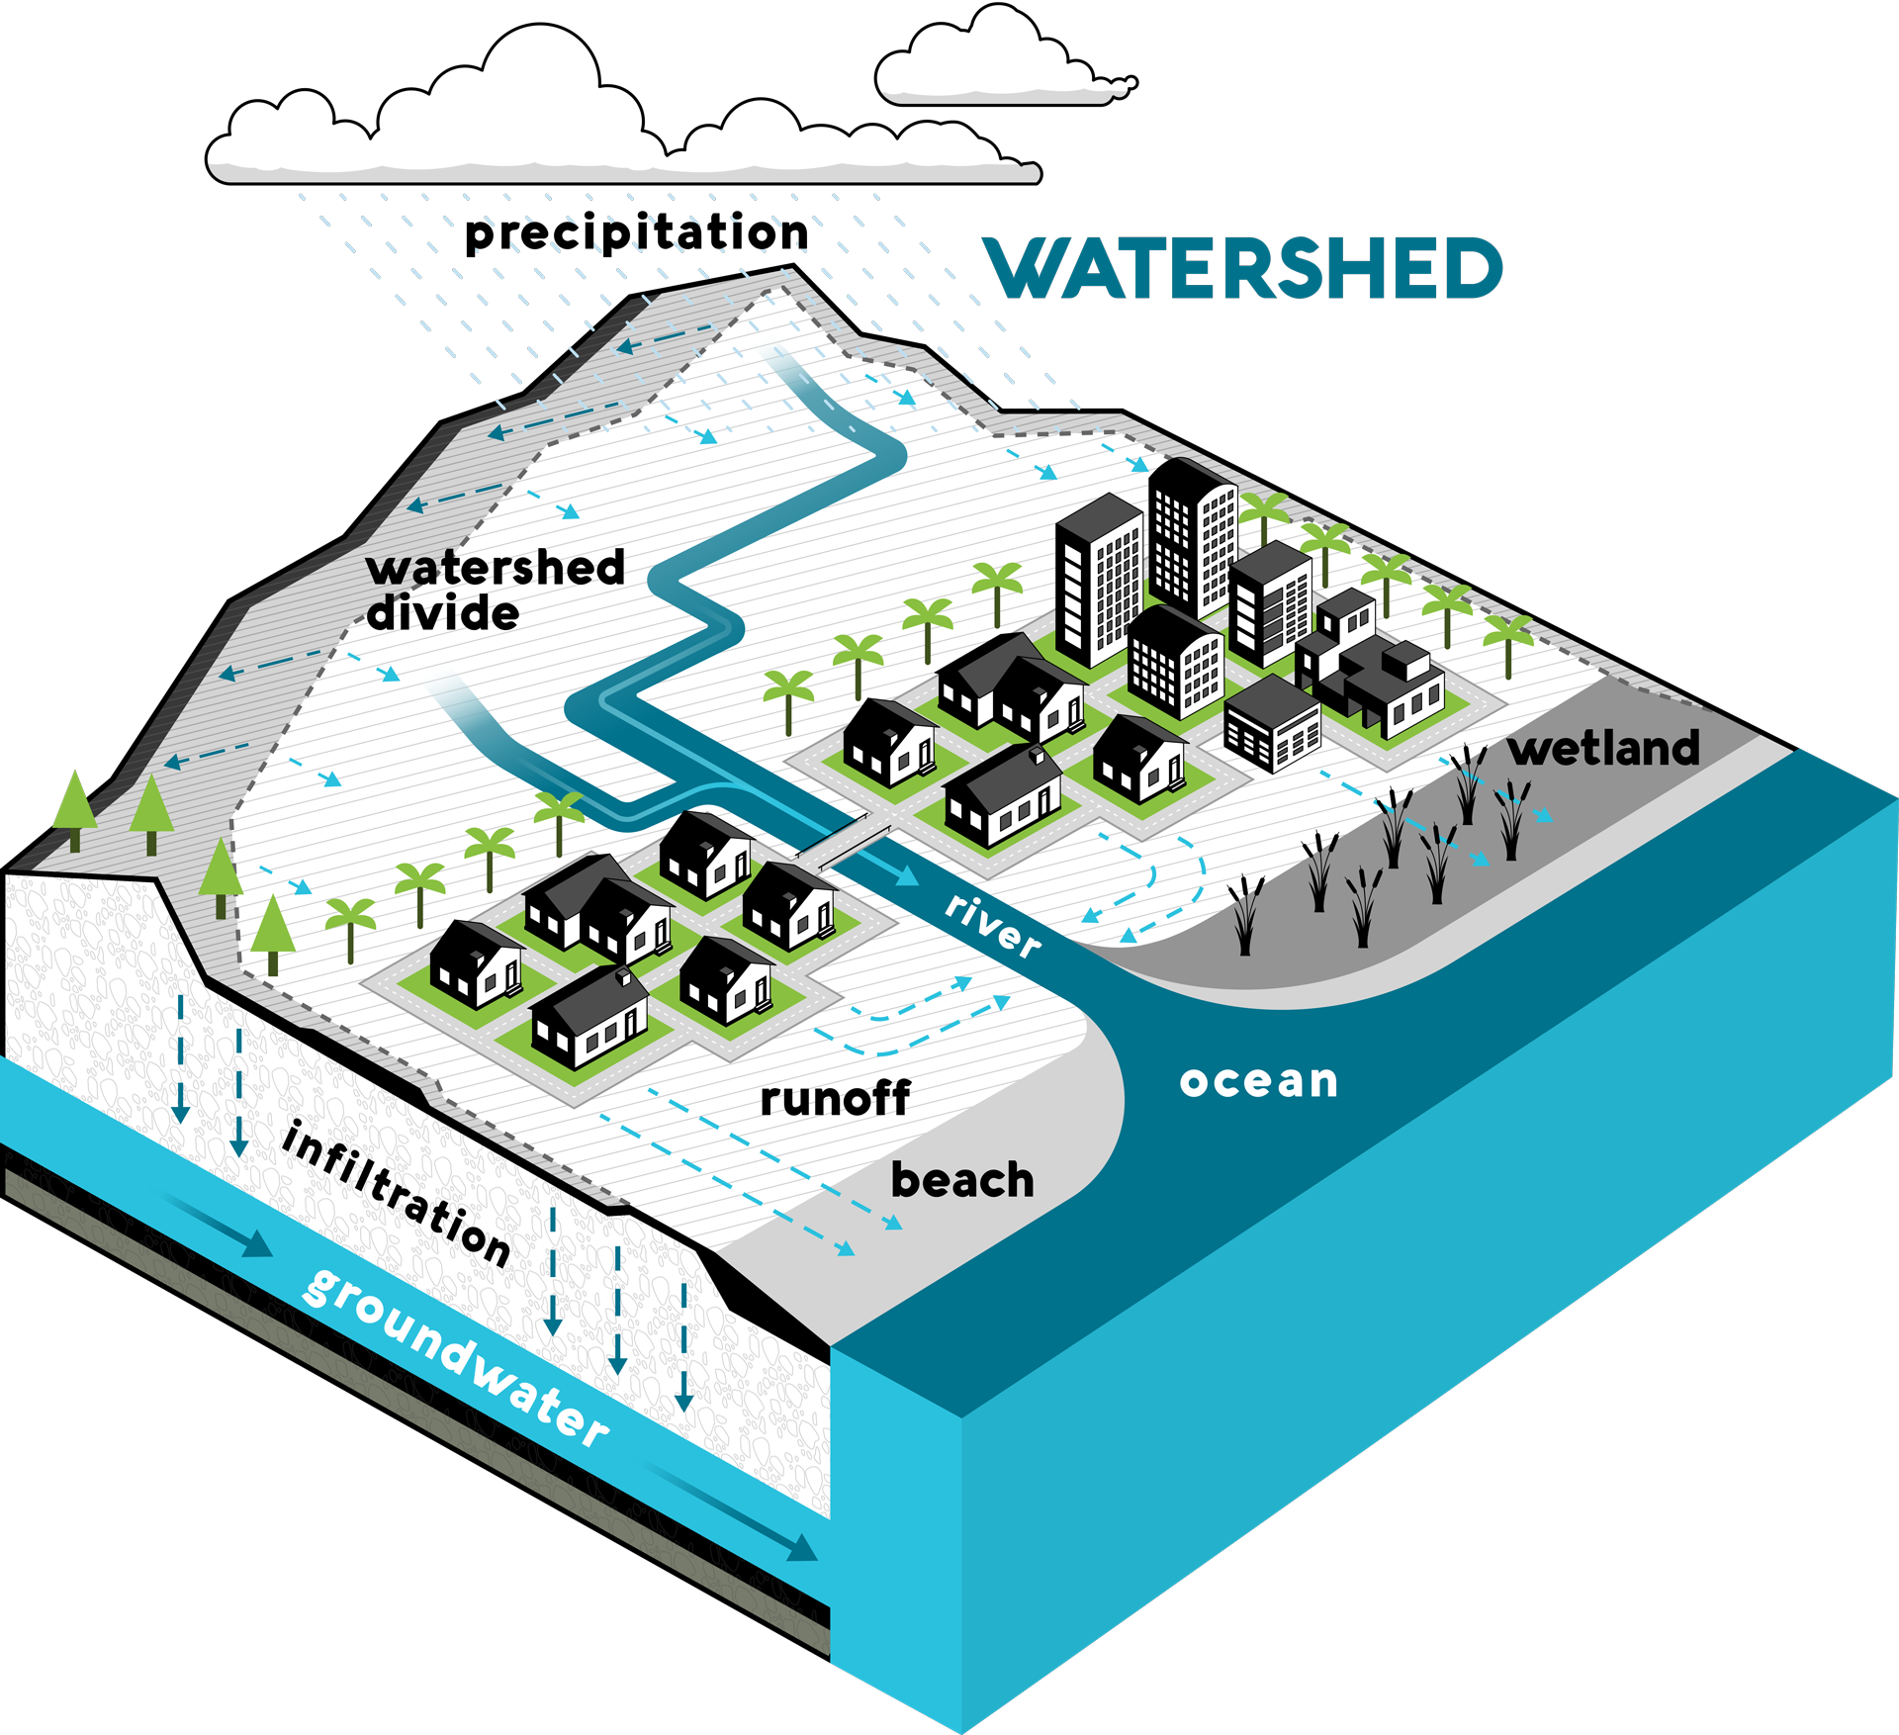
Protecting Our Water Resources
Water quality is more than a coastal issue
Pollution is picked up by stormwater and urban runoff and transported through watersheds to our receiving waters via the storm drain system
A watershed is an area of land that channels rainfall to creeks, rivers, bays, and the ocean
Notes:
The quality of our surface waters is a reflection of how we treat our watersheds

Slide 4
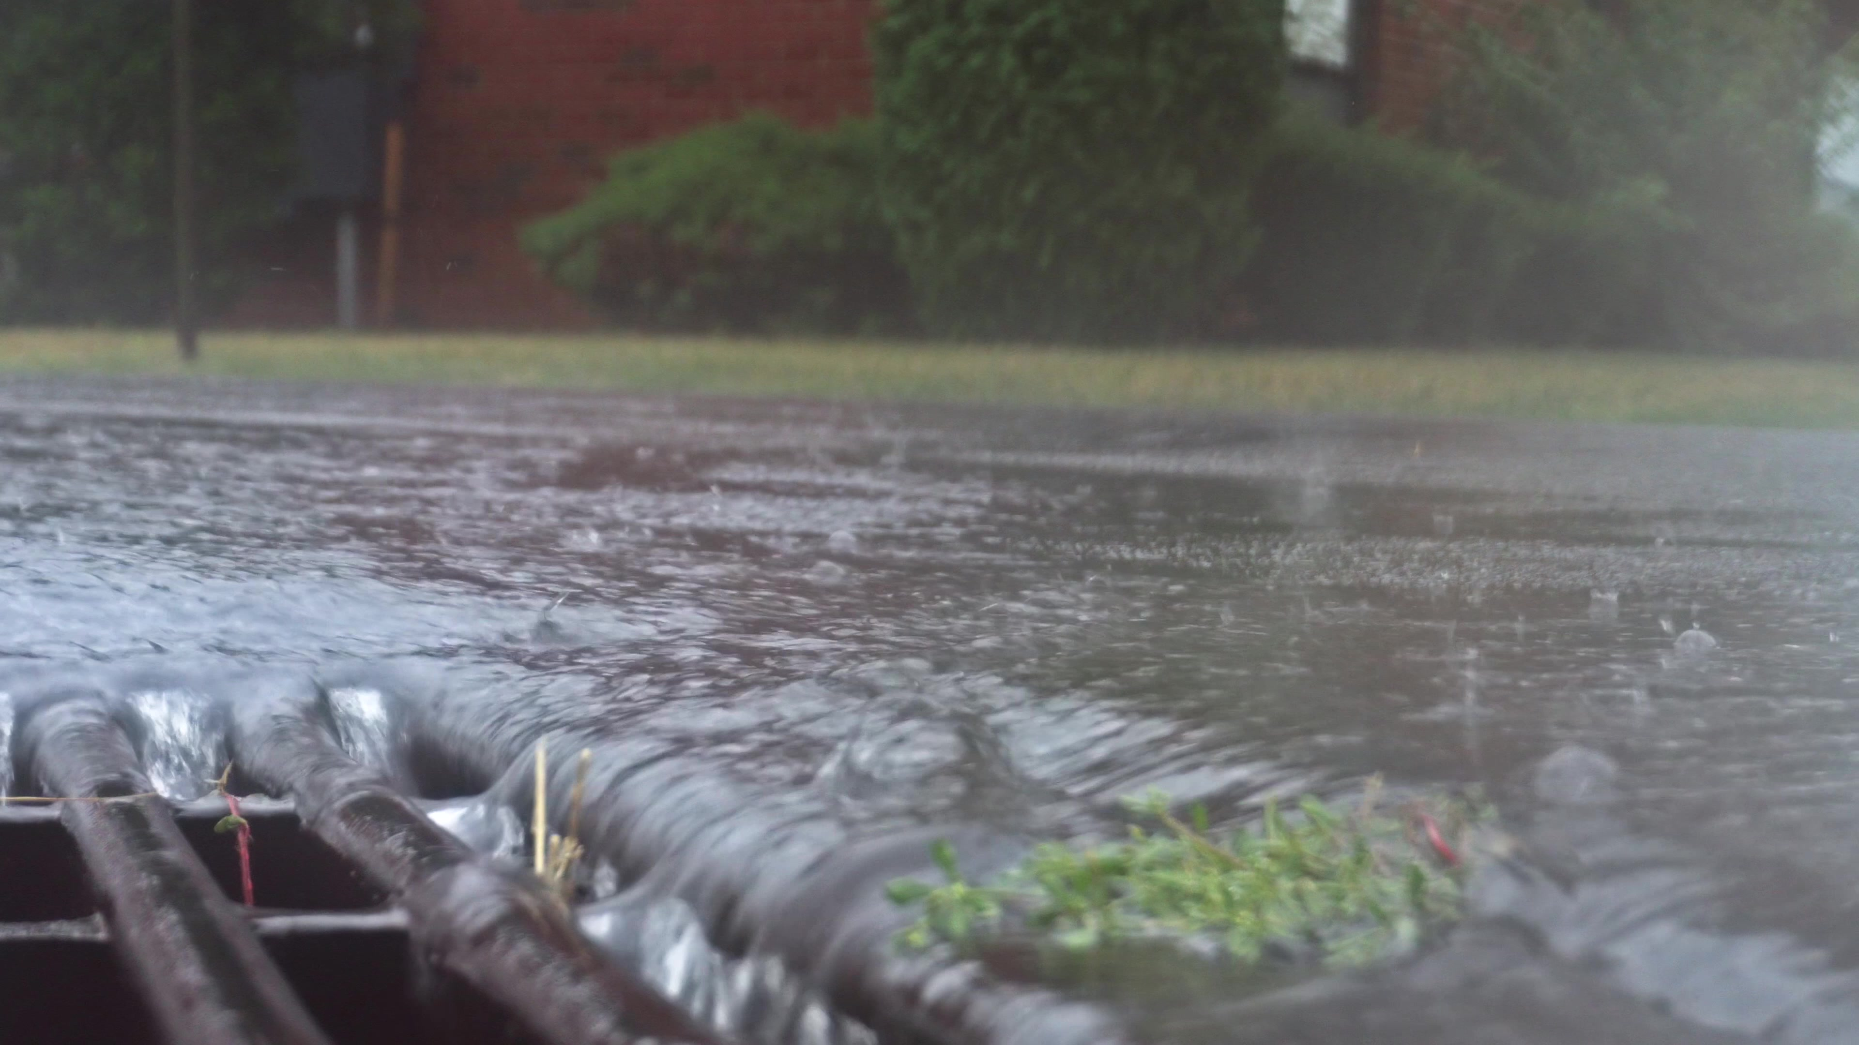
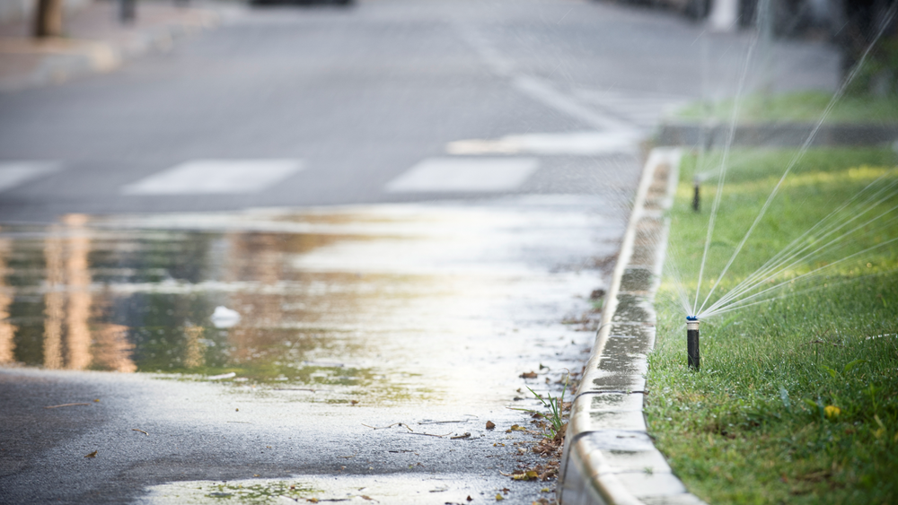
What is Runoff?
Stormwater runoff is water from rain events that runs off roofs, driveways, parking lots, yards, and other surfaces, and does not absorb into the ground
Urban runoff is water from outdoor water use that does not soak into the ground Sources of urban runoff can include:
Overwatering your lawn
Washing your car on impermeable surfaces
Spraying of your driveway or sidewalks

Slide 5
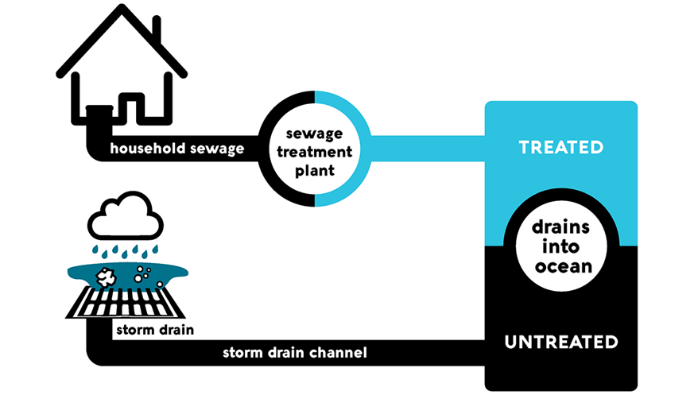
What is the Storm Drain System?
The storm drain system collects excess runoff from paved streets, parking lots, sidewalks, and roofs and discharges it to our waterways
Built for the purpose of flood control, the storm drain system intentionally and effectively moves water from the urban environment out to the ocean
Water that enters the storm drain system is not treated before entering our waterways and should never contain pollutants

Slide 6
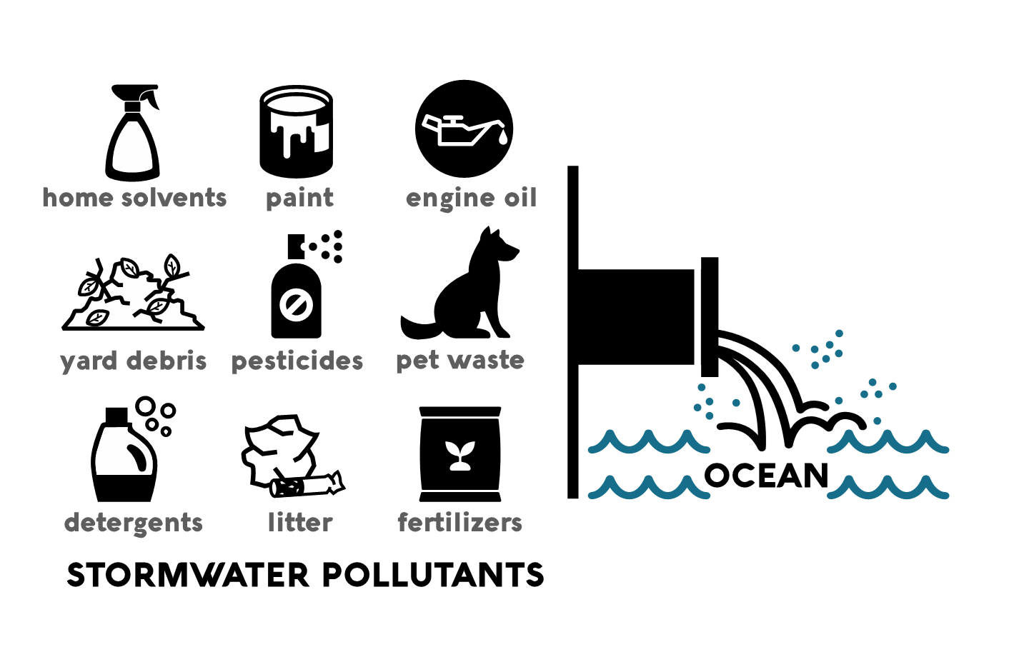
Common Pollutants in Runoff

Slide 7
How do We Protect Water Quality?

Slide 8
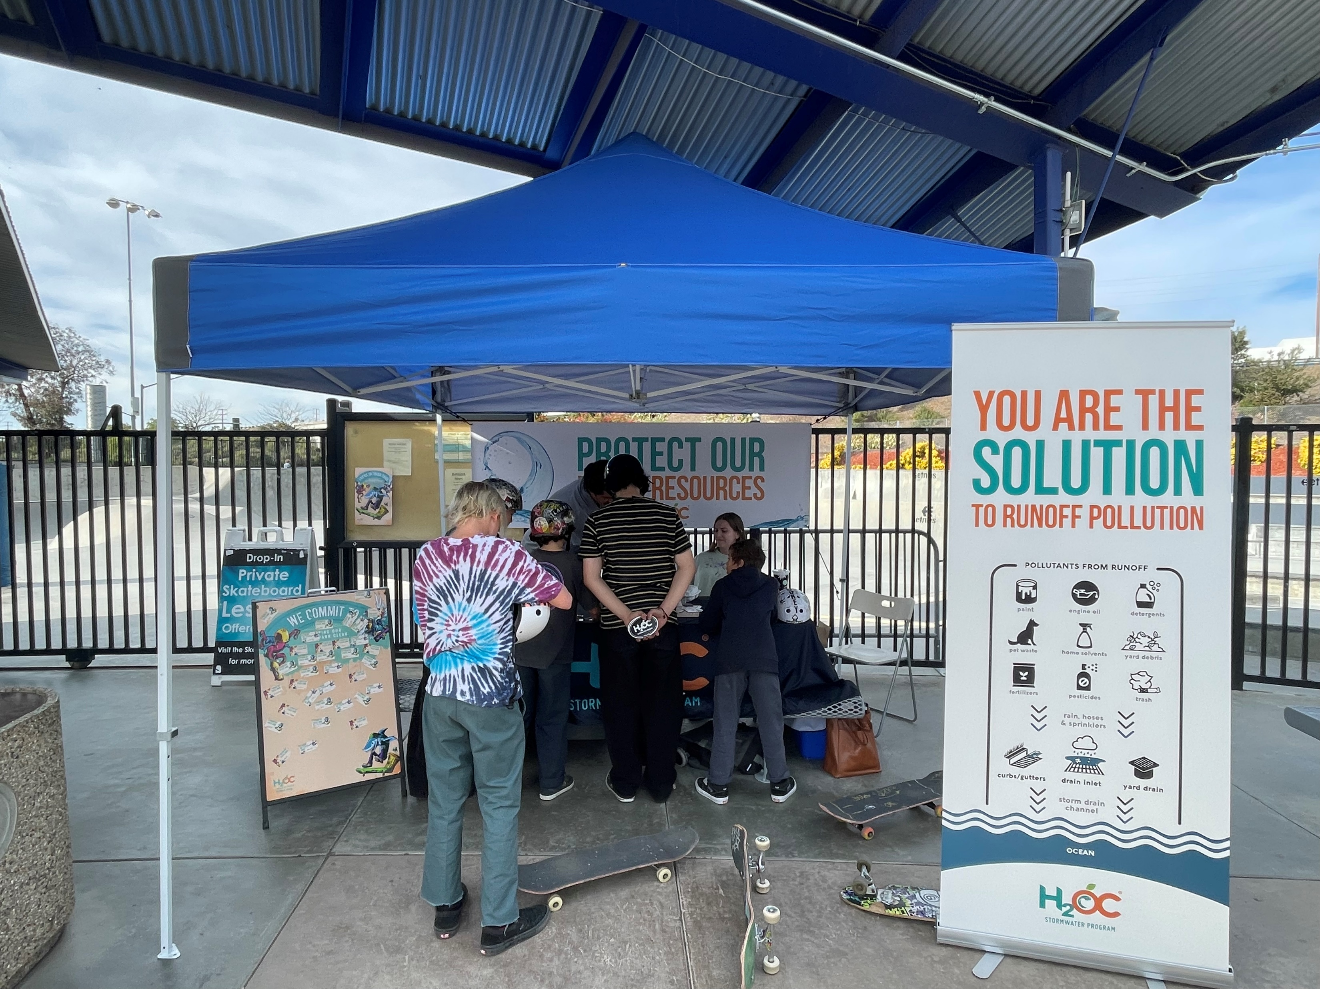
Community Based Efforts
Education and Outreach – Raise knowledge and awareness regarding stormwater pollution through events, ad campaigns, and social media
Behavior Change Research – Understand the barriers and benefits to adopting stormwater-safe behaviors
Pollution Prevention – Working with the community to stop stormwater pollution before it starts

Slide 9
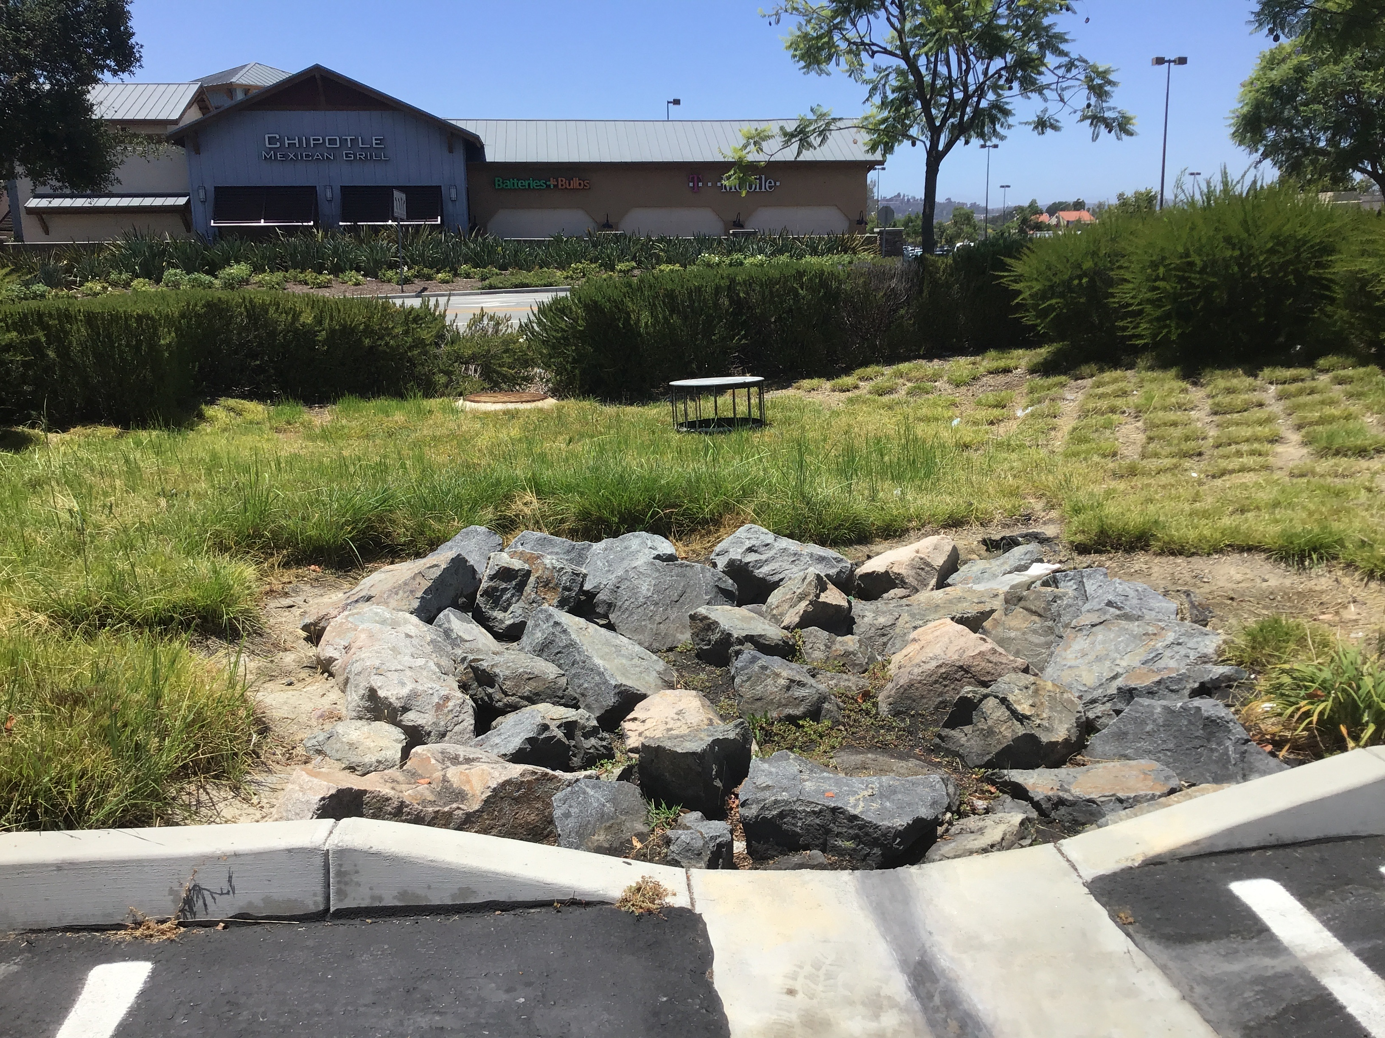
Runoff Relief
Capture – Landscape features like dry creek beds and rain gardens allow stormwater to infiltrate instead of runoff
Treatment – Localized filtration and treatment systems remove pollution before dry weather runoff enters receiving waters
Reuse – Captured dry weather runoff can be treated and reused as recycled water

Slide 10
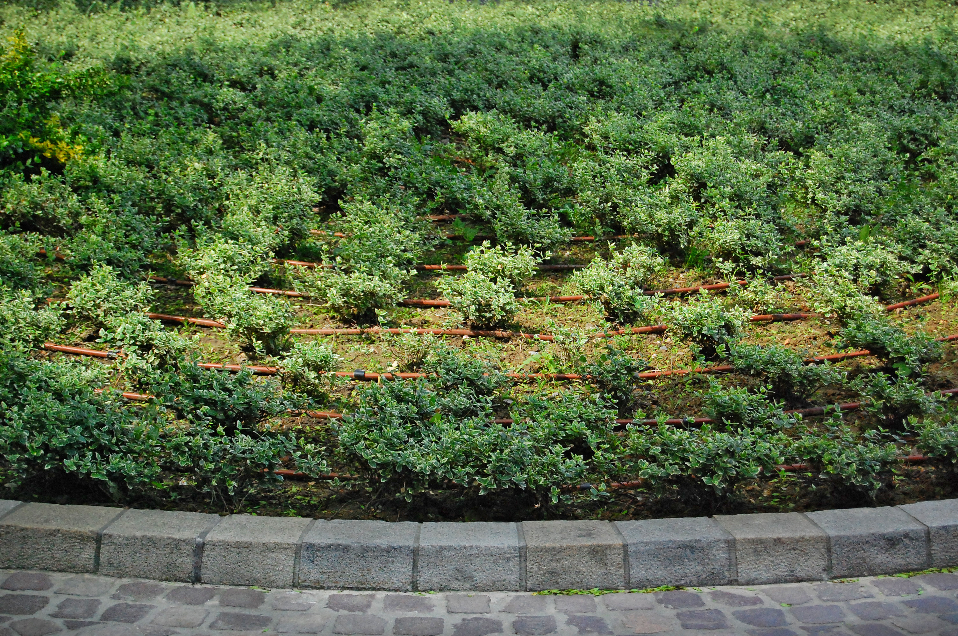
The Results Are In…
In South Orange County’s Watersheds:
Dry weather runoff has reduced around 50% when compared to the early 2000’s
Bacteria loading has reduced more than 90% in dry weather when compared to baseline data from early 2000’s
In North Orange County, dry weather beach bacteria advisories have reduced by 80% since 2000
This could not have happened without the actions taken in our communities

Slide 11
We’re All Making A Difference
Orange County shined in the 2021-22 Heal the Bay Report Card
Most beaches (19) on the Honor Roll in the State of California
No reported illnesses due to beach water contact recreation

Slide 12
How can YOU be Part of the Solution?

Slide 13
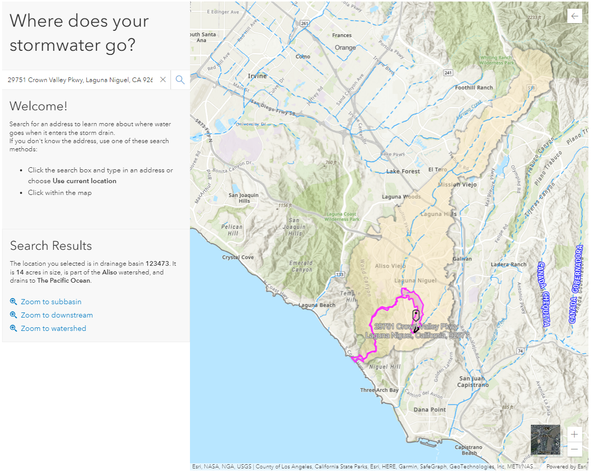
Where Does Our Water Go?
Visit www.h2oc.org to learn about how you can prevent polluted runoff from entering our waterways
Our ‘Where does your stormwater go?’ tool tells you which watershed your HOA is in and shows you the path runoff takes from your property to the Ocean

Slide 14
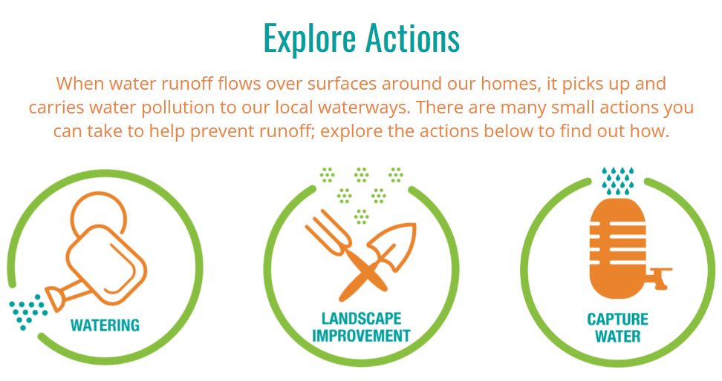
Accept the Challenge
Keeping water from leaving your property keeps pollutants out of our waterways
Take the OWIO Challenge by:
Seasonally updating your watering schedule
Getting a weather-based irrigation controller
Checking for leaks and misaligned sprinklers
Planting drought-tolerant landscaping

Slide 15
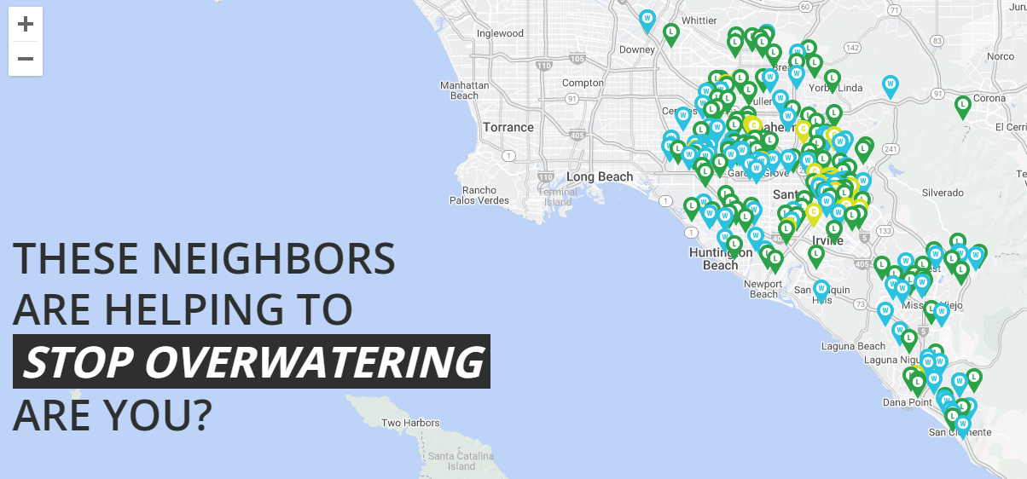
Spread the Word
As an HOA board member, you are in a unique position to affect behavior change
Provide residents with resources
Set an example for others in your community
Start the conversation regarding water use efficiency in your HOA’s common areas

Slide 16
Resources Available
At H₂OC we’ve developed a suite of materials that can help you in conversations with residents
Cover common issues such as pet waste, irrigation runoff, home improvement
Digital and print versions available
Visit h2oc.org/resources/view-order-brochures

Slide 17
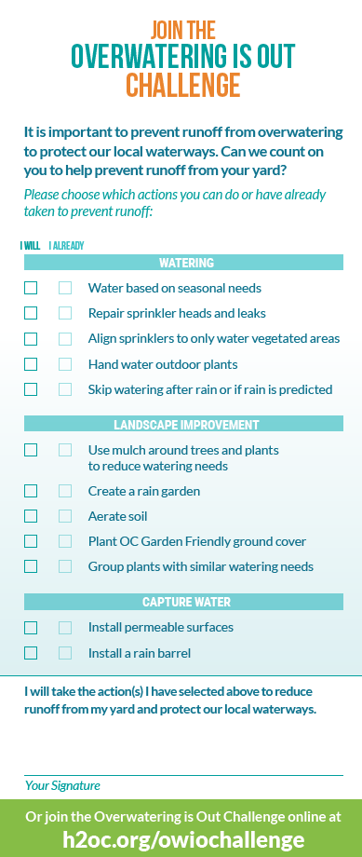
Set an example
Make a commitment today to eliminate irrigation runoff from your community
Visit our table to make a commitment
12 different actions that prevent runoff – what are you already doing and what you will commit to do in the future
Consider these actions for your HOA’s common areas
Include your address so we can add you to our map on h2oc.org

Slide 18
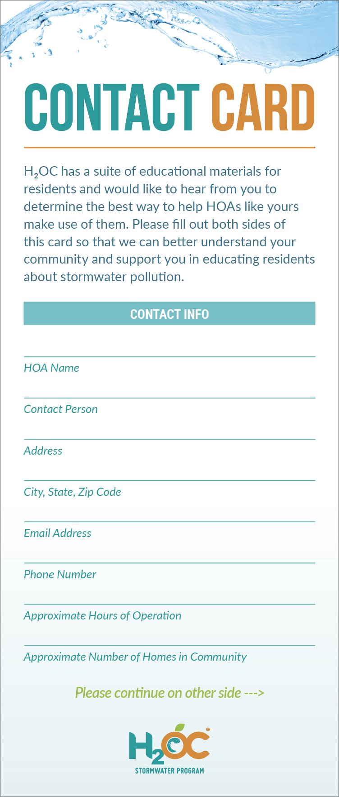
We’re Here to Help!
We are regularly updating our materials and would like your input on what would be most helpful
Contact cards on your table
Fill out your HOA’s contact information
Indicate your interests
We will reach out to provide what you need

Slide 19
Thank you!
Andrew McGuire
Environmental Resources Specialist
County of Orange - OC Watersheds
Email: Andrew.McGuire@ocpw.ocgov.com

